Slide 1

Co-constructing ITE assignments with community partners to improve student teacher’s enquiry thinking and employability
Mieka Harris, Senior Lecturer in Teacher Education, University of Bedfordshire Mieka.Harris@beds.ac.uk

Slide 2
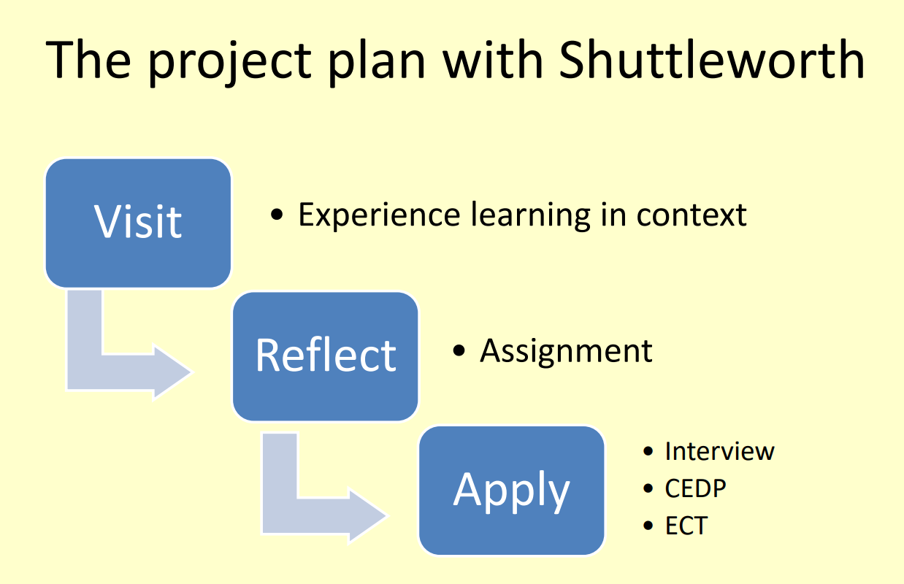

Slide 3
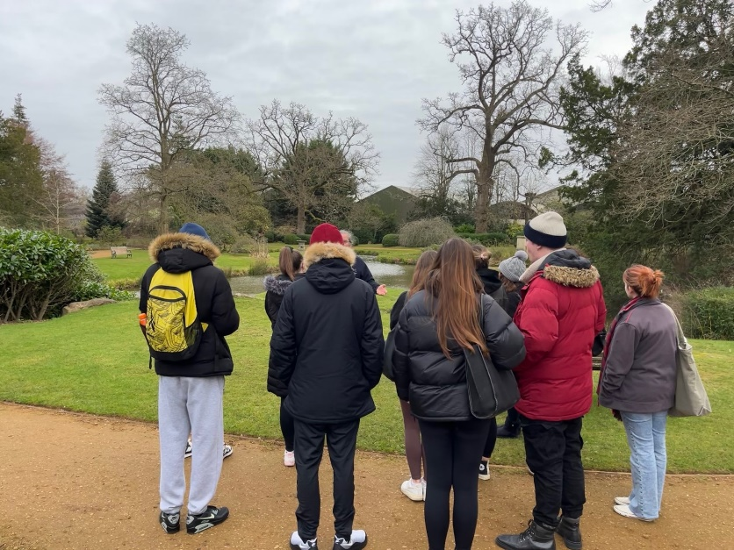
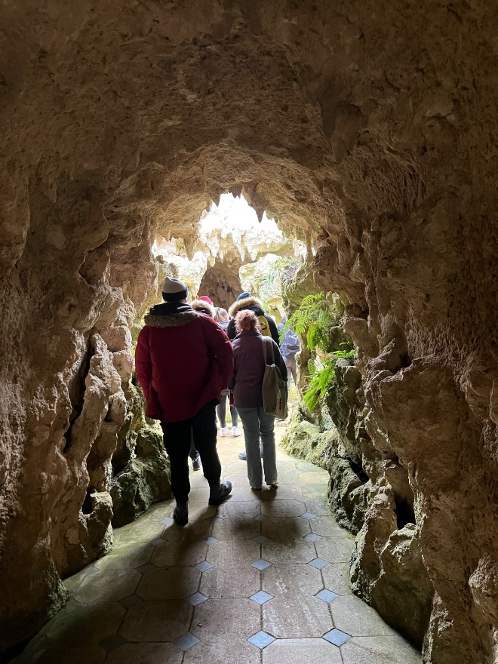

The visit

Slide 4
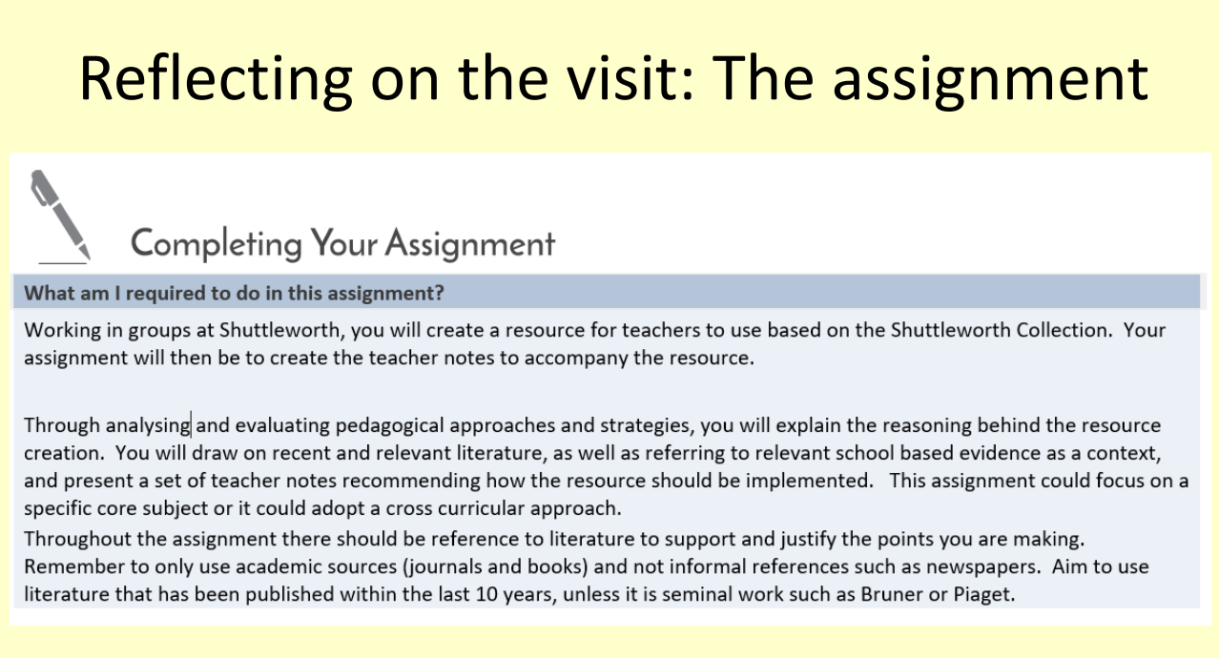

Slide 5
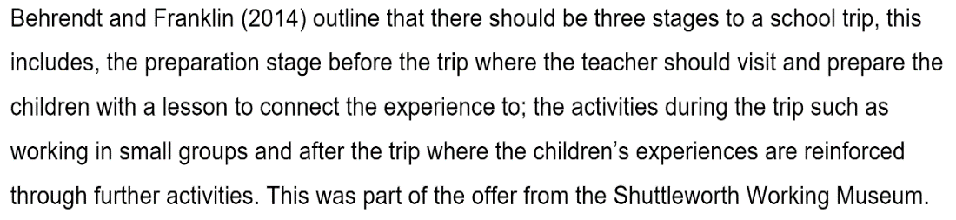
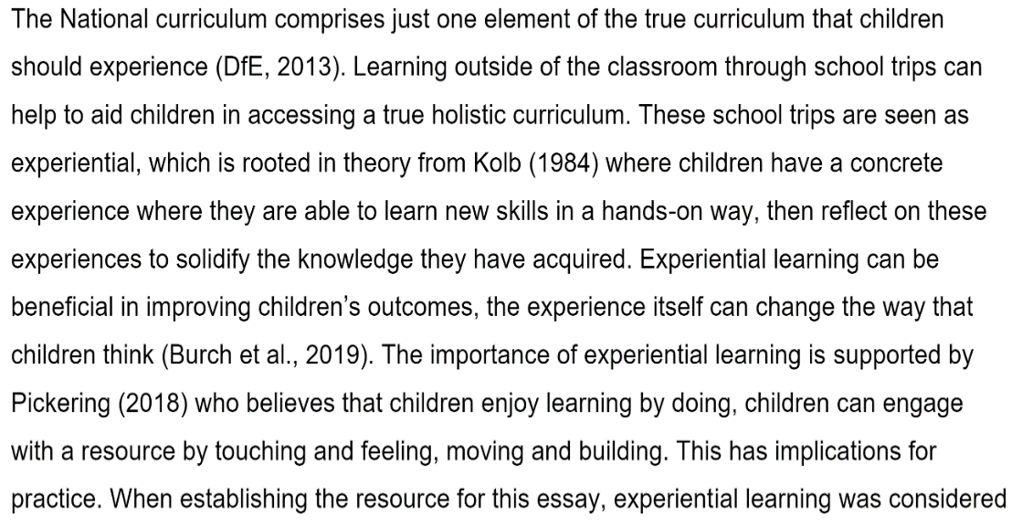
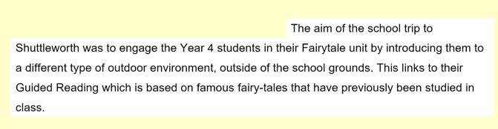
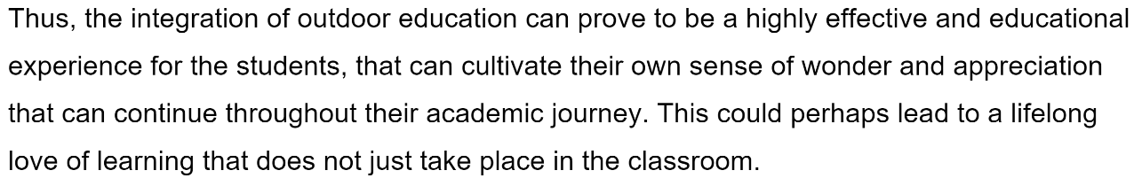
Applying the visit: The follow ups
Interview
CEDP
ECT

Slide 6
Touch: Analysing objects
What else would you like to know?
What can you guess?
What can you see?
Connected language that stimulates intrigue
Adapted from MLA South West Museum Learning Initiative project http://www.gem.org.uk/res/advice/ball/res_lfo.php

Slide 7
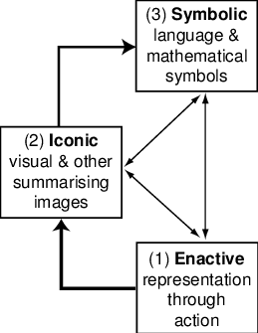
Modes of thinking/representations
Bruner (1966) – seminal book ‘Toward a Theory of Instruction’ conceptualising
  Enactive (action based)
  Iconic (image based)
  Symbolic (language/number based)
This has been developed into Concrete, Pictorial, Abstract where ‘Concrete’ advocates the use of manipulatives
Bruner, J. S. (1966). Toward a theory of instruction, Cambridge, Mass.: Belkapp Press
https://www.researchgate.net/publication/238170268_A_Versatile_Theory_of_Visualisation_and_Symbolisation_in_Mathematics

Slide 8
Learning from the experience
For the students:
For us:
object based learning
alternative learning environments
apply your learnings to an assignment for future practice
share your learning and aspirations at interview
make the initial connection
spend time in the environment
have a tangible outcome from the partnership
share the learnings internally and with the wider community

Slide 9
Advantages to cross curricular learning
More engaging
Knowledge is seen as connected and interdependent
Improves questioning
Promotes relational understanding
Develops critical thinking
Barnes, J. (2015) Cross curricular learning 3-14 London: Sage

Slide 10
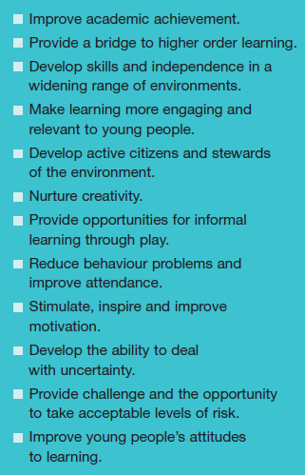


Benefits of LOTC
Finding opportunities through effective teaching and good subject knowledge for pupils to improve their understanding of their achievements is really powerful, and can be transformational about their own beliefs on their learning. These opportunities can take place in a range of spaces or environments.
http://www.lotc.org.uk/wp-content/uploads/2011/03/G1.-LOtC-Manifesto.pdf

Slide 11
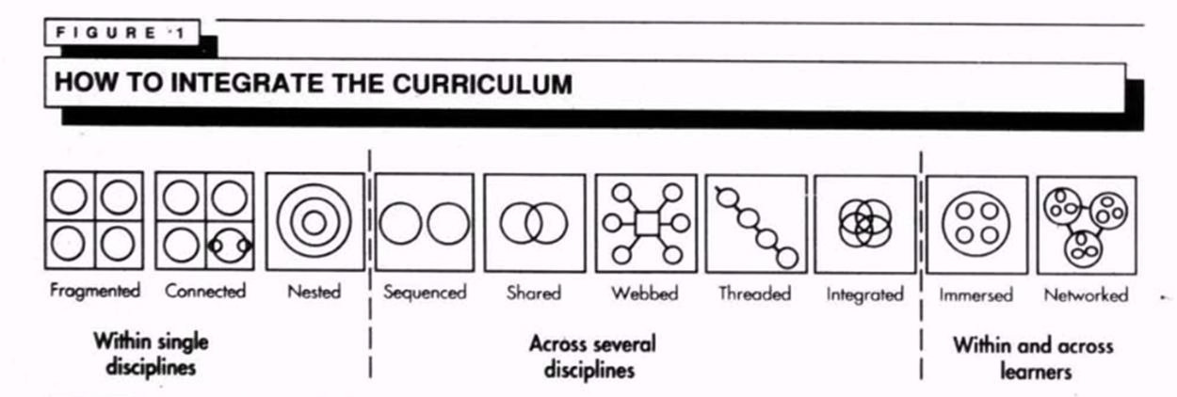
See: How we formed a partnership
Finding commonalities
The importance of mutual gain
Identifying unique opportunities for participants
Fogarty, R. (1991). How to integrate the curriculum [Screenshot]. http://www.ascd.org/ASCD/pdf/journals/ed_lead/el_199110_fogarty.pdf

Slide 12
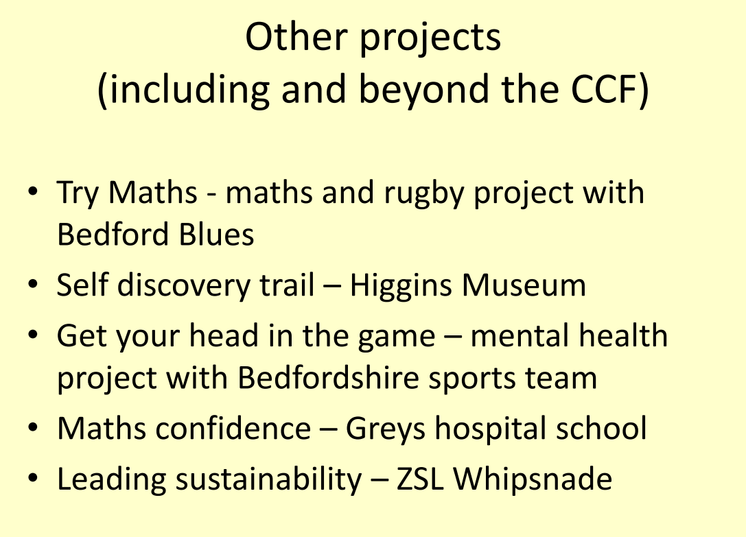

Slide 13
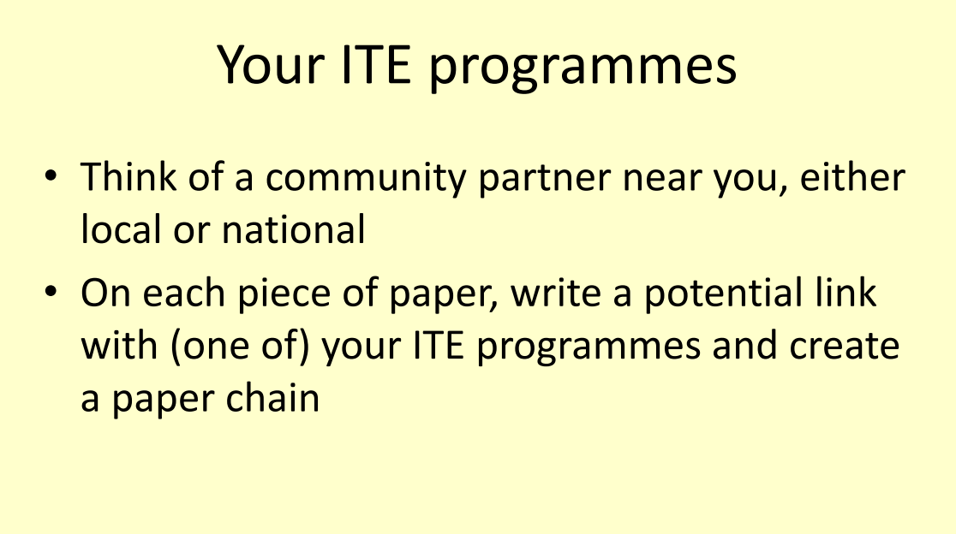

Slide 14
Any questions?
Mieka Harris Mieka.Harris@beds.ac.uk
Matthew Studdert-Kennedy learning@shuttleworth.org

