Slide 1
Making better decisions: developing critical engagement in early career teachers
Alex Ford
Leeds Trinity University / Schools History Project
@apf102.bluesky.social

Slide 2

Meet Evan

Slide 3
Improve pace of lessons
Could have increased the pace for the explanation
Your explanation could have been pitched better to the pupils’ abilities
Was this lesson rightly pitched in terms of content needed?
Can you maintain pace whilst not losing the key content from the lesson?
You pitched a bit high for the class
Keep up the pace in the lesson
Running out of time, consider the pace of the lesson
Try to work on your pitch for the model paragraph

Slide 4
The Issues
Increasing levels of frustration
Struggling with elements coming together
Not being able to make use of observations
Rejecting advice which might help
Getting vague feedback (pace, pitch, engagement)

Slide 5
Initial Approaches
Having a clear theory of trainee learning, making this explicit & revisiting it
Modelling effective target setting for mentors
  Inc. identifying component parts of issues of pace
Using university sessions to reflect on approaches to real problems & unpicking school-based solutions
Jointly observing video lessons to look for elements of pace / transition / engagement

Slide 6
Conceptualising your development (Clarke & Hollingsworth, 2002)
External Domain
(Reading, PGCE Input, Mentor, Peers, Social Media etc.)
Personal Domain
(Knowledge, Beliefs, Attitudes)
Domain of Practice
(Professional Experimentation)
Domain of Consequence
(Observed Outcomes)

Slide 7
The Issues
Underlying code – expressing something intuitive
Seeing different positions as irreconcilable
Increasing levels of frustration
Struggling with elements coming together
Not being able to make use of observations
Rejecting advice which might help
Getting vague feedback (pace, pitch, engagement)
Not seeing how to do it, nor why it matters
Not knowing what to look for
Many mentors intuitive teachers. Trainees not operating on the same wavelength

Slide 8
Legitimation Code Theory
Maton (2014) Legitimation Code Theory (LCT) is a conceptual toolkit for exploring and shaping practice.
LCT begins from the position that knowledge is both social AND real, in that it has effects (Bourdieu)
A discipline is rooted in shared practices and language – these become codes for what is legitimate for knowledge building
Teaching has its own set of legitimation codes. LCT can help reveal these codes which are effectively the “rules of the game”.
  There can be different sets of codes in conflict with each other within a discipline (think prog vs. trad for a very basic idea).
  There is also the issue that history teachers need to grasp codes from 2 disciplines at least: history and teaching.
Understanding these codes can empower new teachers to be on the same wavelength as experienced teachers.
https://www.youtube.com/watch?v=9rYR5z9cT5w

Slide 9
What can LCT offer?
LCT has been used in large scale studies in Australia to identify aspects of effective teaching (Maton, 2018)
LCT has been used directly with trainee teachers in South Africa to improve their “gaze” and therefore improve practice (Rusznyak & Bertram 2021)

Slide 10
Using the LCT toolkit
When trainees struggle with issues identified it is possible they just don’t understand the codes of teaching – their “gaze” is under-developed
The LCT toolkit can help with this
Specialisation Codes
Semantic Waves
Autonomy Codes

Slide 11
Teacher Choices in Action
Who you are
Rusznyak (2021) – developing trainee gaze by using LCT to explore teacher choices in action e.g.
  Choices about knowledge selection
  Choices about knowledge sequencing
  Choices about learning opportunities
  Choices about inclusion
  Choices about classroom management
Where you teach
HOW you teach
What you teach
Who you teach
© Ruzsnyak (2020)

Slide 12
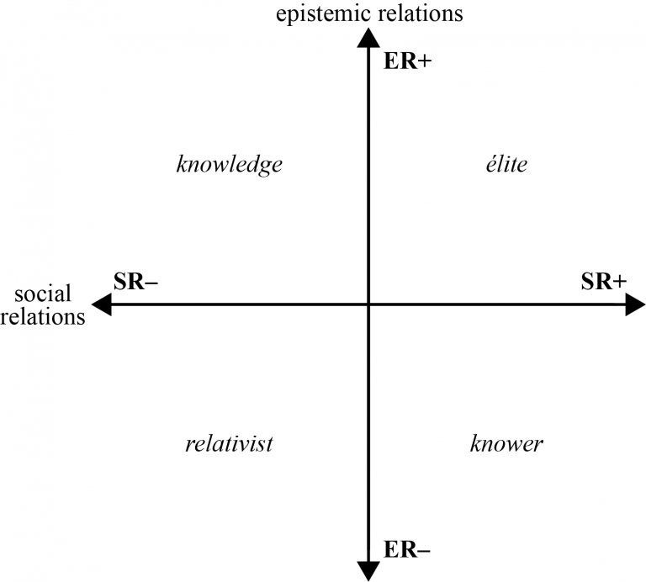
Understanding WHO you are
Specialisation codes aim to explore concepts of knowers and knowledge in a field
Being aware of your own position is crucial – as is understanding that others will sit in different parts of the plane e.g. tutors, mentors, host teachers, pupils etc.

Slide 13

What makes the ideal history teacher?
Knowledge
/ Skills
Personal Qualities /
Characteristics

Slide 14
What you know is most important. E.g. I can teach history because I know a lot of history and about historical pedagogy
You need both knowledge and personal characteristics. E.g. I can teach history because I know a lot of history / pedagogy AND am part of a community of history teachers.
Importance of specific knowledge
Knowledge
Elite
What about the Teachers’ Standards?
Where does your teacher concept fit on this framework?
Importance of being a certain “type” of person
Relativist
Knower
Neither knowledge nor attributes are important. E.g. Children will learn regardless of the teacher.
Who you are and you characteristics are more important E.g. I can teach because I am sociable or because I have children myself

Slide 15
Importance of specific knowledge
Knowledge
CODE CLASH
Elite
Importance of being a certain “type” of person
Relativist
Knower

Slide 16
How does it help Evan?
Beginning to understand different positions and see the underlying codes in advice being offered.
Increasing levels of frustration
Struggling with elements coming together
Not being able to make use of observations
Rejecting advice which might help
Getting vague feedback (pace, pitch, engagement)

Slide 17
What are ‘pace’ and ‘pitch’?
Issues of ‘pace’ and ‘pitch’ are hard to experienced teachers to explain
Not the same as ‘speed’ or ‘difficulty’ on their own
Intuitive sense based on thousands of hours of experience
  Sequencing of content
  Depth of content
  Level of challenge
  Pupils reactions
  Teacher interactions etc.

Slide 18

So how can we SEE it?
Observing teacher exposition is a powerful way to see the teacher decisions which lead to good pitch and pace in action
SEMANTIC WAVES are a key tool to enable us to do this.

Slide 19
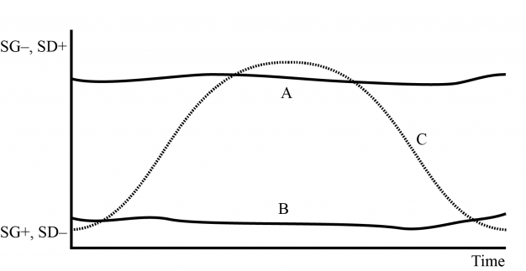
Understanding WHAT and WHO you teach
LCT tool: semantic waves
Complex/abstract concepts (SD+) which apply across contexts (SG-)
Simple/everyday concepts (SD-) which are context specific (SG+)

Slide 20
What are semantic waves all about?
Abstract: Complex and conceptual
We can observe teacher exposition and classify it on a scale from concrete to abstract
Concrete: experiences and examples

Slide 21
What are semantic waves all about?
During a lesson (or several lessons) teacher will move around on this scale
Abstract: Complex and conceptual
Concrete: experiences and examples
Lesson time

Slide 22
What are semantic waves all about?
Effective teachers move in a wave like pattern through the range across time (Maton, 2020; Shay & Steyn, 2016)
Abstract: Complex and conceptual
Breaks down complexity
Begins with a concept
Build complexity up
Gives examples
Concrete: experiences and examples
Lesson time

Slide 23
What are semantic waves all about?
Teachers make DECISIONS about when to move up or down based on a whole range of factors (planned or unplanned)
Abstract: Complex and conceptual
Finds concepts
Looks for patterns
Begins with experience / examples
Transfer to a new concept
Concrete: experiences and examples
Lesson time

Slide 24
Focusing on professional decisions in teacher exposition
Abstract: Complex and conceptual
Teachers who do not know when to shift up or down in their semantic wave often struggle to move students forwards in their understanding (Rusznyak, 2021)
This is often expressed as a lack of pace or ineffective pitching
Concrete: experiences and examples
Lesson time

Slide 25
https://classroom.thenational.academy/lessons/the-british-empire-1776-1900-61j66c?step=1&activity=video (1:20-10:40)
Abstract (complex concepts)
“What did British colonialism look like in the C19th?” (1:20-1:55)
“We’re going to start by looking at this map– what can you see?” (1:55-4:20)
“What can this tell us about the British Empire?” (4:20-7:45)
“We’re going to think more deeply (7:45-8:25)
“What exactly does it mean when we say…” (8:25-10:40)
Concrete
(experience / examples)
Time

Slide 26
https://classroom.thenational.academy/lessons/the-british-empire-1776-1900-61j66c?step=1&activity=video (1:20-10:40)
“What did British colonialism look like in the C19th?” (1:20-1:55)
“We’re going to start by looking at this map– what can you see?” (1:55-4:20)
“What can this tell us about the British Empire?” (4:20-7:45)
“We’re going to think more deeply (7:45-8:25)
“What exactly does it mean when we say…” (8:25-10:40)
Abstract (complex concepts)
1. A big conceptual question
2. Concrete examples
3. Repacking to build a proto-answer to the question
4. Adding conceptual complexity
5. Unpacking more terms
Steady unpacking of concepts with examples
Rapid decline from high flatline
Steady upshift
Concrete
(experience / examples)
Short low flatline
Time

Slide 27
Year 6 KS2 Maths Lesson Observation: Composite Shapes – YouTube (3:05-4:30)
Abstract (complex concepts)
Watch the video extract above and map the semantic wave. It is not an exact science – don’t worry
Concrete
(experience / examples)
Time

Slide 28
Today's Classroom - Elko Middle School – YouTube (1:33-4:00)
Abstract (complex concepts)
Watch the video extract above and map the semantic wave. It is not an exact science – don’t worry
Concrete
(experience / examples)
Time

Slide 29
Year 1 KS1 Numeracy Classroom Observation: Fractions Of Shapes – YouTube (1:10 – 3:10)
Abstract (complex concepts)
Watch the video extract above and map the semantic wave. It is not an exact science – don’t worry
Concrete
(experience / examples)
Time

Slide 30
How do rivers shape the land? (thenational.academy) (2:15-4:50)
Abstract (complex concepts)
Watch the video extract above and map the semantic wave. It is not an exact science – don’t worry
Concrete
(experience / examples)
Time

Slide 31
Semantic waves can even be seen over whole sequences of lessons (and can/should be planned for!)
Abstract
Semantic Waves in a Sequence
Complex understanding of the changing status of Weimar over time
Was Weimar Germany doomed?
Threats to Weimar over time and their resolutions e.g. political threats; hyperinflation; depression
What was Weimar Germany
Concrete
Sequence Time

Slide 32
How does it help Evan?
Demystifies some comments about PACE and PITCH by offering a concrete model to guide discussion.
Increasing levels of frustration
Struggling with elements coming together
Not being able to make use of observations
Rejecting advice which might help
Getting vague feedback (pace, pitch, engagement)
Helps with decision making about sequencing of tasks in lessons and lessons within sequences
Focus for observations which allow trainees to visualise how teachers make choices to maintain pacing.

Slide 33
Where next?
Further refining and integration of LCT tools in sessions
Embedding LCT tools in mentor training
Exploring the power of LCT in written communication (assignments) and decoloniality
Further exploration of LCT in observations of trainees

Slide 34

Reference List
Maton, K. (2014) Knowledge and Knowers: Towards a Realist Sociology of Education. Routledge.
Maton, K. (2020) ‘Semantic Waves: Context, complexity and academic discourse’ in J. Martin, K. Maton & Y. Doran [eds] Accessing Academic Discourse: System Functional Linguistics and Legitimation Code Theory. Routledge.
Maton, K. and Howard, S. (2018) Taking Autonomy Tours: A Key to Integrative Knowledge-Building, LCT Centre Occasional Paper 1. LCT Centre. available from <http://legitimationcodetheory.com/knowledge-base-2/maton-k-and-howard-s-k-2018-taking-autonomy-tours-a-key-to-integrative-knowledge-building-lct-centre-occasional-paper-1-june-1-35/> [25 April 2019]
Ruszynyak & Langsford (2021) ‘Teacher choices in Action: An emergent pedagogic response’ [pre-publication paper available at: https://heltasa.org.za/wp-content/uploads/2021/12/Teacher-Choices-in-Action-An-Emergent-Pedagogic-Response.pdf]
Shay, S. & Steyn, D. (2016) ‘Enabling knowledge progression in vocational curricula: Design as a case study’, in K. Maton, S. Hood and S. Shay (eds) Knowledge-building: Educational studies in Legitimation Code Theory, London: Routledge, 136–57

