Slide 1
A Tale of Two Phases: inquiry in different spaces
Lorraine Smith
Michelle Best

Slide 2
Introductions
Name
Role
Primary/ Secondary/ FE
Where teacher inquiry sits within your role

Slide 3
Phase Context
Further Education
Secondary Education

Slide 4
Introduction
Inquiry for trainee teachers and teachers alike has been heralded as positive for professional development (Vieira et al 2021).
However, as the PGCE year for teacher training is further compressed, the opportunity for inquiry as an assessed part of the programme has become more difficult to include as part of the experience of the teacher training.
In addition, the emphasis from the DfE on evidence based practice has shifted from trainee teacher inquiry to the use of evidence from other sources to support professional development.
develop their knowledge of research so that they can learn about current research and engage in research discussions in and beyond teacher training.

Slide 5
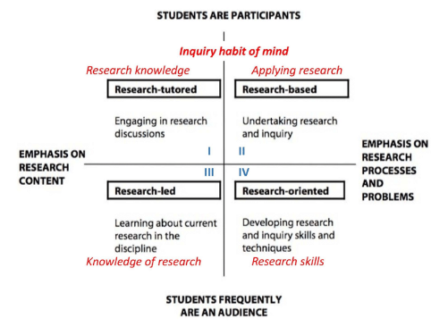
Inquiry Habit of Mind
Katwijk et al. (2022) refer to Healey and Jenkins’s (2009) model - “An inquiry habit of mind” and focuses on inquiry competencies
Katwijk et al. (2022) ultimately posit that by undertaking research and inquiry, trainees will develop research inquiry skills and techniques, which will ultimately develop their knowledge of research so that they can learn about current research and engage in research discussions in and beyond teacher training.

Slide 6
Research Aims
How do trainee teacher experience inquiry-rich teaching, and how do they perceive their roles in leading or being led through the process?
How do collaborative approaches to research/ inquiry between teacher educators and trainee teacher’s influence the success of them as teachers as researchers?
How do inquiry-rich approaches to teacher education impact the professional identity and leadership skills of trainee teachers into their teacher career?
Are they leaders in teacher inquiry or are they led by other’s inquiry?

Slide 7
Methodology
Questionnaire
Focus Group.
We are currently here

Slide 8
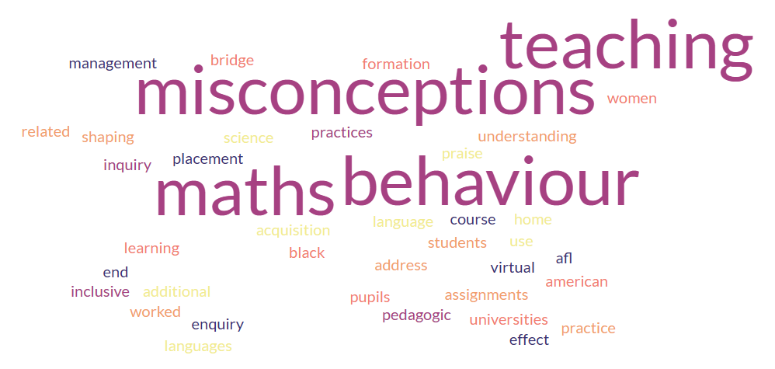
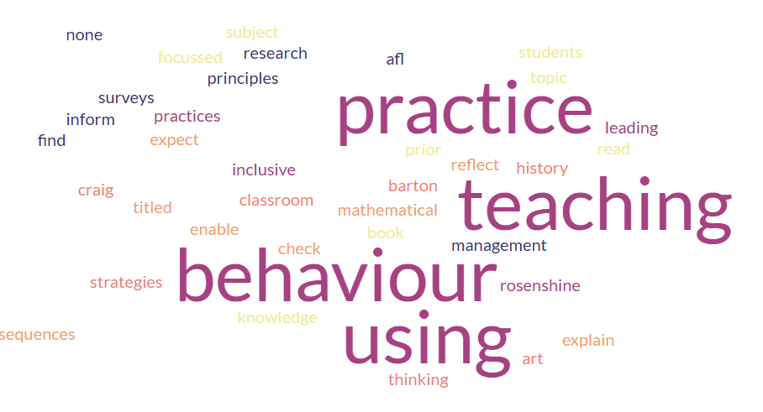
Initial results:
Inquiry in PGCE and as a secondary teacher
PGCE
Teacher
In class: inclusive practices, pedagogical, AfL, behaviour, misconceptions, praise, language acquisition
Other: research participant, research as part of programme, black women and bridging learning
In class: inclusive practices, leading teaching, AfL, behaviour, student feedback (surveys), prior knowledge, subject, reading
Other: art history

Slide 9
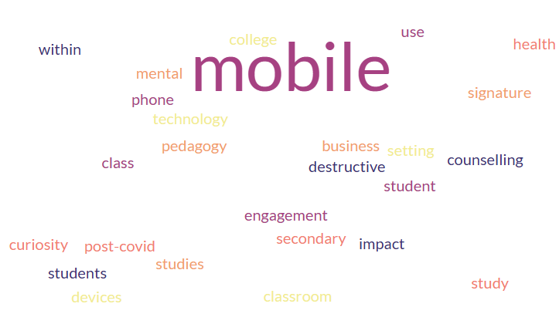
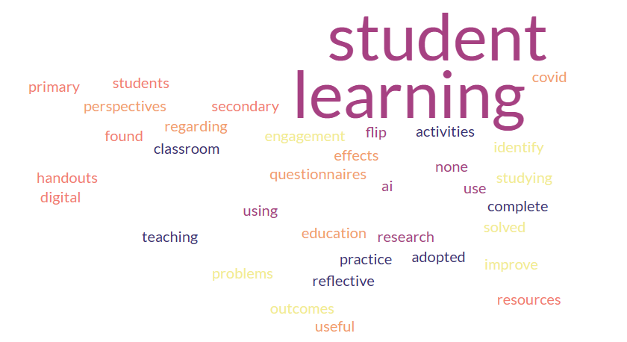
Initial results:
Inquiry in PGCE and as an FE teacher
PGCE
Teacher
In class: mobile phone use, mobile technology, pedagogy for subject, student engagement
Class adjacent: counselling, mental health and post COVID,
In class: AI, flipped learning, class activities, reflective practice, effect of COVID, student feedback,
Other: primary and secondary research

Slide 10
Initial results:
How did the inquiry impact your practice?
Secondary Education
Further Education
‘somewhat useful’
‘I reflect at the end of each lesson, as to how best I can improve my teaching,’
‘I have been able to confidently clear misconceptions’
‘not sure it did’
‘It has improved my classroom management strategy.’
‘Flexibility is encouraged by evidence-based practice.’

Slide 11
Initial results:
Importance of Inquiry: Secondary Education
Importance
Skills gained
Skills benefits
Important/ fundamental: proactive
Personal reflection
Better research informed practices
Better quality of education
Develop teaching
Knowledge of students
Task management
Understanding educational practices
Methods of teaching
Critical thinking
Interpersonal skills and communication
Meet learning needs of students
Productive, knowledgeable and professional
Promotion
Outstanding feedback
Confidence (although time used to the detriment of other aspects of teaching)
Maths mastery

Slide 12
Initial results:
Importance of Inquiry: Further Education
Importance
Skills gained
Skills benefits
Don’t have time
research is a minimal part of the role, your students are your subject matter/ Occasionally to be used if needed
important to a teacher's professional development
Behavioural management techniques and their efficiency can be learned about through research.
informed practice
Teachers that conduct research have a growth mentality and are always looking to learn new things.
Research is paramount to gather statistical data to enable educators to look at key facts and figures and make informed decisions regarding the progression of their practise
None
How to put together a survey
Critical thinking, interpersonal relating, team building, problem solving
Helped me develop a greater understanding of the student mindset
Better written and oral communication skills.
No benefits
Classroom: improved my classroom management and impacted differential lesson delivery, providing accessibility options for students
these skills have boosted my confidence as a lecturer
These skills are significant to every educator.
It has made my writing more fluent
I have adapted critical thinking into my every day working life through looking at the bigger picture by planning long term.

Slide 13
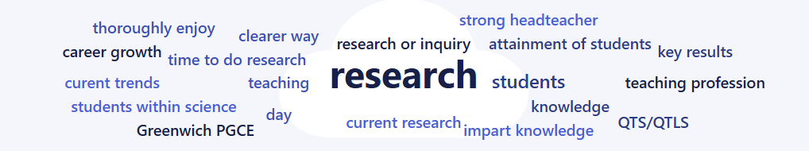
Initial results:
Aspirations

Slide 14
Key messages so far…
A wide range of activities were defined as inquiry by both FE and secondary cohorts
As would be expected, much of the inquiry is classroom based or student based.
Majority view inquiry as important, however there are barriers to engaging with inquiry

Slide 15
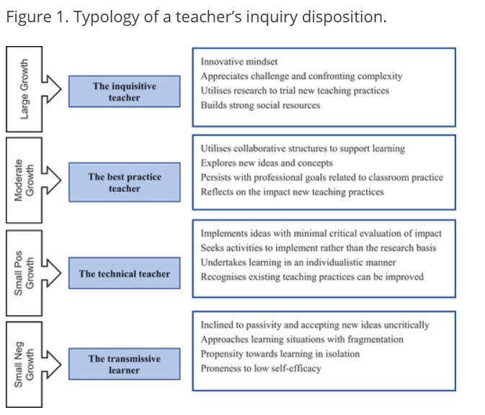
Research and Inquiry is more than a process
There are some important differences exist between the way individual teachers think and act when undertaking collaborative teacher inquiry.
Notes:
Dunn 2021

Slide 16
Next Steps
Focus groups

Slide 17


Questions?

Slide 18
Thank you

