Slide 1

Sector Updates
Session Aim:
To build a case for change based on our experiences in the first year of the new DiT framework – ‘the transition period’.
Dr Lynn Senior: West Nottinghamshire College
Lynn.Senior@wnc.ac.uk
Dr Clare Winder: University of Central Lancashire
clwinder@uclan.ac.uk

Slide 2

Evaluating the DiT framework
The view from FE
The view from the HEI awarding organisation

Slide 3
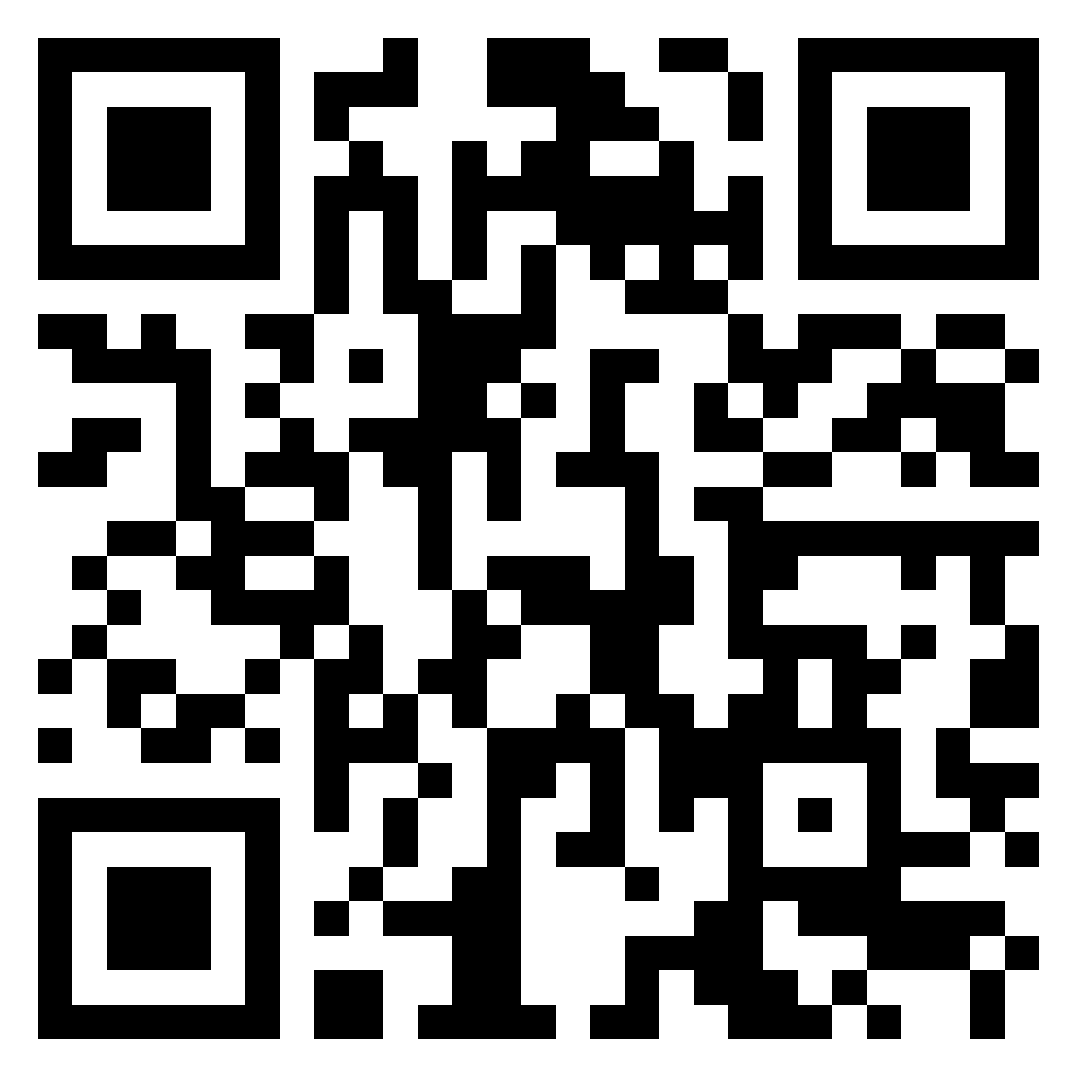
Evaluating the DiT framework and how it could be developed
What do we need to:
Stop?
Start ?
Continue?
https://padlet.com/clwinder/UCETSESSION_D3

Slide 4
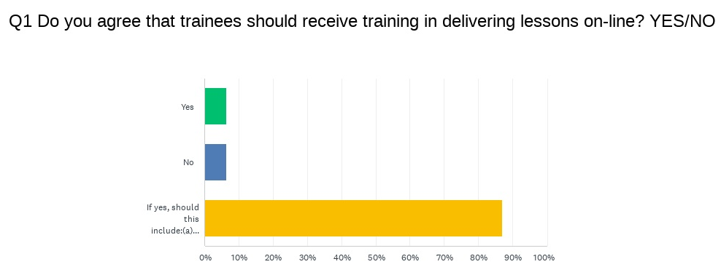
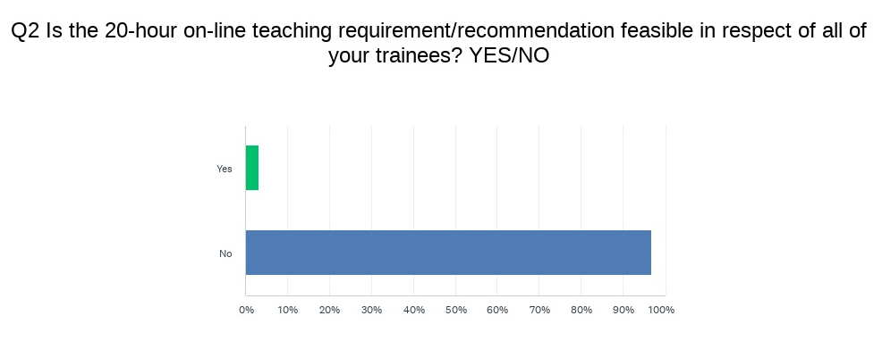
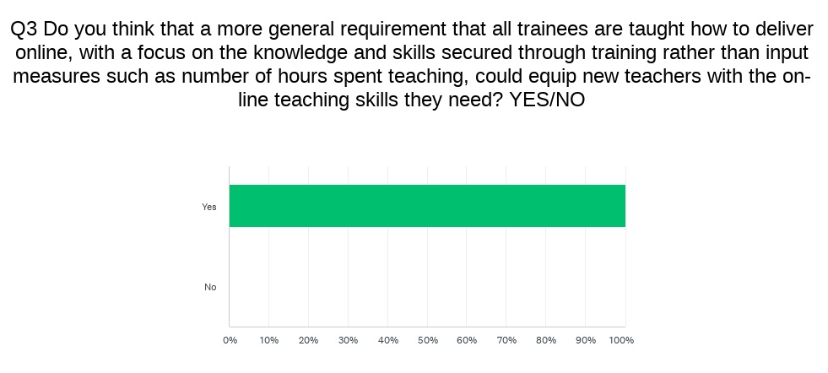
20 hours online synchronous teaching practice
UCET survey received 31 responses

Slide 5
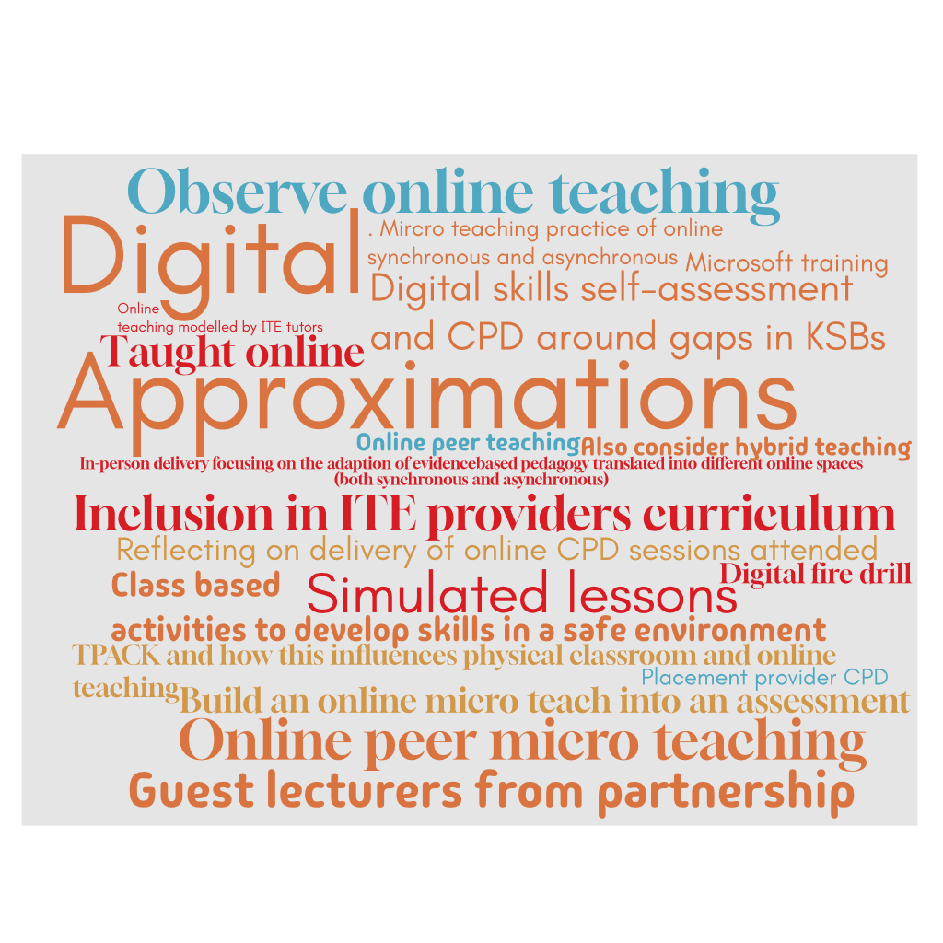
Q4. What other ways, in addition to direct online teaching, might trainees be given the skills they need to deliver online?
What are HEI providers already doing?
12 of the 31 respondents shared ideas:

Slide 6

20 hours in second placement
  What are the key barriers and drawbacks to this approach?
  How else can trainees in- and pre-service be exposed to the wider FE sector in a way that is both meaningful and feasible?
  What approaches are ITE providers taking and what is the rationale for this?

Slide 7
Bigger question: philosophical, ontological and epistemological
What is fes?
Where is fes?
Who is fes
How does fes differ

Slide 8
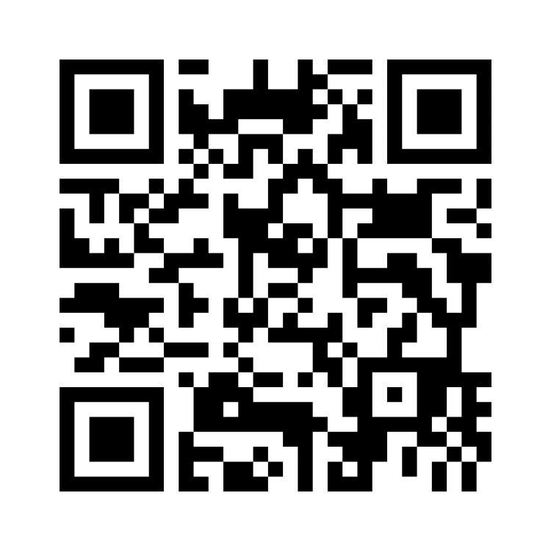
https://www.menti.com/alga2bxvrqpb

Slide 9

Next steps…
All information from the survey will be combined with the outputs of this session and shared with,
UCET
ETF
DfE
To build a case for change based on our experiences in the first year of the new DiT framework – ‘the transition period’.

