Slide 1
Exploring “reality/ practice shock” through the perspectives of ECTs
Jo Milton
jm789@cam.ac.uk
Faculty of Education

Slide 2
Reality shock
Also called practice, praxis and transition shock.
Terms used interchangeably
Dates back to the 1950s (Wagenschein)
‘Reality shock’ - the difference in beginning teachers’ expectations of the teaching profession and the reality they experience.
The “concept is used to indicate the collapse of the missionary ideals formed during teacher training by the harsh and rude reality of everyday classroom life” (Veenman, 1984, p. 143).

Slide 3
Reality shock as a phenomenon
Issues with the term ‘shock’
The term reality shock is “the assimilation of a complex reality which forces itself incessantly upon the beginning teacher, day in and day out” (Veenman, 1984, p. 144)
The transition into teaching is not a single event, rather one that takes significant time.
Not unique to UK teachers e.g. Botha & Rens (2018) in South Africa, Kim & Cho (2014) in the US.
Literature reveals beginning teachers should recover from this shock, but there is currently insufficient evidence for when this takes place (Voss and Kunter, 2019).

Slide 4
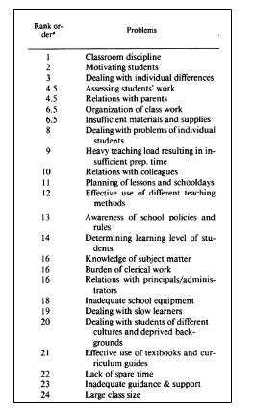
Factors that contribute to reality shock
Veenman (1984) examined 83 other studies exploring this phenomenon, identifying problems international Primary and Secondary ECTs face, based on empirical data.
He identified 24 perceived problems. These were also issues that experienced teachers faced.
Jobs/ roles expected of a teacher.
Individuals ranked these differently - supporting the evidence that reality shock is a deeply personal and subjective phenomenon.
Study is now over 40 years old.

Slide 5
Five indicators of reality shock
Müller-Fohrbrodt et al., (1978) argue there are five indicators of reality shock:
Perceived problems and pressures
Change of attitude, such as towards teaching methods
Changes in teaching behaviour due to external pressures
Personality changes that could be linked to their belief in themselves
Leaving the teaching post/ profession.

Slide 6
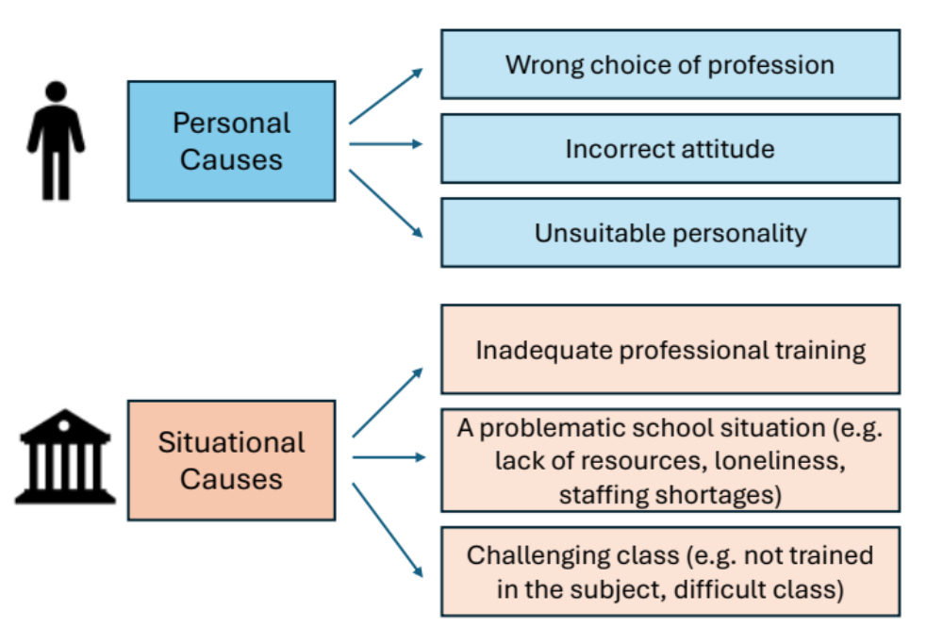
Personal and situational causes of reality shock
(Müller-Fohrbrodt et al., 1978)
Veenman’s factors all sit under ‘situational causes’ for reality shock.
The beginning teachers studied, focused on the role of the teacher, rather than themselves as individuals.

Slide 7
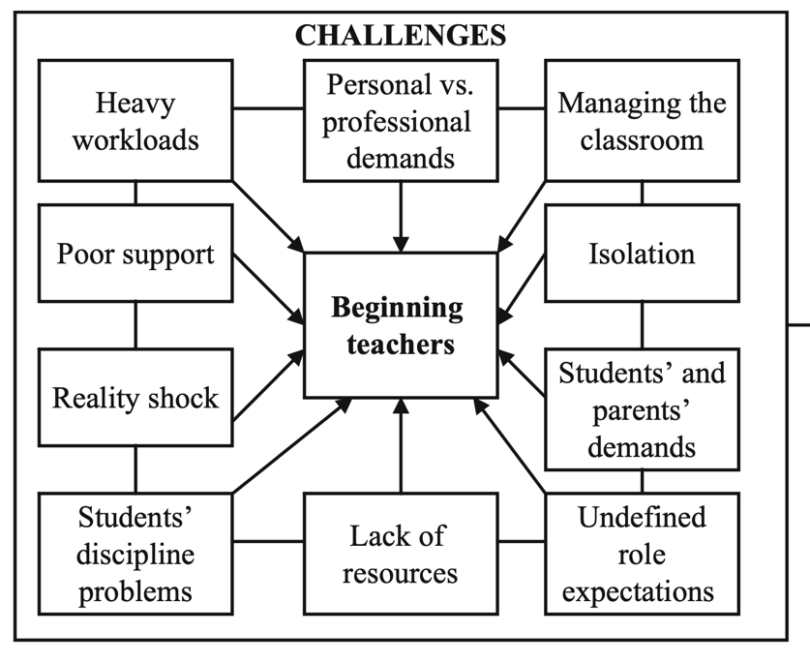


Challenges faced by ECTs, taken from Wanzare, (2007, p.351)

Slide 8
Research to date…
Reality shock is argued to be a key issue affecting retention of teachers.
Most research has focused on secondary teachers , has grouped primary and secondary teachers together, is not up to date, and has been outside of the UK context.
ECTs face many challenges, leading them to a greater prevalence of reality shock amongst them.
My research aimed to address the gap in research, focusing on investigating the perspectives of first- and second-year primary teachers who had successfully completed their initial teacher education course (PGCE).

Slide 9
The Research Questions
What are Primary ECTs’ perspectives of reality shock?
What are the factors that result in reality shock for Primary ECTs?
What are the implications for a) myself as an ITE practitioner, b) the course I work on and c) the wider Primary ITE sector?

Slide 10
Outline of Study
Case study
Ex-PGCE (both ECT 1 and ECT 2) students invited to take part.
19 beginning teachers fully completed a web-based questionnaire.
5 of these then took part in a semi-structured interview.
Data coded inductively by RQ to identify common themes.
Data analysed thematically.

Slide 11


Slide 12
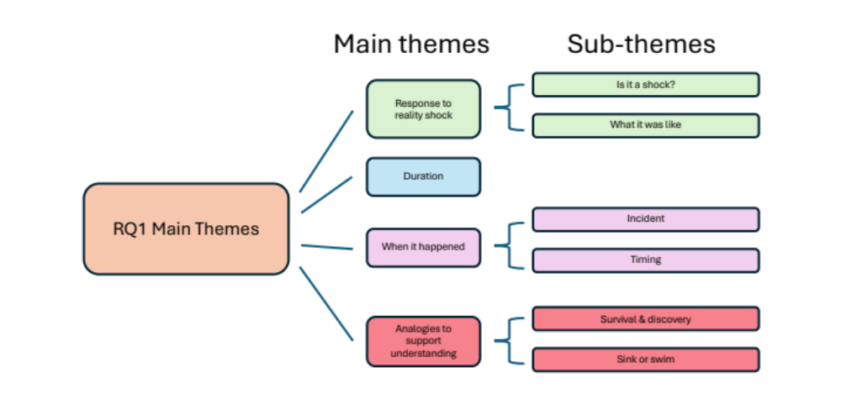
RQ1 - “What are ECTs’ perspectives of reality shock?”

Slide 13
RQ1 - “What are ECTs’ perspectives of reality shock?”
Response
Many identified with the idea of reality shock – 58% stated had experienced it directly.
Only 26% saw themselves staying in teaching for at least 10 years.
Duration
Not a single event, but a prolonged experience.
Fluctuates over time.
“I was looking at other jobs. Like, I was looking to work for XXXX...Like that's how bad it got. I was like on Indeed, all the time….... I think it was just like it was so difficult and I just thought like, how am I actually going to cope with it?"
"I think in one way it lasts all through the first year because you're doing everything for the first time"
Notes:
Issues with data collection

Slide 14
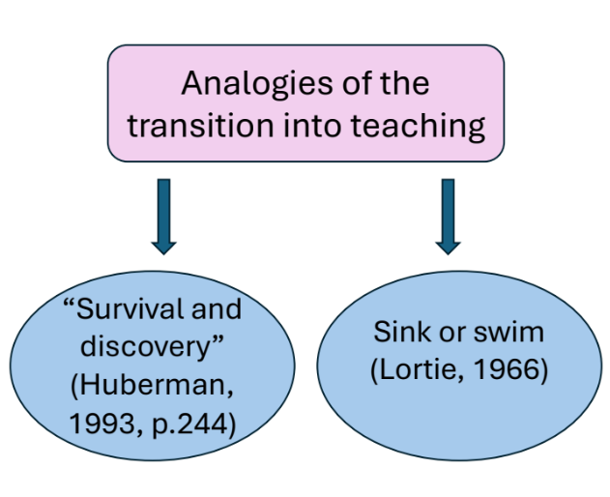
When it happened
Start of the academic year as a particularly challenging time.
Analogies
“Survival” regularly referenced in the literature with the idea of ‘getting through it’ rather than thriving.
The Robinson Crusoe approach or ‘sink or swim’ is again common.
ECTs used analogies of drowning before they were introduced to analogies that used water references.
“last year I was just trying to keep afloat”
“I didn't feel like drowning. I'm prepared for it.”

Slide 15
Implications from RQ1 –
“What are ECTs’ perspectives of reality shock?”
Response to RS
Reality shock needs to be reconceptualised to support ECTs.
The gradient of which RS is experienced is highly personalised and subjective.
ECTs need personalised support to help them navigate it, supporting retention.
Duration
Not a single event, but a prolonged experience.
Teach student teachers about how it presents as a challenge.

Slide 16
When it happened
No key event.
Students and mentors need to see the ECTs as a starting point to their training, they are not “finished products” (Feiman-Nemser, 2001, p.27)
Analogies
Share these with the students to help them reflect on their experiences.
Provide opportunities for students to create their own.

Slide 17
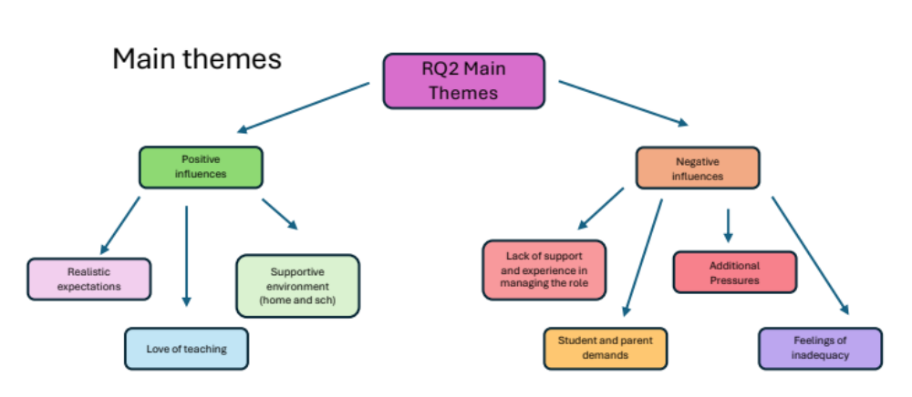
RQ2 “What are the factors that influence ECTs’ experiences of reality shock?”

Slide 18
Negative influences
Lack of support and experience
ECTs didn’t feel prepared for what was expected of them.
They were aware of the colleagues workload so didn’t feel able to ask for help.
Student and parent demands
Identified as the biggest challenge in the data.
Diverse student needs, including SEND a key issue.
“You find out stuff like everyday, and it’s like…every point in the year there’s…something new that comes up”

Slide 19
Additional Pressures
Pressure and responsibility places on themselves personally and on themselves as teachers.
They set very high expectations for themselves.
Pressure from being solely responsible for their class.
“the responsibility…the continued pressure across the year, you know being the main sort of person with the responsibility for these children….So I think just the feeling like a parent of 24 children.”

Slide 20
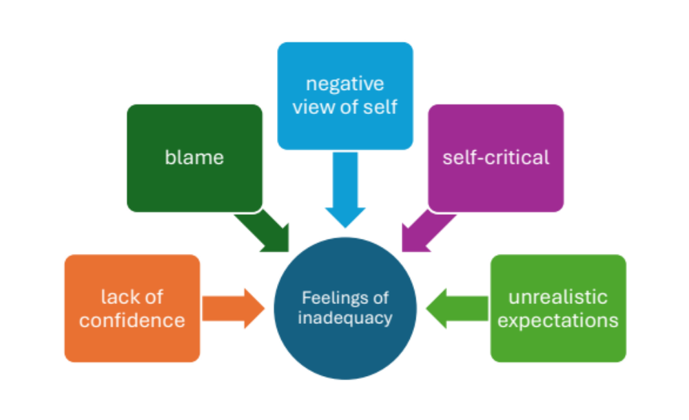
Feelings of inadequacy
Links to self and teacher efficacy.
As Bandura (1997) reported, these beliefs affect teachers effort, resilience, stress levels and how long they will try to overcome these challenges.
High expectations of the PGCE course - “I felt like the PGCE was brilliant for how the ideal of teaching should be and setting us high expectations for our practice, but I don't think it was always realistic and so I had a couple of months this year where I felt like I wasn't doing a good job because I knew all the things I wanted to do, but I couldn't do them."
“I didn’t appreciate how difficult it would be and as a consequence I’ve struggled all year”

Slide 21
Muller-Fohrbrodt et al., (1978) personal and situational causes where shared with the students, they all thought it was helpful to consider the causes within these two categories.
“Definitely more personal than situational. Because….I think if things like go wrong I'm quick to think why it was my fault… she was like having issues at home and it never got seen at school. So then when it started this year, I'm straight away. It's my fault. I've done something.”
“I should display it [the personal and situational causes] like in my classroom for having on a bad day. I’ll be like, situational.”
Notes:
She actually blamed herself for the child’s issues – but looking at the causes, it is situational – a challenging class.

Slide 22
Positive Influences
Realistic expectations
Prior and course experience helped them have realistic expectations of what teaching would be like.
Realism of the profession, ECT resilience and optimism, and understanding the bigger picture
“three placements really triangulated the sort of the different approaches that different schools have, the different approaches of teachers….I think just having all those three helped show such a diversity of what I might be entering into"
"I felt like the final placement was really useful. Getting that, I think it was eight weeks, 7 or 8, in one class from school and actually seeing how things really ran" Sarah
“Like currently I’m not being the best teacher, but I’m doing my best and that’s ok and I’ve been trained in a way that I am confident I’m still doing a good job”

Slide 23
Love of teaching
Enjoying the challenge of the role
Seeing children’s progress
Passion for teaching
These all help them through the trickier times, with their commitment to the role means they keep trying, wanting the best for their class.
“I love it. I love what I do.”
“I've honestly fallen in love with it”

Slide 24
Implications from RQ2 –“What are the factors that influence ECTs’ experiences of reality shock?”
Negative Influences
Lack of support and experience
Students are taught about the role of the ECT mentor
Support students with the decision-making processes they will be involved in, so they are used to the increased responsibility.
Student and parent demands
Further develop students understanding of adaptive teaching and SEND.
Support their understanding of SEND administration.
Notes:
Ect mentor – feel able to ask for help as they know it’s expected of them. Not being seen as a burden.

Slide 25
Additional pressures
Better prepare students for whole class responsibility, by taking more responsibility on placements.
Support students to build a realistic understanding of the profession.
Feelings of inadequacy
Training needs to build students’ self-efficacy to support them to succeed.
Ensure ITE tutors are clear that their teaching is best practice and there may be barriers to this in schools.
Students need to be aware that QFT is challenging and needs practise.
Share Muller-Fohrbrodt et.al., (1978) personal and situational causes as a framework for reflection.
Notes:
- More responsibility – will have more opportunities this year due to increased % of teaching required.

Slide 26
Implications from RQ2 – positive influences
Supportive environment
Support students to build supportive networks with fellow students, staff and teachers.
Host events to support ECTs to continue developing these networks.
Teach the importance of choosing a school that fits their values.
Love of teaching
Help them find their love and passion for the profession.
Reinforce the importance of celebrating their own successes.
Help them to be optimistic about the improvements they can make.
Realistic expectations
Support students to develop realistic expectations.
Provide a range of diverse placements.
Extended placements so they see the full reality of teaching.
Reinforce that “good is good enough”.
Notes:
Diverse placements – so students see different approaches of staff and schools, so they see how schools operate

Slide 27
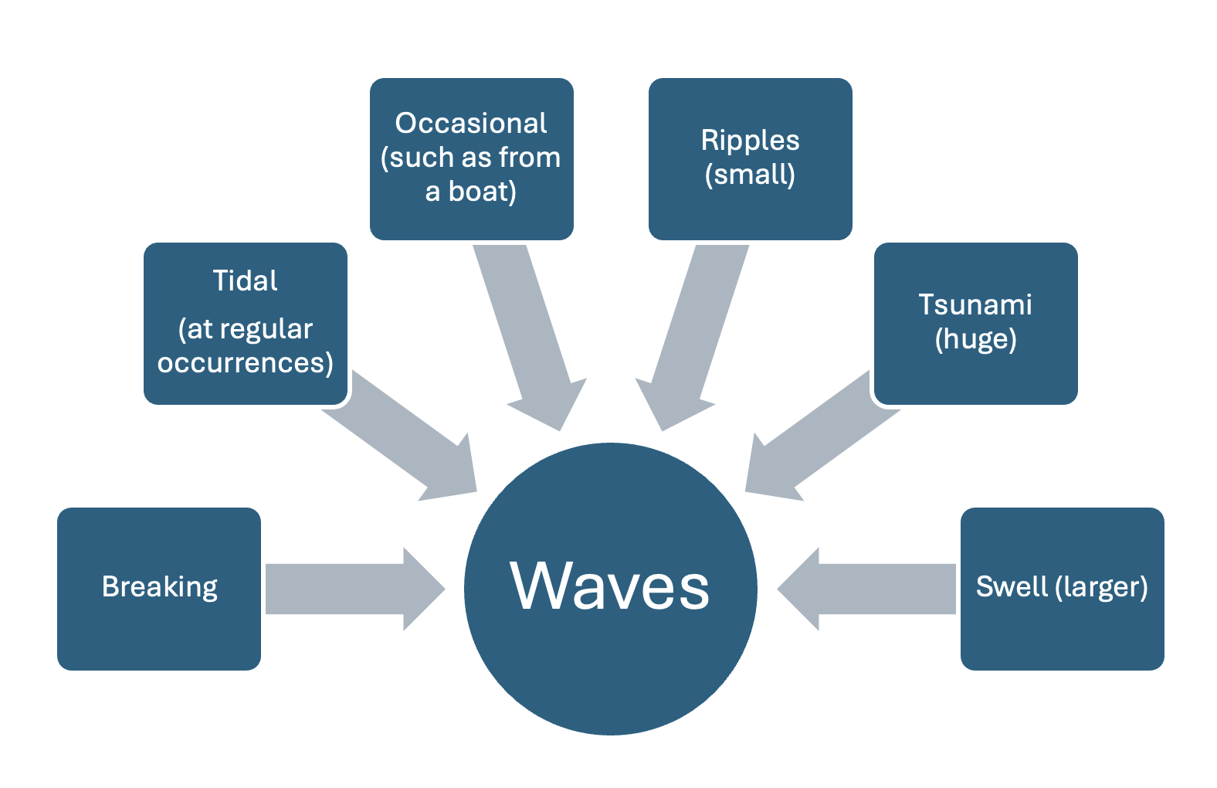
Conclusions
RQ1 – “What are ECTs’ perspectives of reality shock?”
The ‘reality shock’ as a term was found to be unhelpful as it does not conceptualise the prolonged, fluctuating experience that the ECTs reported.
New term proposed
“Waves of disturbance”
By teaching students about WOD,
  they can understand what to expect,
  understand what it entails
  learn how to cope with it.
Notes:
‘Shock’ implies a surprise event, however the ECTs expected to find teaching challenging, so the word ‘disturbance’, meaning interruption of a settled condition, is more appropriate. By making the term clearer, beginning teachers can understand the term better and use it to reflect, discuss and make sense of their experiences.
Waves can come in many different sizes/ severities and caused by different reasons.

Slide 28
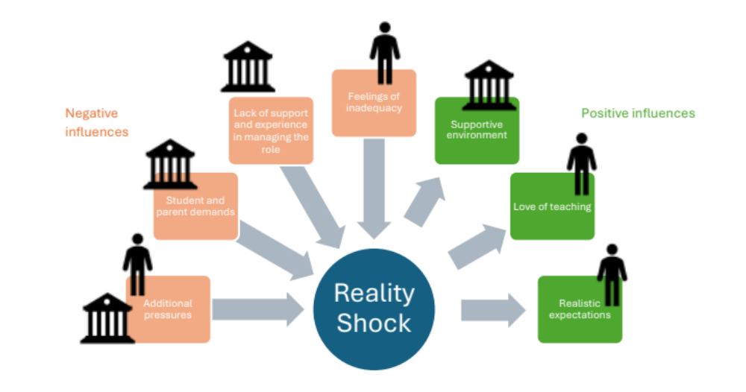
Conclusions
RQ2 - “What are the factors that influence ECTs’ experiences of reality shock?”
Four significant factors that increase the influence of reality shock
Three significant factors that help to reduce the influence of reality shock
Notes:
Wanzare (2007) saw reality shock as one challenge that beginning teachers face along with other challenges. I disagree; I believe these other challenges lead ECTs to experience reality shock. I created the above figure to exemplify this, showing how the negative influences lead to reality shock, whilst the positive influences help buffer the experience of reality shock. The causes are both personal and situational (Müller-Fohrbrodt et al., 1978).

Slide 29
Conclusions
RQ3 – “Implications for teacher educators, ITE providers”
We need to empower the beginning teachers to understand the concept of reality shock or ‘waves of disturbance’; and to support them to reflect on their own practice with optimism, perspective and pragmatism.
Share these findings with beginning teachers so they are not surprised when they encounter challenges but know these ‘ebb and flow’
  With a supportive environment, realistic expectations and their love of teaching they can get over these waves and remain in the profession.
Share these findings with other teacher educators and ITE providers.

Slide 30
Further research ideas
My study was focused on ECTs at one ITE institution, so future research could further explore my findings and continue to address the gap in research in this area, as well as addressing retention and recruitment concerns. Based on the evidence provided within this study, I offer the following ideas for future research:
A longitudinal study of ECTs’ experiences of reality shock during their ITE, ECT 1 and ECT 2 years
The different perspectives of reality shock of beginning teachers in their first and second year of teaching
The perspectives of those supporting beginning teachers (i.e. do the perspectives of mentors/ school leaders mirror those of ECTs? What would be the similarities and differences between different stakeholders?)
Beginning teachers’ perspectives of the usefulness of ‘waves of disturbance’ as a concept to help them understand the challenges they face as beginning teachers (i.e. would educating students about reality shock help them to make sense of their ECT experience and deal with the effects of this phenomenon better?)

Slide 31


Slide 32

Thank you!
Jo Milton
jm789@cam.ac.uk

