Slide 1

C8 – The Benefits and Challenges of ITaPs in large HEIS

Slide 2
Introduction
Catherine Clutterbuck – Primary – c.clutterbuck@worc.ac.uk
Suzanne Lawson – secondary - s.lawson@worc.ac.uk

Slide 3
How many ITaPs?

Slide 4
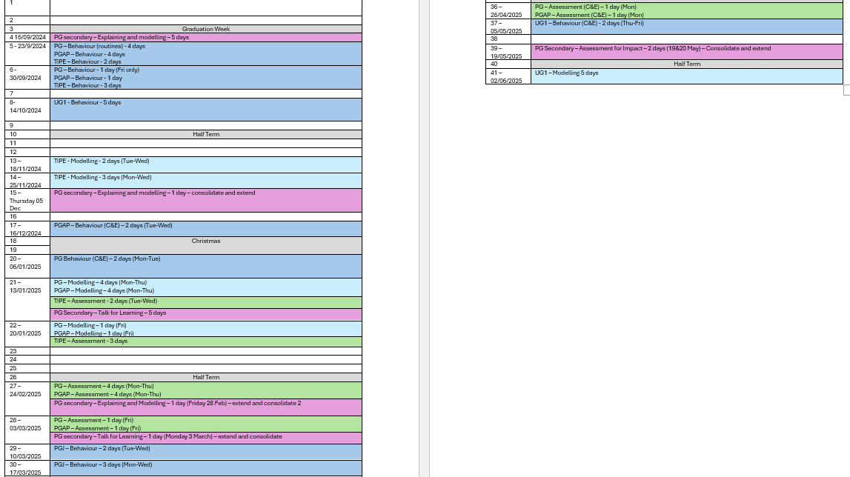

Slide 5
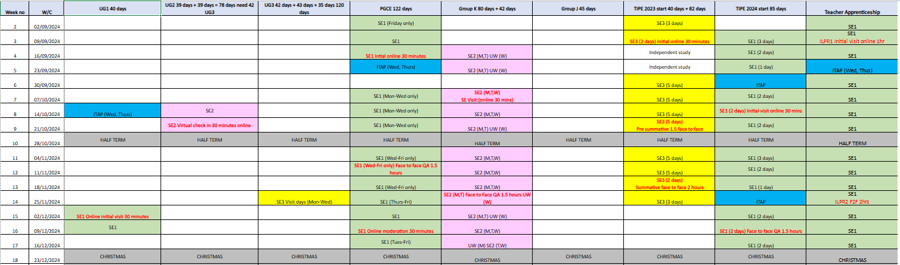

Slide 6
Satellite or placement schools?

Slide 7
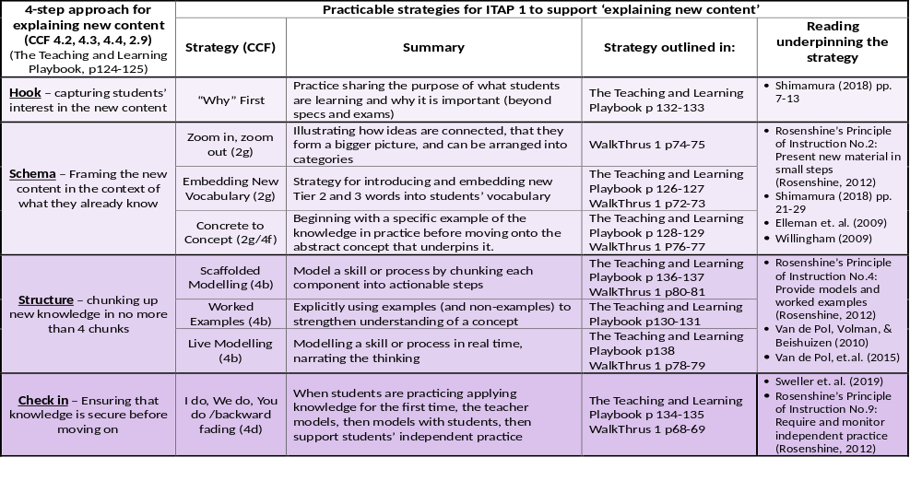
Explaining and Modelling – Practice-able Strategy Framework

Slide 8
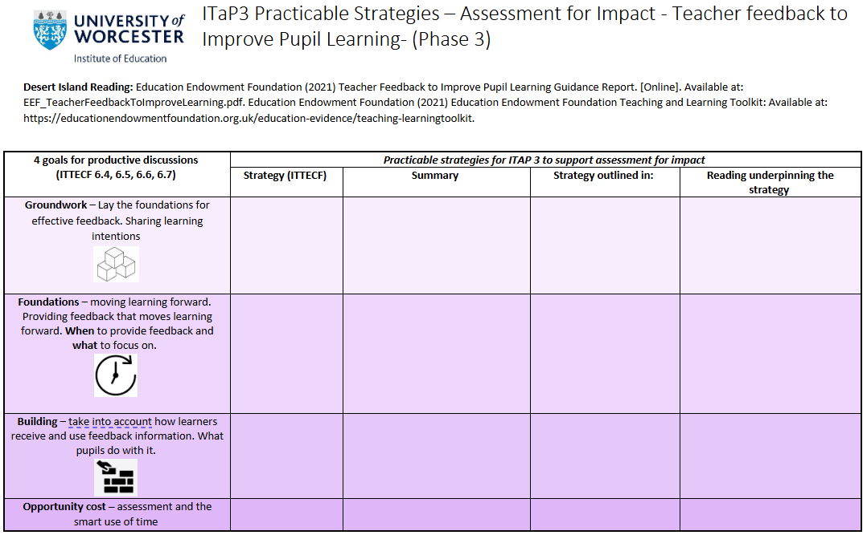
Assessment for Impact– Practice-able Strategy Framework

Slide 9
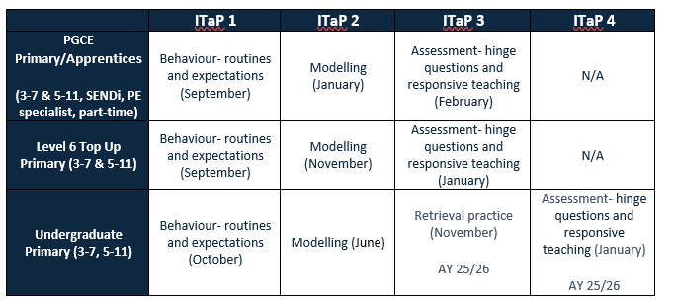
Multiple pathways... how many ITaPs?

Slide 10
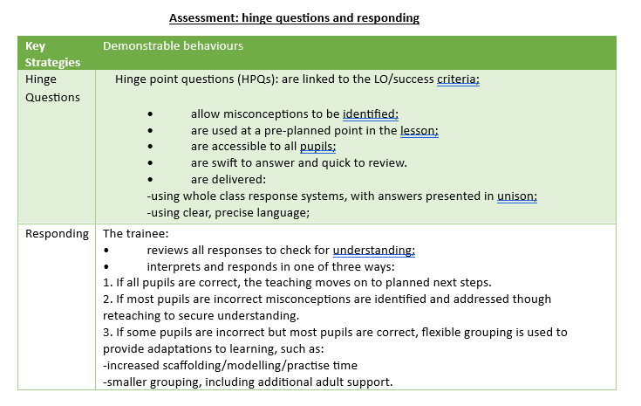

Slide 11
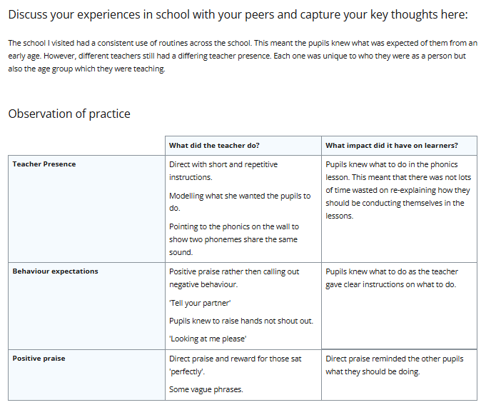

Slide 12
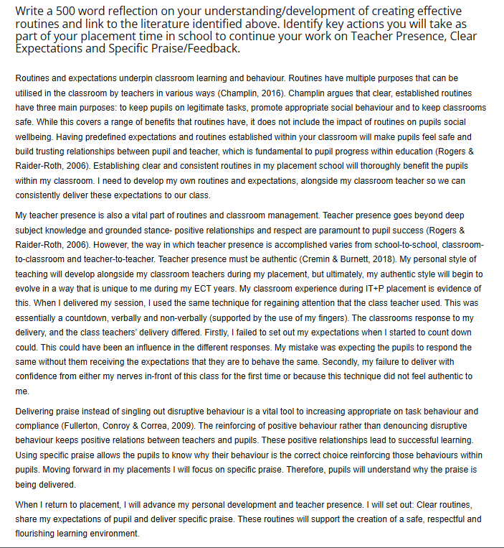

Slide 13
How do we quality assure?

Slide 14
Department for Primary Education
Six Ways of Quality Assurance – Intensive Training and Practice (ITAP)
Student baseline & end point confidence assessment - PebblePad ERP
School – QA visits
Teaching (hubs) – Online QA visits
Course representatives
Mentor feedback
Student feedback - demonstrable behaviours
University of Worcester

Slide 15
Department for Secondary Education
Six Ways of Quality Assurance – Intensive Training and Practice (ITAP)
Student baseline & end point confidence assessment - PebblePad
QA visits – schools and placement sessions
Regional Teaching (hubs) – Online QA visits
Course representatives
Mentor feedback (including tutors (lead mentors)
Student feedback - demonstrable behaviours
University of Worcester

Slide 16
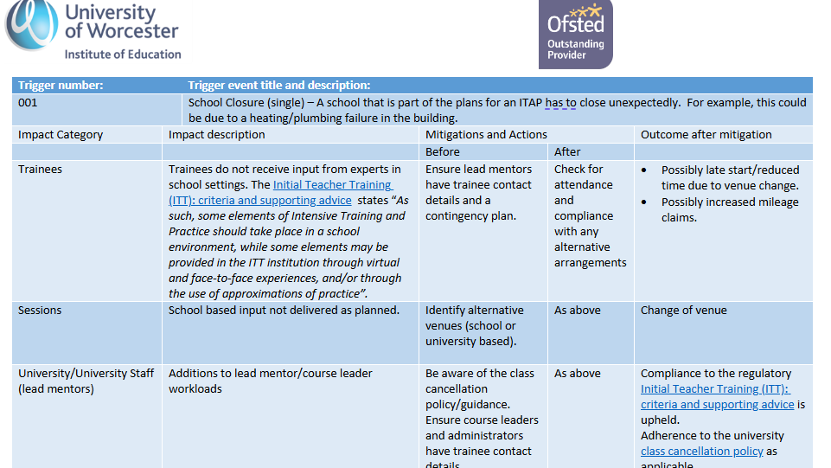

Slide 17
If we could scrap ITaPs would we?

