Slide 1

Primary student teacher perceptions of the expert primary teacher
Dr Lorain Miller
Northumbria University
Session Block B2
Tuesday 12th November 2023
14:45-15:45 Rochester room

Slide 2
Introduction
Research problem
Background to primary teaching
Research questions
Research approach
Scope

Slide 3
Research problem
The research problem to be considered in this thesis is the concept of expertise and how this relates to the primary classroom teacher.
The attrition of teachers in the first five years post qualification is widely appreciated (Roberts, 2012; Dupriez, Delvaux and Lothaire, 2016; den Brok, Wubbels and van Tartwijk, 2017) and also during ITT (Doherty, 2020).
Retention of teachers is one of the key challenges in schools today. Reducing teacher attrition could be one of the key drivers to the acute teacher shortage facing schools in the UK.
The reasons why teachers leave the profession in the first five years are complex, but the reasons offered most frequently are; overwhelming workload, constant changes to government policy which make schools more accountable and reduce teacher creativity, lack of support from senior leaders and salary considerations (DfE, 2017a, 2017b, 2018a,2018b). All of the above have an impact on teachers’ abilities to cultivate expertise.
The government is focusing on recruitment rather than retention. This thesis would like to investigate the changes that could be put into place during ITT and beyond which may have an impact on the attrition rates currently measured (DfE, 2022b).

Slide 4
Background to primary teaching
Prior to 1960’s most primary teachers in England were non-graduates.
Batchelor of Education honours (Bed) degree was introduced in 1963.
Post Graduate Certificate in Education grew during 1980’s.
Majority of teachers were trained outside of the university sector in teacher training colleges (Alexander, 2010).
Subsequent governments have failed to achieve their own teacher recruitment targets for over a decade (House of Commons, 2023).
The government is focussing on recruitment rather than retention

Slide 5
Research questions
What do trainee teachers consider to be the characteristics of expertise in primary teachers?
What do trainee teachers perceive to be the barriers to achieving expertise in primary education?
How does initial teacher training impact upon trainee teachers’ perceptions of the journey towards expertise?
How do trainee teachers’ perceptions of expertise impact on primary teacher identity?

Slide 6
Research approach
Mixed methods approach – quantitative->qualitative->qualitative->quantitative
Pilot study
Online survey to whole cohorts BA and PGCE Part time at the beginning of the academic year
In-depth online interviews from volunteers identified from online survey
Online focus groups – participants invited from interview participants
Online survey at end of academic year to trainee teachers completing programme of study.

Slide 7
Scope of the study
To improve my own understanding of primary teacher expertise including knowledge streams important in ITT
Limited to trainee primary teachers in one Northeast provider of ITT

Slide 8
Literature Review
Definition of expertise
Generic attributes of expertise
Specific attributes of expertise
Specific models of teacher expertise
Barriers to achieving teacher expertise

Slide 9
Definitions of expertise
Expertise is a dynamic state. Expertise is domain specific. The basic components of expertise can be identified as knowledge, experience and problem solving (Herling 2004).
The distinguished journeyman, highly regarded by his peers, whose judgments are uncommonly accurate and reliable whose performance shows consummate skill and economy of effort, and who can deal effectively with certain types of rare or ‘tough’ cases. Also, an expert is one who has special skills or knowledge derived from extensive experience with subdomains. (Hoffman et al., 1995 p.132).
The work of (Shanteau, 1992b, p. 5) defines experts as:
‘…. operationally defined as those who have been recognized within their profession as having the necessary skills and abilities to perform at the highest level.’

Slide 10
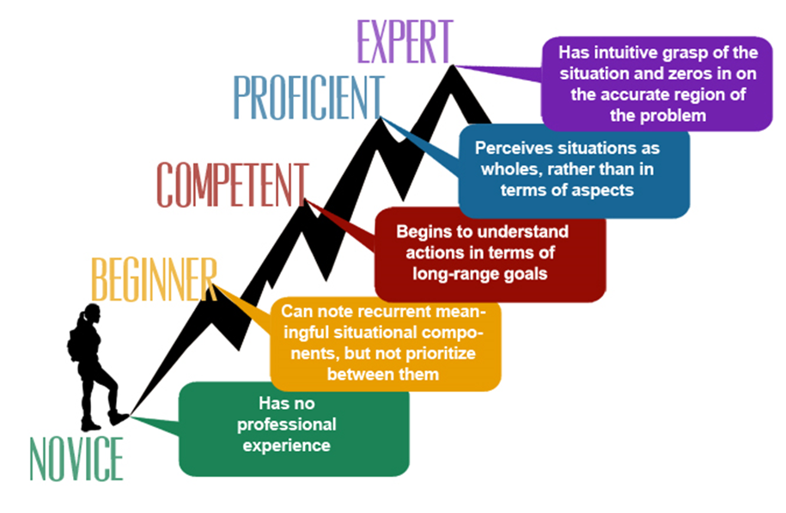
Models of developing expertise – Dreyfus and Dreyfus 1986

Slide 11
Models of developing expertise – Glaser’s Change in Agency (1996)
External support
Transition
Self-regulation

Slide 12
Models of developing expertise – Stages of cognitive development Shanteau (1992)
Cognitive stage
where knowledge is amassed
Associative stage
where connections are strengthened
Autonomous stage
where the skills become practiced and rapid
TACIT stage
where knowledge is embedded

Slide 13
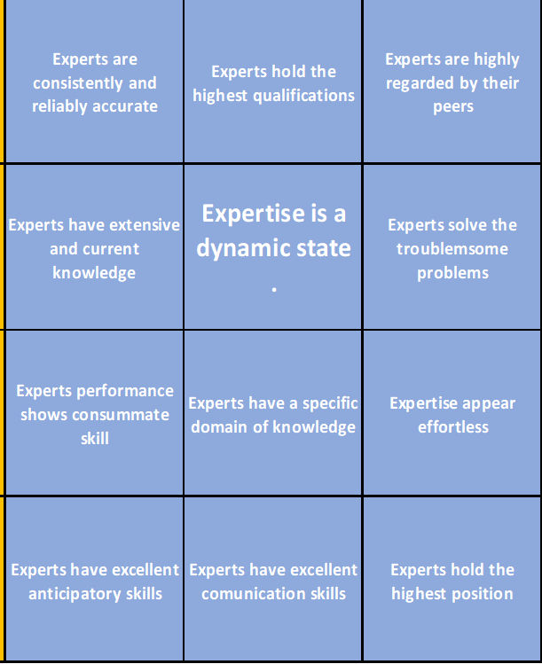
Generic attributes of expertise

Slide 14
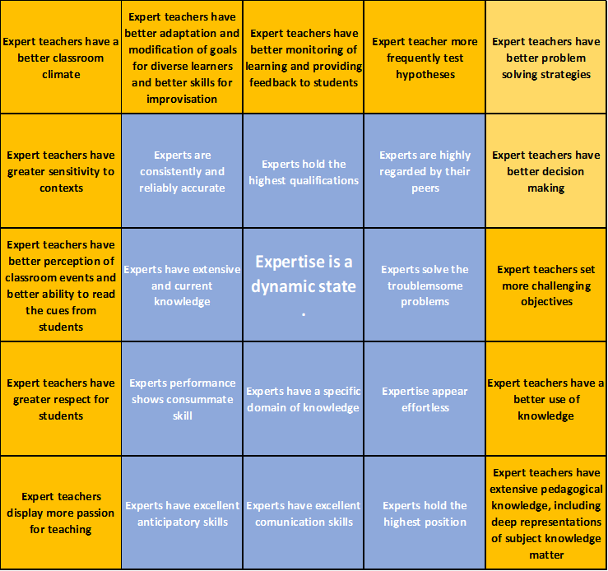
Specific attributes of expertise

Slide 15
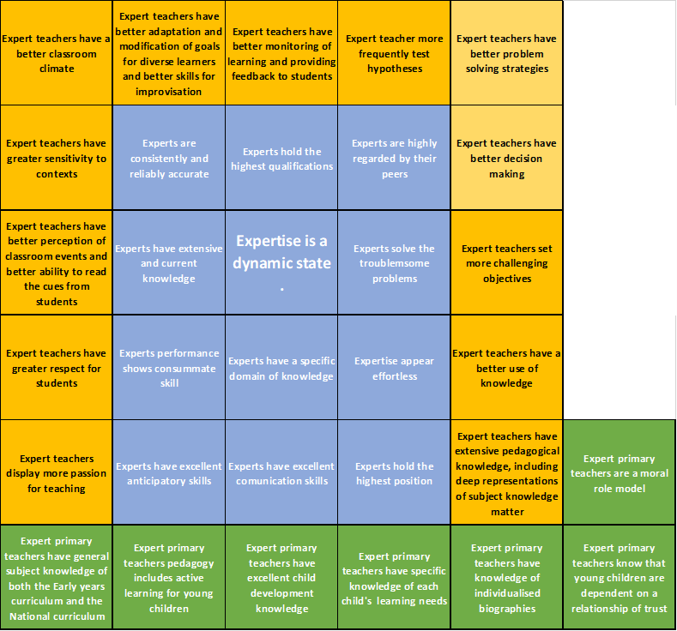
Specific attributes of teacher expertise

Slide 16
Barriers to achieving teacher expertise
Expertise
Innate ability or talent
Deliberate practice
Grit, determination, perseverance or passion
Intelligence
Opportunity

Slide 17
Methodology
Aim of the study
Research approach
Design frame
Data gathering instruments
Data analysis techniques
Ethical considerations

Slide 18
Aim of the study
To identify what trainee primary teachers’ perceive to be the traits of an expert primary teacher
To identify what trainee primary teachers’ perceive to be the barriers to achieving expertise in primary education
To identify if this data changes over ITT
To identify if teacher identity changes over ITT

Slide 19
Research approach
Ontological belief – there are multiple realities that are shaped by the contexts in which they exist (Berger and Luckmann, 1966). Bounded relativism holds that truth is not constant but varies in relation to context, time and circumstances (Moon and Blackman, 2014).
Epistemological position – interpretivism. People interpret their social roles in relationships and give meaning to those roles (Van de Walt,2020). Knowledge is everywhere and is socially constructed (Thomas, 2017). Burr (2003) believes that we create reality through our social interactions and the interpretations that we have of our interactions.

Slide 20
Design frame
The hypothesis in this study is that primary teachers do not fully appreciate the traits required to be an expert primary teacher (Jegede, Taplin and Chan, 2000) and as a consequence they lack the understanding of how to achieve expertise. In addition, they feel unsupported, undervalued within their role and disillusioned, as a result of this, they then prematurely choose to leave the profession.
Recent research shows that early career teachers’ sense of self- efficacy is strongly linked to the level of support they receive in school (McIntyre and Hobson, 2016; Spencer et al., 2018). In addition, more emotional support is a common reported need, and a supportive school culture is critical for their success and retention in the profession (Ashby et al., 2008; Spencer et al., 2018; Doherty, 2020).
The overriding aim of the research is to generate interpretive understanding of why primary teachers act in the way that they do, where quantitative information can be used to deepen the interpretation and provide a more robust confirmation of the understandings acquired through the collection of qualitative data (Tashakkori and Teddlie, 2010). The idea of mixed methods is that both qualitative and quantitative methods are used in order to better answer the question.

Slide 21
Data gathering instruments
Online survey to all members of the population
Online interviews
Online focus groups
Online survey to members of the population at the end of their programme of study

Slide 22
Data analysis techniques
Statistical analysis – using descriptive analysis techniques(Howitt, 2014) ONLINE SURVEY
Constant comparative method – allowing themes to emerge from the data (Thomas, 2017). ONLINE INTERVIEWS
Discourse analysis – study of language in social use(Vaughan,2007). ONLINE FOCUS GROUPS

Slide 23
Ethical considerations
Whilst all of the participants were adults (over 18 years of age) and were therefore able to give personal consent, the majority of the population would be considered young people which offered additional complexities that engaging in naturalistic enquiry via participatory research entails.
The key aspect of naturalistic research is the difficulty of creating a trusting relationship with the participants which is crucial in eliciting accurate information.
The three-part data capture design allows for sufficient time to allow a deeper relationship and rapport to be developed in order to access deeper layers of their voices.
As the research study was designed to engage with non-vulnerable adults the project would be identified as a medium risk for ethical purposes. This meant that the university insisted that the proposal was submitted to the Ethics committee lead. The proposal would then be reviewed by one independent reviewer. In addition, the study was required to obtain informed consent forms from the programme leaders in respect to recruitment of participants and from all of the participants involved, permission to use data from the Data Controller, as well as confidentiality/anonymity issues.

Slide 24
Results and Analysis
Results of online surveys
Results of online interviews
Results of online focus groups

Slide 25
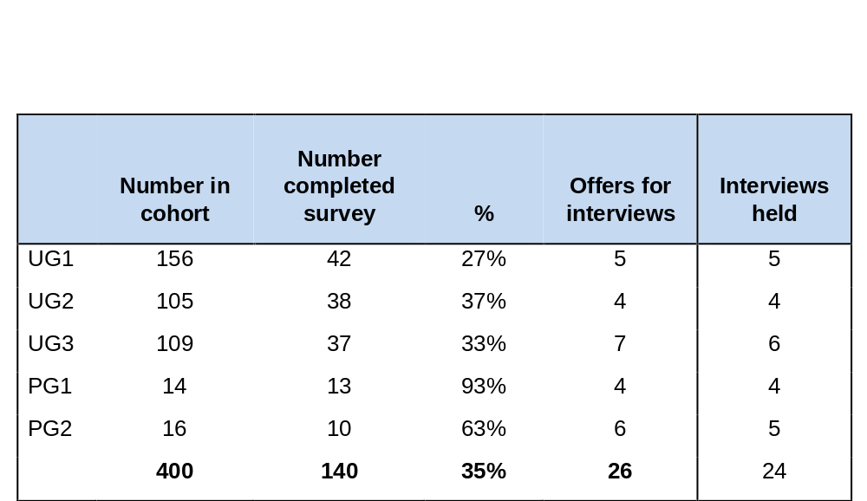
Sampling statistics

Slide 26
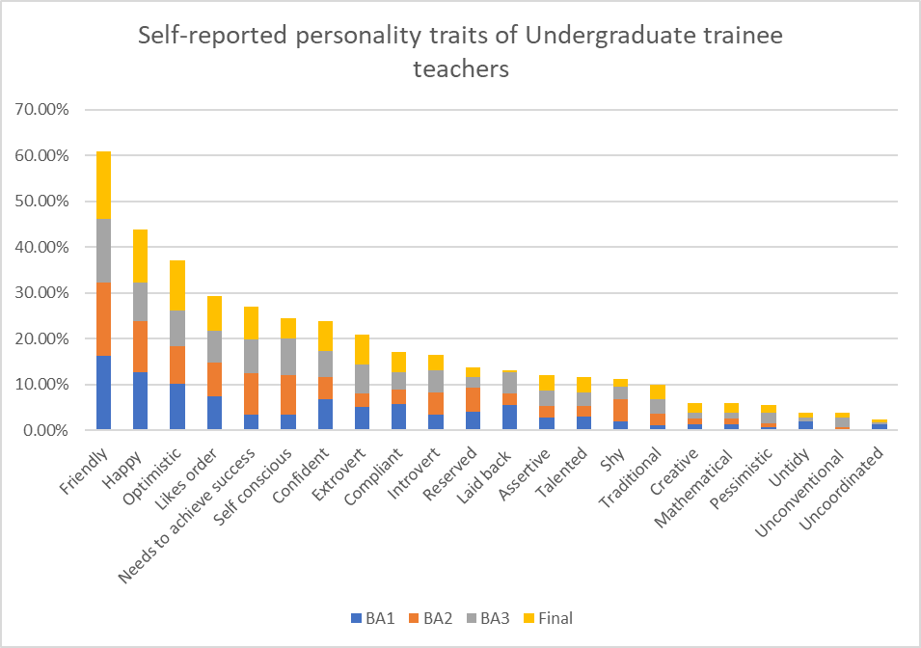
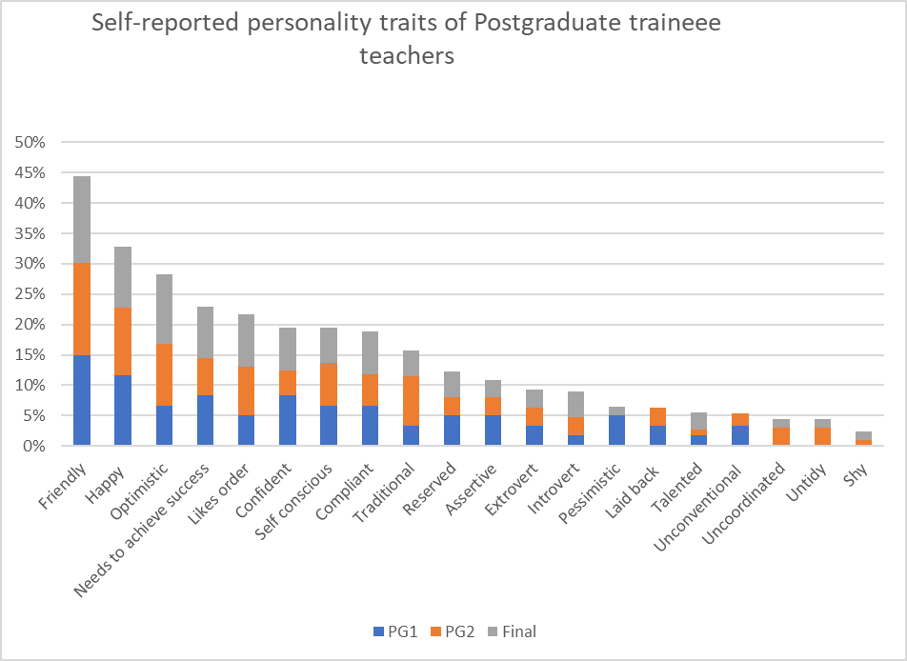
Results of online surveys

Slide 27
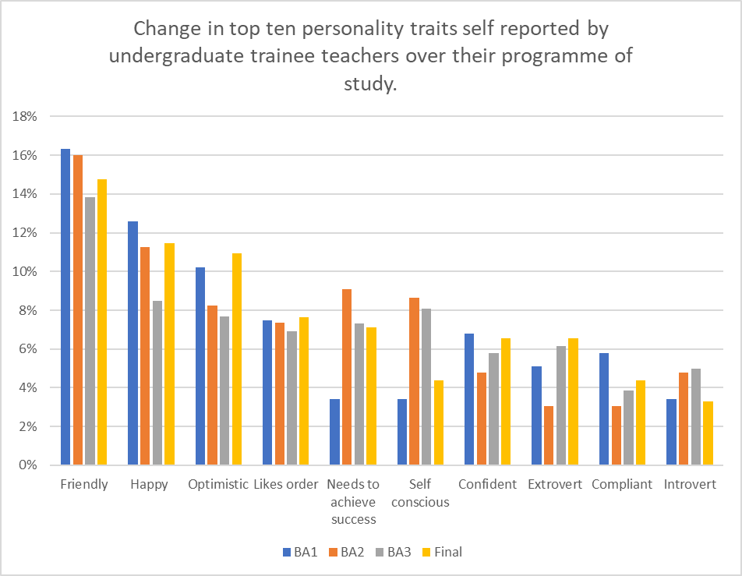
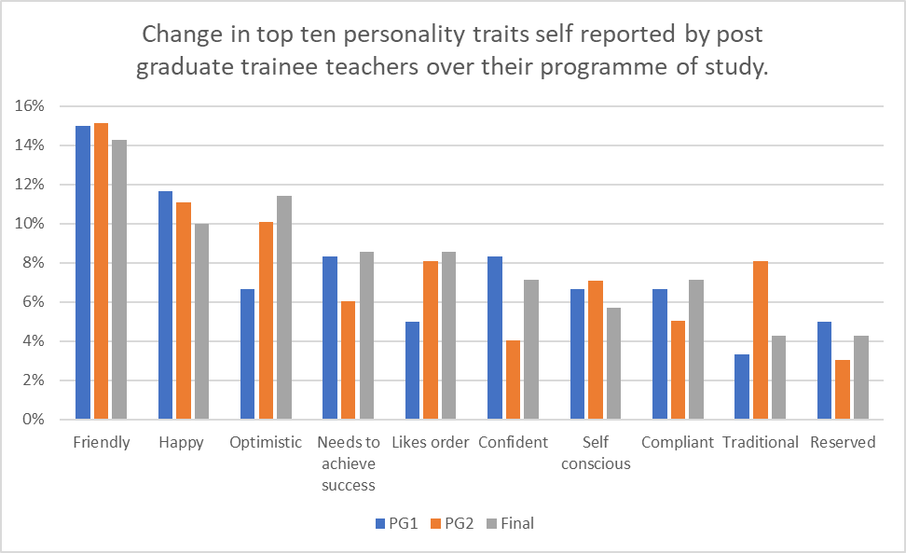
Results of online surveys

Slide 28
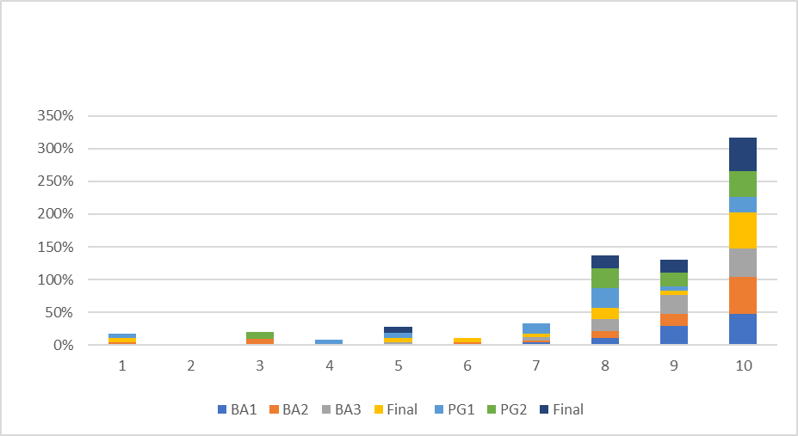
Q3 On a scale of 1-10 how important is it for you to be successful in your chosen career?

Slide 29
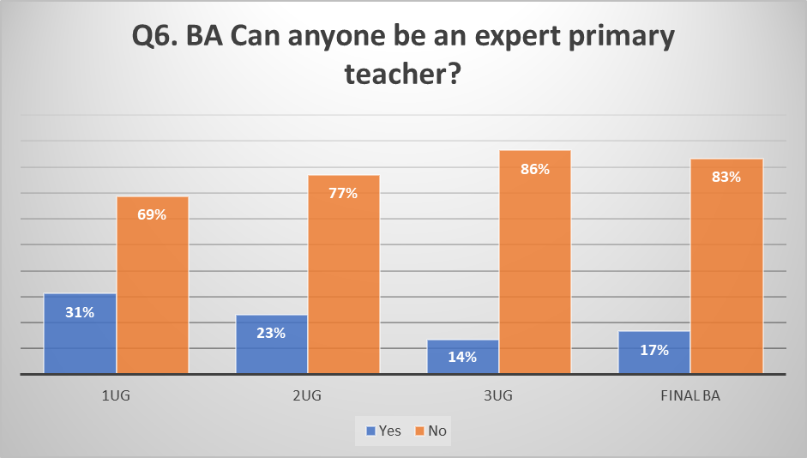
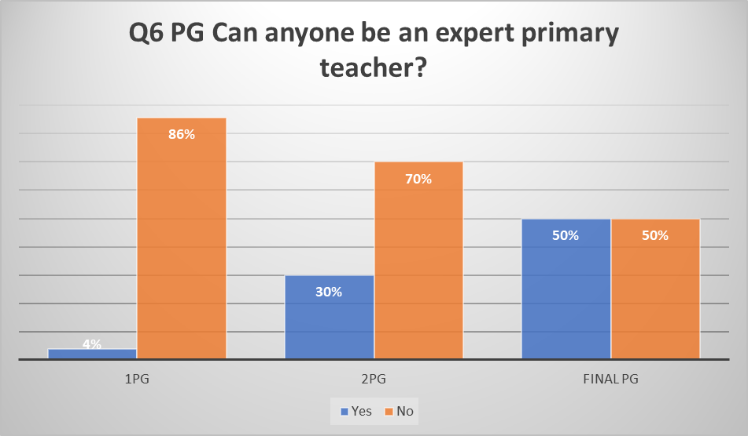

Slide 30
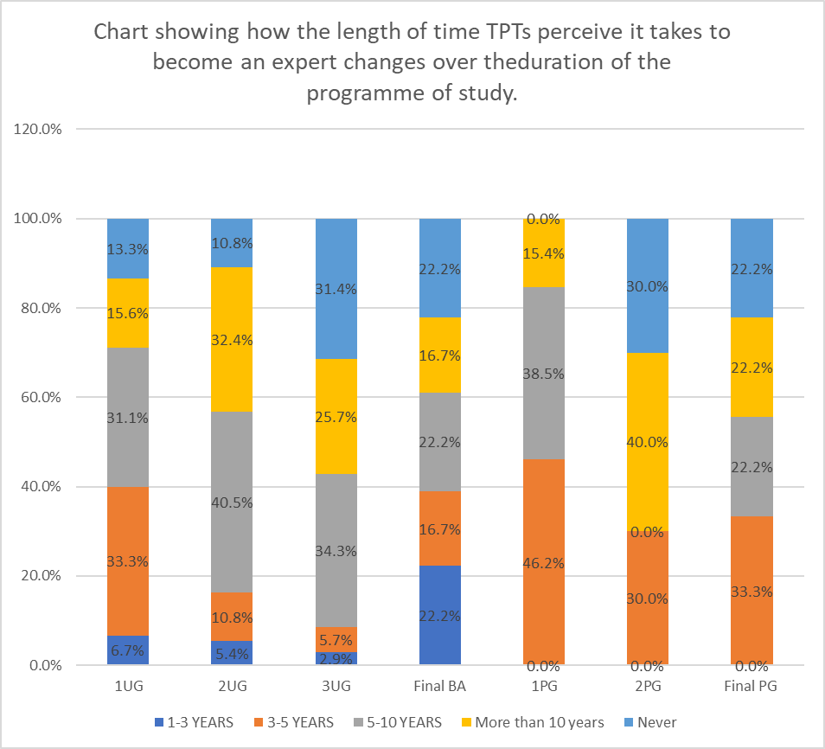

Slide 31
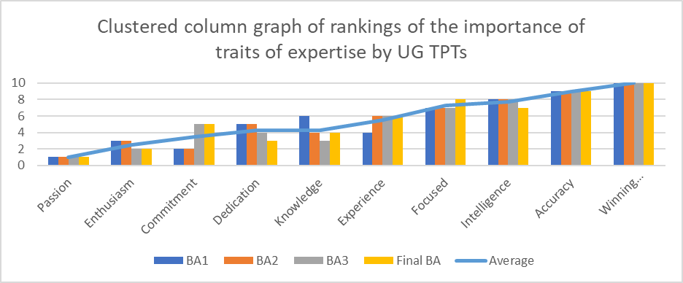
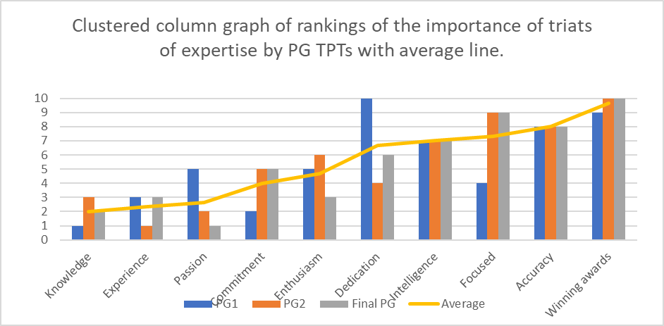

Slide 32
Results of online interviews – RQ1
The most prevalent trait that TPTs perceived to be necessary to be an EPT was passion, drive and being of a hard-working ethical character. This trait was considered to be inherent and not something that could be learned over time or by training.
Another trait mentioned most frequently which was considered to be inherent and could not be learned was to have a nurturing personality.
Adapting teaching to the needs of the children in your class and reflecting upon your teaching were both mentioned most frequently as traits and again TPTs did not think that they could be learned.

Slide 33
Results of online interviews – RQ2
TPTs felt that they needed to find other people to cover their personal commitments to allow them to work longer hours.
TPTs believed that it is impossible to keep up with the changes that are constantly imposed upon teachers which make expertise impossible to achieve.
TPTs believed that experts are perfect and no one is perfect.
Teachers who have other commitments (children) will not be able to achieve expertise as they will not be able to commit enough time and effort to their chosen profession.
The work load for a teacher is perceived to be impossible to achieve therefore excellence is unachievable.
TPTs believed that a lack of collegiality and the school environment played a part in the ability of a teacher to achieve expertise.

Slide 34
Results of online interviews – RQ3
As TPTs progressed through their programmes of study they became aware of the full extent of the workload of a primary teacher.
The illusion that primary teachers were perfect changed as they progressed through ITT to a more realistic viewpoint.

Slide 35
Results of online interviews – RQ4
TPTs have a strong need to be successful in their chosen profession. Success means successful children to this sample of TPTs.
A significant number of the sample had suffered a childhood trauma which had contributed to their decision to train as a primary teacher.
As TPTs travel through their programmes of study a number of the sample indicated a reduced need for success and explained that their personal wellbeing was more important.

Slide 36
Results of online focus groups – RQ1
TPTs in the final year of study considered developing good independent leaners and collaborative learning an attribute of an expert primary teacher.
TPTs across all programmes agreed that passion, a love of working with children and commitment were necessary attributes of all teachers.
TPTs early on in their training stated a need to create good relationships are vital to developing the skills to be an expert teacher.

Slide 37
Results of online focus groups – RQ2
TPTs in the last year of training can perceive that primary teacher expertise is possible if the teacher engages consistently in lifelong learning.
TPTs appreciated the dynamic nature of expertise and repeated the need to consistently engage in continuous professional development.

Slide 38
Results of online focus groups – RQ3
As TPTs progress through their ITT they gain a greater understanding of the requirements of the primary teacher and appreciate the complexities of the role.

Slide 39
Results of online focus groups – RQ4
TPTs across all programmes agreed that the role of primary teacher was challenging and required someone determined and committed to the profession who was driven to constantly improve their practice.
TPTs need for success was high but the success they were driven to achieve was for the children in the classroom to be happy, fulfilled learners who achieve their potential not personal ambition.

Slide 40
Discussion
RQ1 What do trainee primary teachers consider to be attributes of expert primary teachers?
RQ2 What do trainee primary teachers consider to be the barriers to achieving expertise in primary teaching?
RQ3 How does ITT impact upon trainee primary teachers’ perception of the journey towards expertise?
RQ4 How do trainee teachers’ perceptions of expertise impact upon their teacher identity?
The primary teacher as a problem solver.

Slide 41
RQ1 What do trainee primary teachers consider to be attributes of expert primary teachers?
Confusion between skills required of teachers generally (as specified in the Teachers Standards), those that would result in a good teacher and the additional traits that are only present in an expert teacher was clear.
Participants correctly identified passion (or grit, determination, hard work), commitment, adaptability, reflective practice and an ability to create good relationships as important propellants along the journey of expertise.
Participants felt experience was less important than those traits mentioned above and had no clear understanding of the range of domains of knowledge they are required to develop.
Subject knowledge was mentioned but pedagogical knowledge, child development knowledge, situational knowledge, contextual knowledge and self-knowledge were not mentioned heavily during the data capture.

Slide 42
RQ2 What do trainee primary teachers consider to be the barriers to achieving expertise in primary teaching?
Trainees believe that passion, a love of working with children and commitment to the profession are requirements of the role for any teacher. If these traits are missing the perception is that they cannot be learned or developed, and the teacher will never achieve expertise. All other traits required to be an expert primary teacher were perceived to be able to be learnable and developed over time.
TPTs’ expressed a belief that an expert was a synonym for perfection and due to the cascade of government initiatives imposed upon teachers constantly increasing workload it was not possible to achieve perfection. The ever- increasing workload was a source of concern for TPTs’ who indicated a feeling of becoming overwhelmed prior to starting their first position as a primary teacher.
The concept that expertise develops over time was well accepted by the sample and that you have to strive to maintain expertise once achieved – you cannot be a complacent expert.
The areas which were not present in the trainee teachers’ perceptions were the role of intelligence(in particular emotional intelligence), the role of talent and opportunity as a barrier to achieving expertise.
Other personal commitments (having carer responsibilities) and the school context were mentioned as possible barriers to achieving expertise. A school lacking in collegiality would be considered a relevant school contextual barrier.

Slide 43
RQ3 How does ITT impact upon trainee primary teachers’ perception of the journey towards expertise?
The first finding discussed was the longer trainee teachers engaged in ITT the longer they perceived it would take to become an expert primary teacher. This was explained as the Kruger and Dunning (1999) effect whereby people tend to hold overly favourable views of their abilities in many social and intellectual domains. This was deemed to be a natural phenomenon.
The second finding was in relation TPTs becoming more hesitant to try new things the longer they progress through their programmes of study. This result was deemed to part of the changing identity of trainee teachers.
The third finding was the gradual appreciation of the full extent of the workload of a primary teacher and greater understanding of the requirements of the primary teacher and complexities of the role as they journeyed throughout ITT. This result was discussed and identified as an area that could be improved by mandatory prior experience of an extended period prior to commencing the PoS to try to avoid training people who would not then stay in the profession.
The final finding in this section was that TPTs in their final year of study started to appreciate that primary teachers were not perfect and a more realistic understanding of the requirements and complexities of the role became apparent.

Slide 44
RQ4 How do trainee teachers’ perceptions of expertise impact upon their teacher identity?
TPTs indicate a strong need to be successful in their profession but their idea of success was to have happy fulfilled learners who achieve their personal potential, not personal career development. The reasons people choose to enter the profession tend to be emotional and altruistic (Heinz, 2015). This strong need for success is what drives them to be effective teachers (Darling-Hammond and Bransford, 2007).
A significant number of the sample interviewed outlined a perception of childhood trauma that had created the catalyst to become a primary teacher. These altruistic reasons for entering the profession and the continuing need for success may form part of their teacher identity. Staub and Vollhardt (2008) theorise that altruism can be born from suffering and Lifton (2003) writes about how the effect of trauma can embed a deep commitment to prevent future suffering.
Whilst TPTs predominantly identify as being happy, friendly, optimistic people the scale of happiness decreases as they travel through ITT and self-conscious and compliant traits increase. These findings were discussed as part of the natural development of the emerging adult (Arnett, 2000; Arnett and Jensen, 2002; Ceci, Barnett and Kanaya, 2003; Arnett, 2007; Jensen, 2011; Arnett, 2015; Mitra and Arnett, 2021) where significant identify development is occurring for 18–25-year-olds and the profound changes experienced by people within these age brackets are of significant importance to their future self.
A significant number of the sample of TPTs had chosen to engage in further education voluntarily. Life-long learning is an aspect of teacher identity which is required of an expert. The TPTs appreciated this need and were already acting with this intention to allow them to enter the profession or as part of a previous career.
TPTs perceived that an aspect of teacher identity is a very determined person who puts the needs of the children in their care first. This altruism may lead to teacher burnout and subsequent attrition from the profession (Van Droogenbroeck et al., 2021). An ability to achieve the purpose for which they have entered the profession(to make a positive difference to children’s lives) coupled with very high levels of administrative work (DfE, 2019c) may be one of the factors why teachers choose to leave the profession in the first five years.

Slide 45
The primary teacher as a problem solver.
One noticeable absence throughout this study was the EPT as a problem solver. This lack of appreciation may account partially for the reason that TPTs did not perceive that a primary teacher could be an expert as the focus was on an infinite amount of knowledge rather than the creative application of this knowledge to solve new problems.
Problem solving has been defined as a trait of the expert. Problem solving, as defined by Bereiter & Scardamalia (1993) is the searching or deliberation in order to find a way to achieve a goal. It has been argued that the problem solutions depend on the previous experience of the problem solver combined with the expert creating an original solution (Hill, 1971). The concept of experience leading to insightful solutions is described as the single dynamic element in the growth of experts as being progressive problem solvers whereas the non-expert is more likely to come up with more traditional solutions elicited from experience alone (Bereiter & Scardamalia,1993).

Slide 46
Conclusions
Further research
Recommendations

Slide 47
Recommendations
Address all five domains of knowledge that are necessary for a primary teacher in the curriculum for trainee teachers.
Incorporate the traits of expertise within the ITT curriculum
Use deliberate practice as a form of developing expertise in primary teaching

Slide 48
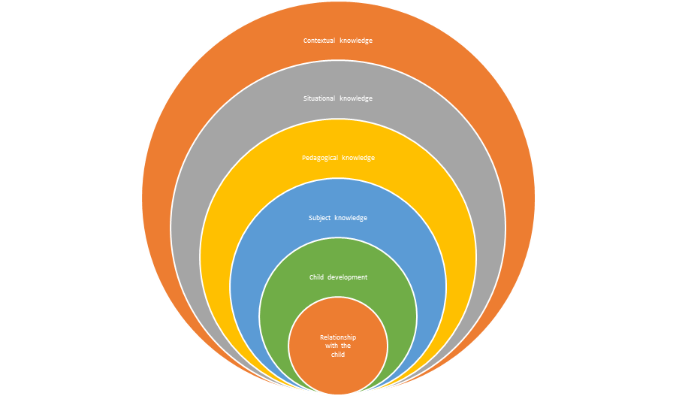
The five domains of primary teacher knowledge

Slide 49
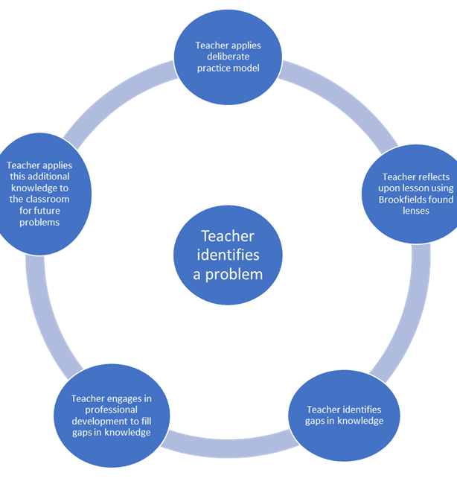
Deliberate practice supported by Brookfield’s model of reflective practice

Slide 50

Model of Developing expertise in primary teaching.
Situational knowledge
Subject knowledge
Child development
Pedagogical knowledge
Contextual knowledge
Relationship with the child

Slide 51
Further Research
An area for further research would be to take this model to a series of schools and apply it for a period of time, possibly one academic year, and measure the impact that this model has had upon the teachers perceived level of expertise. This research project would be most beneficial if it focused on a specific aspect of expertise development; ECT, teachers in the first five years of their teaching career, teachers who have 5-10 years teaching experience and finally teachers with 10 years post qualification experience.

Slide 52
References

