Slide 1
UCET Conference 2024​
Enhancing EAL Provision in ITE
Navigating Current Challenges and Future Directions for Linguistic Justice
Dr Matt Dunn - Head of ITE Programmes
matthew.dunn@bishopg.ac.uk
Ami Montgomery – Deputy Head of ITE Programmes
ami.Montgomery@bishopg.ac.uk

Slide 2

Overview of today’s Objectives
Explore and discuss the current landscape,
including a review of policies, statutory frameworks, and the ITE sector's response to EAL.
Identify the key strengths & challenges for ITE providers,
discussing current practice across providers and identifying the pressure points and challenges of EAL in ITE for 2024 onward.
Create time and space for collaboration and co-creation,
engaging in discussions and activities to develop actionable strategies, and possibly start thinking about drafting a Policy Brief

Slide 3

Before be begin…a quick poll
Time to vote!
    There are 9,092,073 pupils in England.
    How many pupils are classified as using English as an Additional Language?
a) Less than half a million
b) Less than a million
c) Over 1.5 million
d) Over 2 million

Slide 4
Number of pupils identified as using EAL
c)
1,770,160 (20.8%)
(1,715,912 (20.2%) in 2022/23)
More than 1 in 5 of all pupils
Source: School Census, January 2024

Slide 5

Number of pupils identified as using EAL
c) 1,770,160 (20.8%)
2024
2023
Over 1 in 5 pupils
20.8%
20.2%
Source: School Census, January 2024

Slide 6
Number of pupils using EAL in detail
      11,264 in state-funded nurseries (30.7%)
      1,050,199 in state-funded primary schools (22.8%)​
      684,422 in state-funded secondary schools (18.6%)​
      22,605 in state-funded special schools (14.5%)
      1,231 in Alternative Provision (7.8%)
      Source: School Census, January 2024

Slide 7
Number of pupils with EAL in detail
Source: School Census, January 2023
Nursery
30.7%
Primary
Secondary
22.8%
18.6%
Special schools
14.5%
Alternative
7.8%

Slide 8
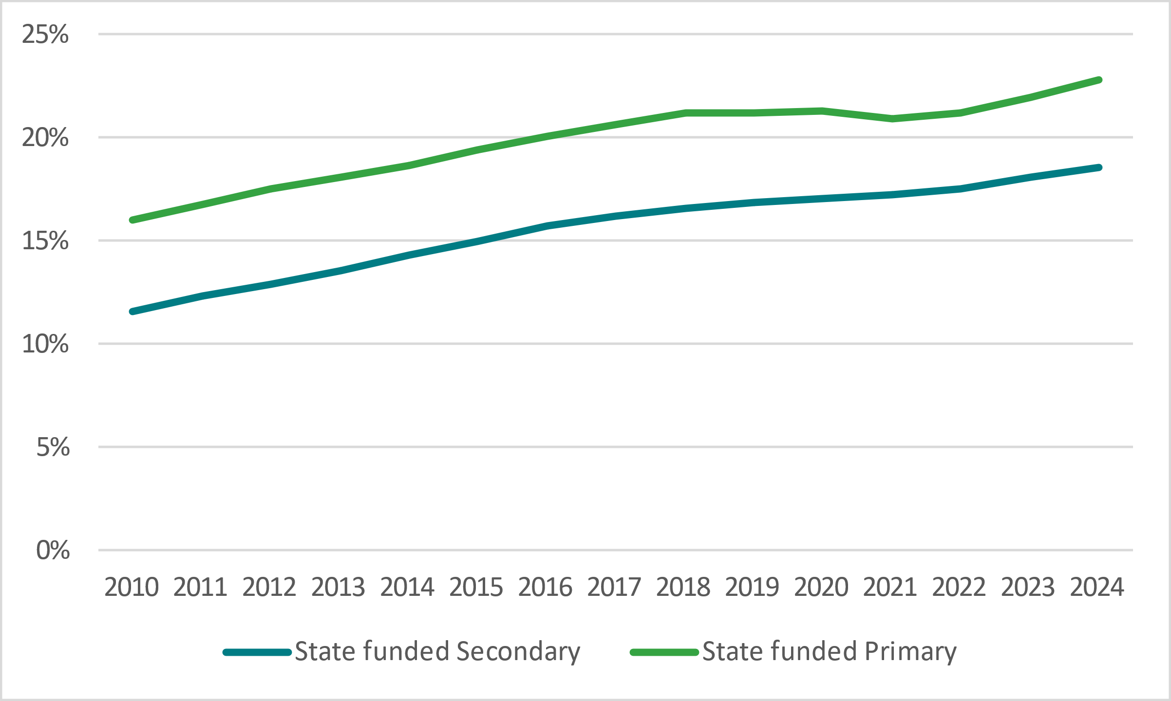
Number of learners using EAL
Learners using EAL will continue to make up a significant proportion of the student population.

Slide 9

Setting the Scene
Policies & Frameworks
Presentation on the current landscape of EAL in ITE polices & frameworks in the UK
Northern Ireland (DoE NI)
Wales (DfES)
Scotland (Education Scotland)
England (DfE)

Slide 10
Setting the Scene cont…
Policies & Frameworks
Northern Ireland (DoE NI)
Code of Values and Professional Practice (GTCNI, 2018) – three explicit references
  Professional Knowledge and Understanding:
    Acknowledgement of Irish medium and other bilingual contexts,
    K&U of the need to take account of the significant features of pupils’ cultures, languages and faiths.
  Teaching and Learning:
    employ strategies that motivate and meet the needs of all pupils…those not learning in their first language
Wales (DfES)
Professional Standards for Teaching and Leadership (DfES, 2019) – no explicit reference
Scotland (Education Scotland)
The Standard for Provisional Registration (GTCS, 2021) – no explicit reference
The Standard for Full Registration (GTCS, 2021) – no explicit reference
England (DfE)
Core Content Framework (DfE 2019) – no explicit reference
ITTECF (DfE 2024) – one explicit reference;
  High Expectations: - Pupils’ experiences of school and their readiness to learn can be impacted by their home life and circumstances, particularly for EAL pupils, young carers, and those living in poverty.
Teachers’ Standards (DfE 2021) – one explicit reference:
  Adapt Teaching - clear understanding of the needs of all pupils…those with EAL…be able to use and evaluate distinctive teaching approaches to engage and support them

Slide 11





“We Need to Talk” report by the Oracy Education Commission
Definition and Dimensions of Oracy
Oracy Throughout Education
Opportunities Beyond the Classroom
Implementation
Considerations, specifically for EAL
  importance of oracy in supporting learners with EAL.
  effective oracy education can help to develop language skills more rapidly and integrate better into the classroom environment.
  calls for tailored strategies, ensuring equal opportunities to develop their speaking and listening skills.

Slide 12

Mixed Blessings

Slide 13

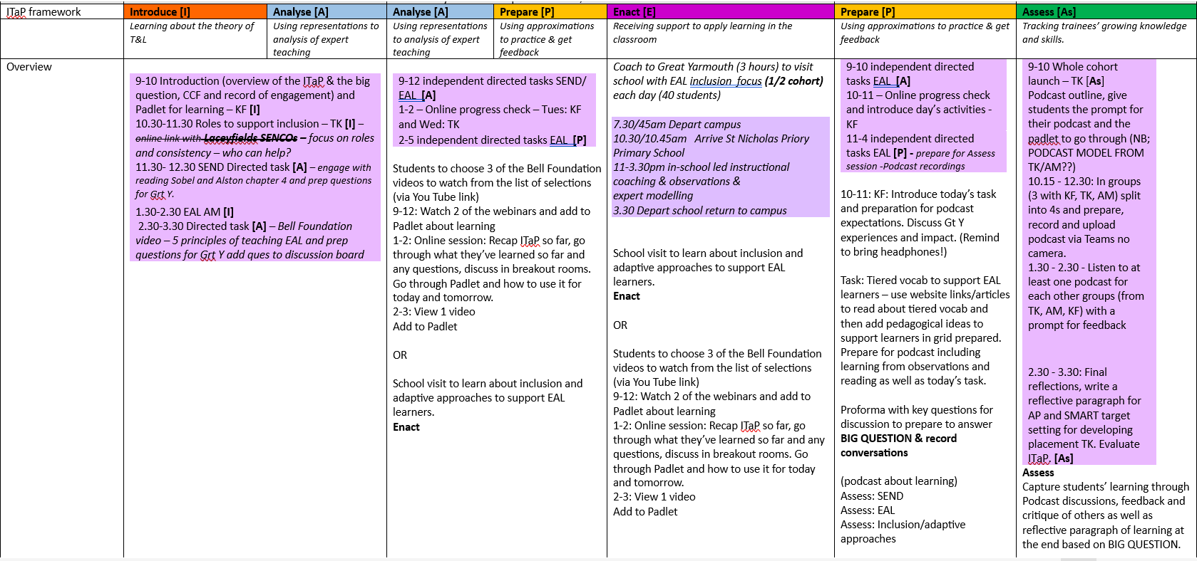
Further opportunities for 24/25
Intensive Training and Practice (ITaPs)
Big question: How do teachers adapt their teaching so that all learners are able to make progress?
Big question: How do teachers adapt their teaching so that all learners are able to make progress?

Slide 14

Linguistic Justice - Impact & Possibilities
Inclusive Attitudes in Practice Survey
Key Findings
Top-Rated Practices
Visual aids & multimodal resources - avg. rating 4.2
Collaborative learning & peer support - avg. rating 4.0
Differentiated instruction - avg. rating 3.8
Action Points
Increase use of visual aids - develop a shared repository.
Enhance peer support programmes - structure consistent interactions.
Focus on continued professional development - targeted EAL strategy training.

Slide 15
Transitioning from CCF to ITTECF
Core Content Framework - Initial Teacher Training & Early Career Framework
'Learn that...' and 'Learn how to...' statements.
Standard 5: Adapt teaching
Adaptive Teaching
Learn that adapting teaching to meet the needs of all pupils, including those with EAL, is essential for promoting progress and engagement.
Learn that using a variety of teaching strategies can help address the diverse needs of EAL pupils.
Learn how to differentiate instruction to support the language development of EAL pupils, including the use of visual aids, scaffolding, and peer support.
Learn how to implement strategies that promote language acquisition, such as structured talk, collaborative learning, and explicit vocabulary instruction.
Standard 1: Set high expectations
Inclusion and Diversity
Learn that effective teaching involves setting high expectations for all pupils, including those with EAL, and ensuring that every pupil is given the opportunity to succeed.
Learn that understanding the cultural backgrounds and linguistic needs of EAL pupils is crucial for creating an inclusive learning environment.
Learn how to create a classroom environment that values and respects cultural diversity, and promotes the inclusion of EAL pupils.

Slide 16

Initial Teacher Training &
Early Career Framework (ITTECF)
'Learn that...' and 'Learn how to...' statements.
Standard 6:
Make accurate and productive use of assessment
Inclusion and Diversity
Learn how to use assessment data to identify the specific needs of EAL pupils and plan targeted interventions.
Any Others?

Slide 17

Time to Collaborate
Developing Strategies Together

Slide 18

Current Challenges in EAL Provision
What’s going well & where are the pressure points?
1. How does your ITE provider currently support trainee teachers in developing their knowledge and understanding of teaching children with EAL?
2. What is successful with your current practices/approaches?
3. What are the challenges currently being faced when developing trainee teachers’ knowledge and understanding of EAL-specific knowledge and understanding?
Notes:
https://miro.com/welcomeonboard/bGUxRUJnTW9PUnVxTDJNVFhZZmhnN05ETE9QVElrVVZzcFk0a0Z5eE8xd1kyeXlDTXg4VDd4UWtBV0Z2OGlGTnwzNDU4NzY0NTg3ODU0MTI0Mzk5fDI=?share_link_id=795364339192

Slide 19

The Journey Ahead…
Disrupting the Narrative & Opportunities for Further Collaboration

Slide 20
References
Beauchamp, G., , Clarke, L., Hulme, M. and Murray, J. (2015) ‘Teacher education in the United Kingdom post devolution: convergences and divergences.’ Oxford Review of Education. 41 (2), pp. 154-170.
DfE (2019) ITT Core Content Framework Available from: https://assets.publishing.service.gov.uk/media/6061eb9cd3bf7f5cde260984/ITT_core_content_fram ework_.pdf
DfE (2021) Teachers’ Standards Guidance for school leaders, school staff and governing bodies Available from: https://assets.publishing.service.gov.uk/media/61b73d6c8fa8f50384489c9a/Teachers__Standards_ Dec_2021.pdf
DfE (2024) Initial Teacher Training and Early Career Framework Available from: https://assets.publishing.service.gov.uk/media/661d24ac08c3be25cfbd3e61/Initial_Teacher_Training_ and_Early_Career_Framework.pdf
DfES (2019) Professional standards for teaching and leadership Available from: https://hwb.gov.wales/api/storage/19bc948b-8a3f-41e0-944a-7bf2cadf7d18/professionalstandards-for-teaching-and-leadership-interactive-pdf-for-pc.pdf
GTCNI (2018) Code of Values and Professional Practice Available from: https://www.gtcni.org.uk/professional-space/professional-competence/code-of-values
GTCS (2021) The Standard for Provisional Registration Available at: https://www.gtcs.org.uk/documents/the-standard-for-provisional-registration
GTCS (2021) The Standard for Full Registration Available at: https://www.gtcs.org.uk/documents/the-standard-for-full-registration

Slide 21

Thank you
Enhancing EAL provision in ITE…
crucial for promoting linguistic justice and ensuring equitable access to education
Any Questions?

