Slide 1
Forget ‘fidelity’ – getting co-creative and contextual with coaching
Rachel Lofthouse and Pinky Jain (Leeds Beckett University)
Amanda Nuttall (Leeds Trinity University)
Tom Shaw (Carr Manor School)
Leeds Learning Alliance
CollectivED

Slide 2
Our focus on coaching
Coaching in education is an inter-personal and sustained dialogue-based practice. The coach works with a coachee to facilitate self-reflection, decision making and action in the context of their own personal and professional challenges. (Lofthouse et al, 2022, p157)

Slide 3
Forget fidelity?
Challenging the rhetoric
Contextual coaching and collaborative professionalism
Dilemma based coaching case study
Introduction
Explanation
Listen in
Finding hope through coaching
Get co-creative
What’s occurring?
Discussion activity

Slide 4
Forget fidelity?
Challenging the rhetoric
Contextual coaching and collaborative professionalism
Dilemma based coaching case study
Introduction
Explanation
Listen in
Finding hope through coaching
Get co-creative
What’s occurring?
Discussion activity

Slide 5
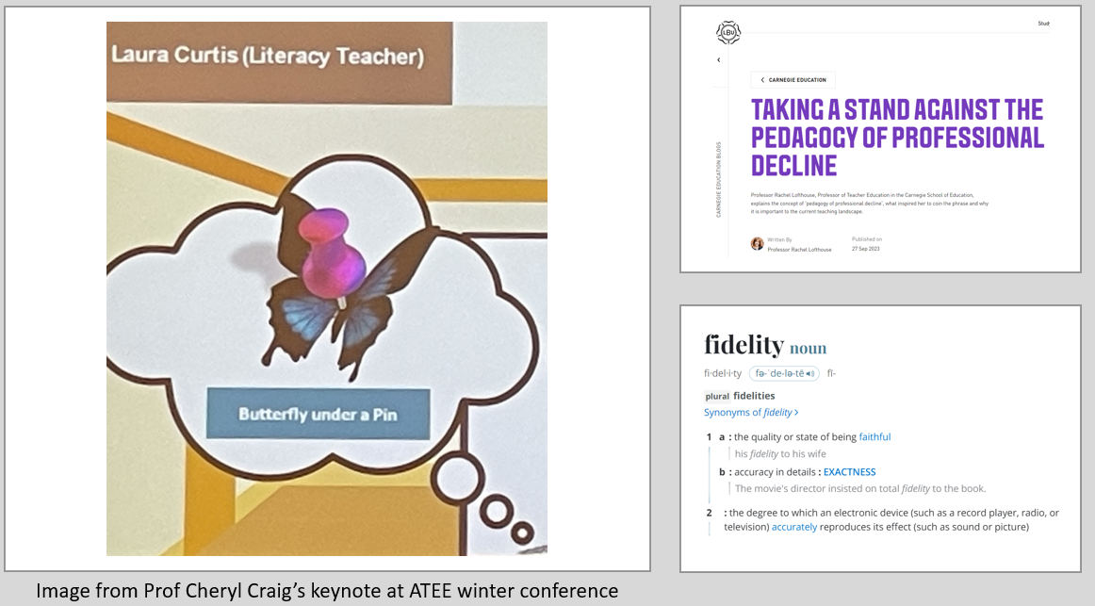

Slide 6
Forget fidelity?
Challenging the rhetoric
Contextual coaching and collaborative professionalism
Dilemma based coaching case study
Introduction
Explanation
Listen in
Finding hope through coaching
Get co-creative
What’s occurring?
Discussion activity

Slide 7
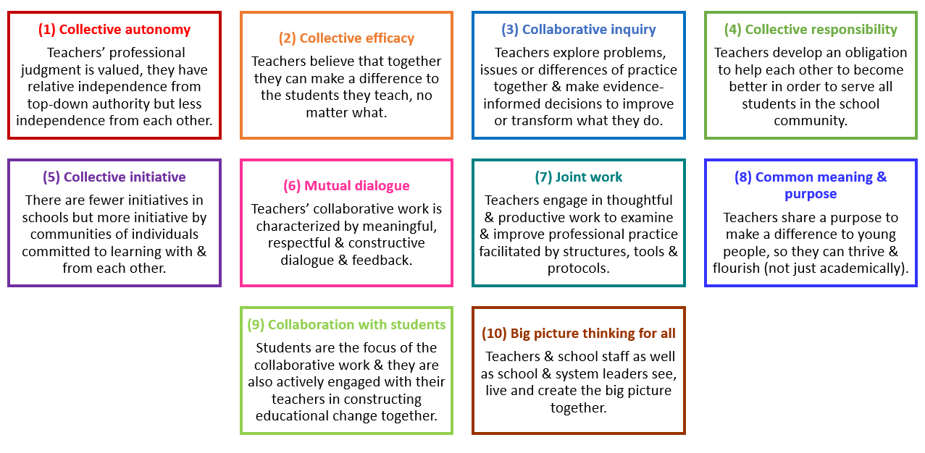
What’s occurring?
Choose either
mentoring (ITTE or ECF)
OR
your work as teacher educators
What’s occurring?
How common are the characteristics 1-10?
Which characteristics could be changed to the greatest positive effect?

Slide 8
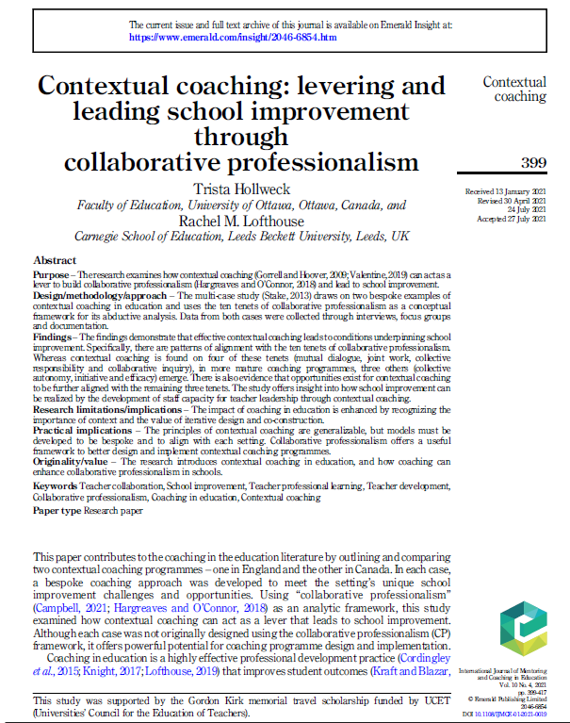

Slide 9
Ten tenets of Collaborative Professionalism: 2 case studies of contextual coaching

Slide 10
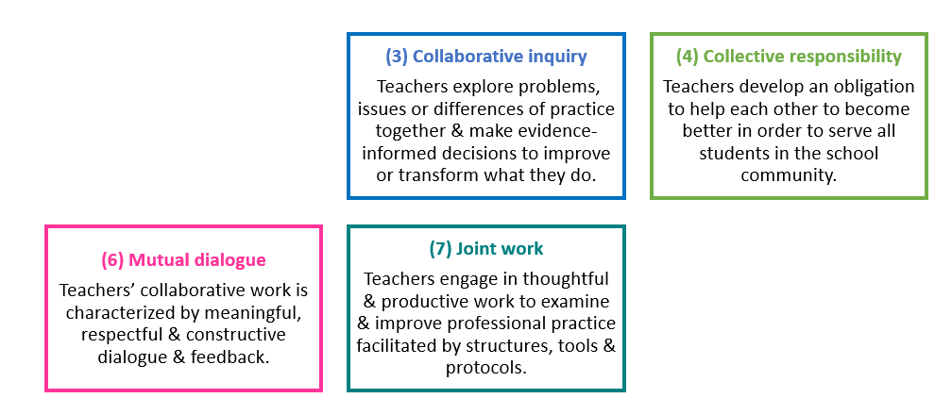
Foundations of contextual coaching

Slide 11
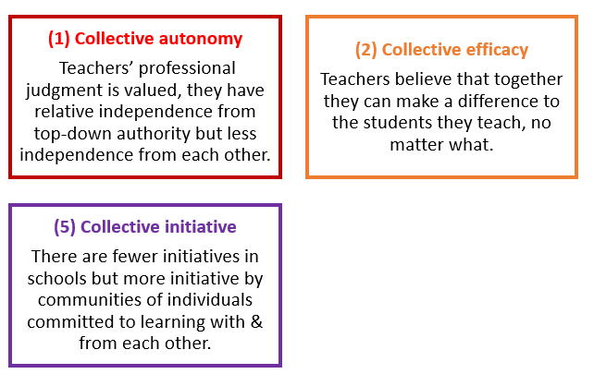
Strengthened through contextual coaching

Slide 12
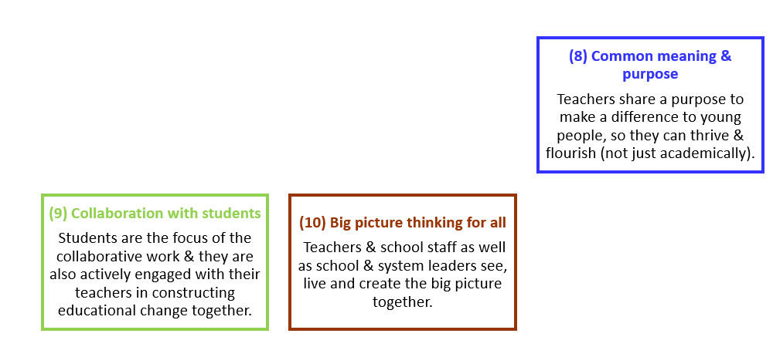
Sometimes emerging through contextual coaching: potential for development

Slide 13
(1) What came before the model of CP existed?
(2) What other kinds of collaboration exist betwixt or alongside the model in question in the school and in the distinctive culture of the whole society?
(3) What support does the system provide beside the specific collaborative design in government grants, in official allocations of time for collaboration or in wider professional networks?
(4) What connections does any specific design have to collaborative ideas and actions beyond the school, in overseas schools, in international research and in online interaction or elsewhere?
The 4 Bs of collaborative professionalism: before, betwixt, between and beyond
Contextual and cultural factors for effective implementation of collaborative designs, leading to school or system improvement

Slide 15
Forget fidelity?
Challenging the rhetoric
Contextual coaching and collaborative professionalism
Dilemma based coaching case study
Introduction
Explanation
Listen in
Finding hope through coaching
Get co-creative
What’s occurring?
Discussion activity

Slide 16
Working model of dilemma based coaching: listen in to a thinking round

Slide 17
Forget fidelity?
Challenging the rhetoric
Contextual coaching and collaborative professionalism
Dilemma based coaching case study
Introduction
Explanation
Listen in
Finding hope through coaching
Get co-creative
What’s occurring?
Discussion activity

Slide 18
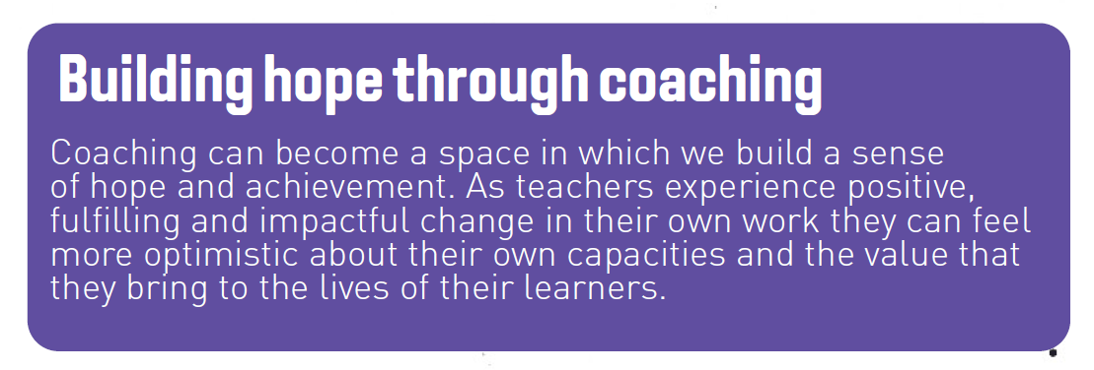
We developed, adapted and reviewed Dilemma-based coaching:
the context was professional communities focusing on inclusion in education
Thinking about the potential of coaching (not the fidelity of a specific approach)
what contexts could you develop it in, and for what purposes?
who might you co-create it with?
what would be the challenges?
what would you hope it could achieve?

Slide 19
CollectivED The Centre for Coaching, Mentoring, Supervision and Professional Learning in Education Leeds Beckett University, UK
Where collaborative conversations create powerful professional learning
Building local, national and global networks and expertise
Valuing and integrating research and practice
Creating a community and a knowledge base
Offering qualifications, professional development and school awards
Always curious, always questioning, always listening
https://www.leedsbeckett.ac.uk/research/collectived/
@CollectivED1

