Slide 1
Artful Improvisation and the Expert Teacher
Nick sorensen
Emeritus professor of education
Bath spa university, uk
UCET Annual conference
15 november 2023

Slide 2
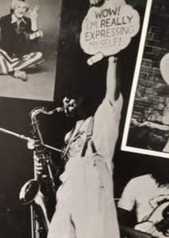
Wow! I’m really expressing myself!

Slide 3
Roisin’s story
I used to plan everything, down to the last minute, and I went into a class one day and, I don’t know what it was exactly but the whole group was not in the mood for learning so I just stood up and I literally picked up my printed lesson plan and walked to the bin, dropped it in it and said “so what are we going to talk about today?” That one little thing scared the life out of me as I realised I would be winging it but I also had trust in myself … and it was a brilliant session and they actually ended up learning quite a lot because we just pulled out from what they talked about various bits that I hoped they would learn anyway. It was quite a powerful experience from my perspective and the students.

Slide 4
Improvisation: a working definition
Improvisation:
is a mode of intentional creative behaviour that can be present in all aspects of life
taking place within “real time” involving spontaneity, intuition and interaction
is unpredictable and each improvisation is unique.
is the consequence of the dynamic interplay between stability and change.
emerges from the dynamic interplay between ‘fixed’ and ‘emergent’ structures
can be artless or artful

Slide 5
Three perspectives
The Improvising Teacher
Educational
Improvisational
Professional

Slide 6
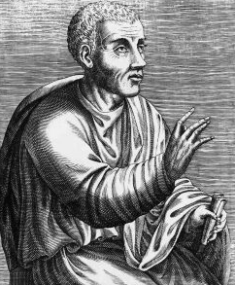
Professional: Quintilian
“… the crown of all our study and the highest reward of our long labours is the power of improvisation.”
Artless improvisers rely solely on their ingenuity, they may have a natural talent for oral performance but they do not spend time on their studies, they don’t make scripts or plan a structure for their scripts.
The artful improviser, however, will be skilled in the subject they are speaking about in addition to having a natural talent and being educated in the art of speaking.

Slide 7
The artful improviser
Knowledgeable in their subject and of the linguistic means that they could use.
The acquisition of a repertoire (copia).
Preparation is all-important; having the ability to speak freely, with or without notes, and that a lack of general preparation will inhibit the ability to improvise.
Improvisation is required to respond to:
  mishaps; when examining a witness in a trail, when it is impossible to foresee how the witness will answer;
  happy incidents, moments within a prepared speech when the speaker suddenly gets new insights.

Slide 8
Improvisational: disposition and skills
Noticing
Dialogue
Connecting
Adapting
Permission to improvise
Personalisation
Adaptation IN and ON action

Slide 9
Improvisational skills
So what does this story tell us? First of all it tells us that the teacher noticed that the class were not in the mood to respond to the lesson that had been planned “I don’t know what it was exactly but the whole group was not in the mood for learning”.
The teacher then responded to what they had noticed. When she placed the prepared lesson plan in the wastepaper bin she clearly demonstrated to the class that this was going to be a different kind of lesson to the one they were expecting, she was adapting to the given circumstances and demonstrating this to the class.
Asking the question “so what are we going to talk about today?” opened up a dialogue with the students.
The teacher knew she was taking a risk. “That one little thing scared the life out of me as I realised I would be winging it”. However she realised that she “also had trust in myself”, a trust that was based on her experience and expertise as a teacher.
This trust enabled her to give herself permission to improvise. So, as a consequence of taking this risk “it was a brilliant session and they actually ended up learning quite a lot because we just pulled out from what they talked about various bits that I hoped they would learn anyway”.
The teacher was able to make connections between what the students talked about and what she wanted them to learn anyway.

Slide 10
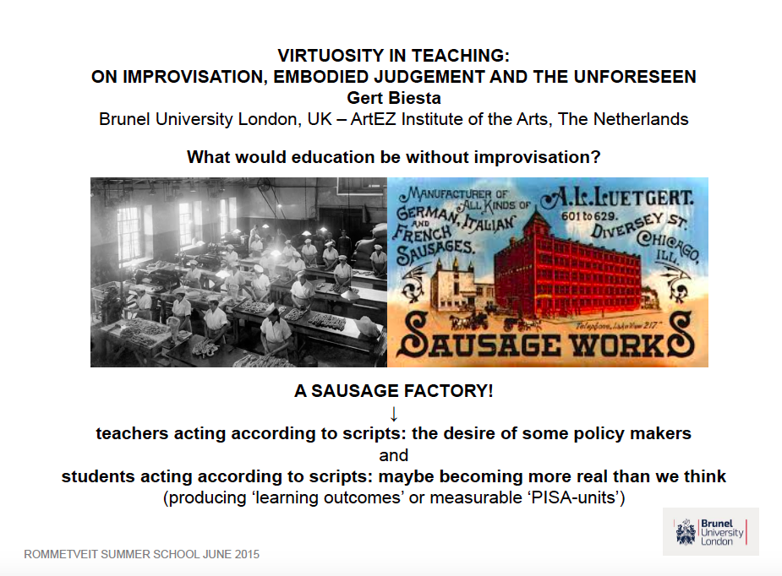
Educational: Gert Biesta

Slide 11
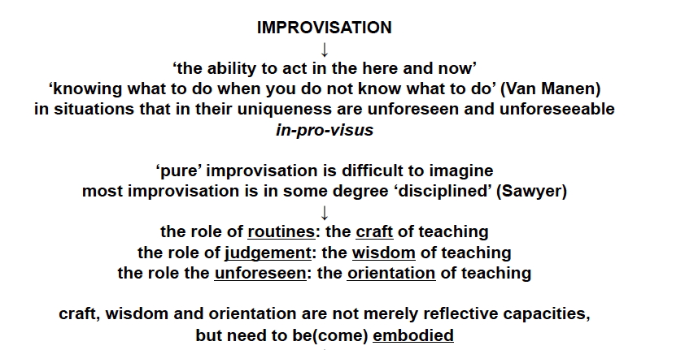
Biesta (2015): view of improvisation

Slide 12
Biesta (2015) – some conclusions
Teaching necessarily requires improvisation
(a social / relational activity)
Educational improvisation: the capacity for embodied judgment
  About the how (craft)
  About the what for (wisdom)
What ‘disciplines’ improvisation in teaching is orientation on the purpose of education
Orientating one’s action towards the unforeseen
(See also Biesta, G. (2015) The Beautiful Risk of Education; chapter 7 ‘Virtuosity’. London: Paradigm)

Slide 13
The formation of The Improvising Teacher
Promote artful improvisation
Foreground the necessity of having a disposition to improvise
Develop the four improvisational skills
Attend to developing the whole professional: holistic
  What is educationally desirable?
Constant practicing of educational judgment
(from Day 1): embodied
Study the virtuosity of others (or absence of it)
  Master classes, interviews with retired teachers, literature, film

Slide 14
6 takeaways for UCET
Concept of The Improvising Teacher supports UCET’s vision for high quality teacher education
Acknowledges the unique contexts in which high quality teaching takes place
Empowers professionalism and agency of teachers
Supports the development of healthy learning environments
Promotes teaching (and teacher education) as a collective, co-constructed endeavour
Contributes to the development of competent, confident and ethical professionals.

Slide 15
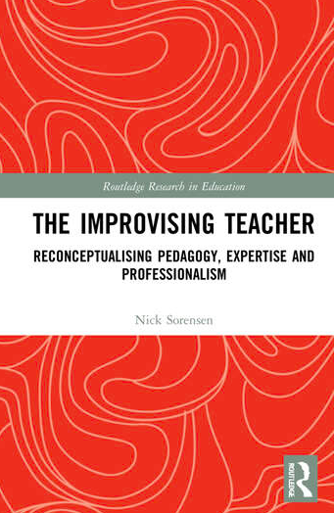
https://nicksorensen.org
Sorensen, N. (2023)
The Improvising Teacher: Reconceptualising Pedagogy, Expertise and Professionalism.
London: Routledge.

