Slide 1
Resisting the culture wars in ITE
UCET Equalities Sub-Group Keynote

Slide 2
Presenters
Sarah Brownsword - University of East Anglia
Jo Byrd - University of Derby
Balbir Kaur – University of Nottingham
Lyndsay Muir – Bishop Grosseteste University
Vini Lander – Leeds Beckett University
Thanks to Liz Chamberlain, Open University & Pinky Jain, Leeds Beckett University

Slide 3
Jam Board Codes
https://shorturl.at/iqsPW
https://shorturl.at/htIX0

Slide 4
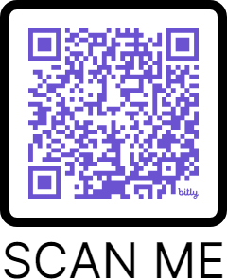
Anti-racism Framework for ITE/T

