Slide 1
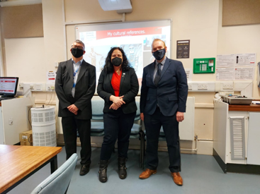
Transforming teacher education - introducing ITE students to Epistemic Insight: a workshop
Adrian Warhurst (University of Leicester)
Rob Campbell (St Mary’s University Twickenham)
Agnieszka J. Gordon (Canterbury Christchurch University)

Slide 2
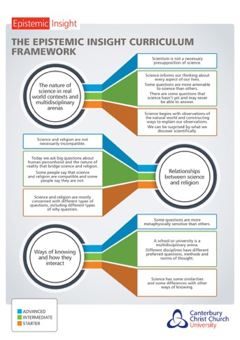
The Epistemic Insight Initiative at CCCU is a £1.5 million research and curriculum innovation project that combines research-engaged teaching with a national research project in schools and in a consortium of participating HE institutions. The initiative proposes an educational framework for schools and teacher education with curriculum objectives and teaching strategies designed to detect and address gaps caused by entrenched compartmentalisation Available here https://bit.ly/3udAtsY
EI activities: CC
UCET CONFERENCE 2022

Slide 3
EI activities: CC
Consortium Partners
Epistemic Insight Consortium Lead: Dr Aga Gordon; Epistemic Insight Initiative PI: Professor Berry Billingsley

Slide 4
EI activities: CC
Activities across the consortium
Embedding EI in ITE curricula – transformational teaching and learning
Collaboration across the consortium
Co-creation of teaching resources and research instruments
Student involvement in co-creation of research via epistemic insight sessions
Research across the consortium for evidence-based teaching
Bespoke sessions depending on tutor experience and student needs

Slide 5
EI activities: CC
What is epistemic insight?
Intellectual virtue –teachable & assessable
Knowledge about knowledge – particularly methods and norms of thought within disciplines and interactions between disciplines
Pedagogical approach
Moving beyond discipline content through recognising the distinctiveness of and interaction between the disciplines

Slide 6
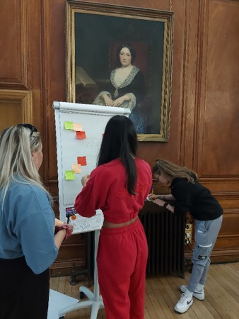
EI activities: CC
Why epistemic insight?
Develops critical thinking, curiosity and thirst for knowledge
Builds students’ capacities for connecting knowledge across disciplines
Enriches answers to Big Questions and global issues

Slide 7
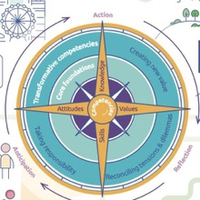
EI activities: CC
Affinity of EI with Ofsted, OECD, UNESCO
Call for more holistic view of curriculum (Ofsted)
OECD - future ready students need ‘working knowledge how disciplines can work together to address real-world problems’ and ‘capacity to think across boundaries of disciplines’
OECD Learning Compass 2030 – calls for students’ agency
UNESCO – a need to address global challenges in a holistic way

Slide 8
How is EI distinctive from existent pedagogical approaches?

Slide 9
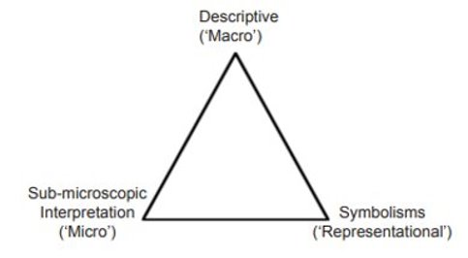
multiliteracies
The New London Group (1996) ‘A Pedagogy of Multiliteracies: Designing Social Futures’, Harvard Educational Review, 66(1), pp. 60–93. doi.org/10.17763/haer.66.1.17370n67v22j160u.
Taber, K. S. (2013). Revisiting the chemistry triplet: drawing upon the nature of chemical knowledge and the psychology of learning to inform chemistry education. Chemistry Education Research and Practice, 14(2), 156-168. doi: 10.1039/C3RP00012E

Slide 10
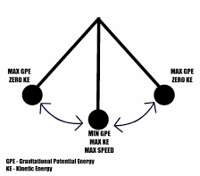
A dichotomous position?
Didactic Pedagogy
Authentic Pedagogy
Cope, B. and Kalantzis (2015) "The things you do to know: An introduction to the pedagogy of multiliteracies inCope, B. and Kalantzis, M. eds., A pedagogy of multiliteracies: Learning by design. Palgrave Macmillan New York pp. 1-36.

Slide 11
metacognition
Image taken from https://www.thescientificteen.org/post/metacognition-thinking-about-thinking
Reference Gauthier, L., 2014. How learning works: 7 research-based principles for smart teaching. Journal of the Scholarship of Teaching and Learning, pp.126-129.

Slide 12
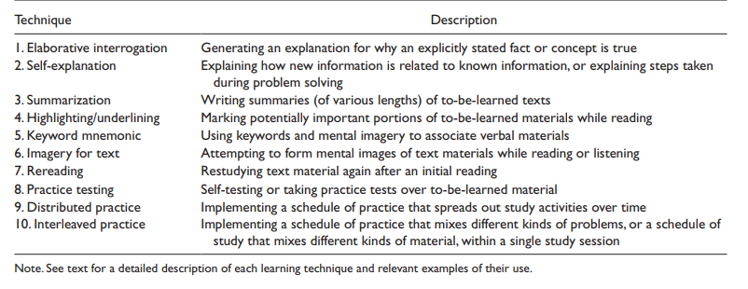
Exemplar metacognitive strategies
Donker, A. S., de Boer, H., Kostons, D., Dignath van Ewijk, C. C., & van der Werf, M. P. C. (2014) Effectiveness of learning strategy instruction on academic performance: A meta-analysis. Educational Research Review, 11, 1–26. https://doi.org/10.1016/j.edurev.2013.11.002. (Table taken from p6)

Slide 13
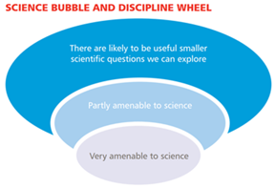
Setting a justification for Epistemic Insight
Epistemic
Insight
Metacognition
Ways of thinking/ Norms of thought
Questions
Methods

Slide 14
Self regulation of learning
Zimmerman gives a helpful description of what a successful self-regulated learner looks like:
‘These learners are proactive in their efforts to learn because they are aware of their strengths and limitations and because they are guided by personally set goals and task-related strategies, such as using an arithmetic addition strategy to check the accuracy of solutions to subtraction problems. These learners monitor their behaviour in terms of their goals and self-reflect on their increasing effectiveness. This enhances their self-satisfaction and motivation to continue to improve their methods of learning.’
Zimmerman, B. J. (2010) ‘Becoming a Self-Regulated Learner: An Overview’, Theory into Practice, 41 (2)
Connection to EI

Slide 15
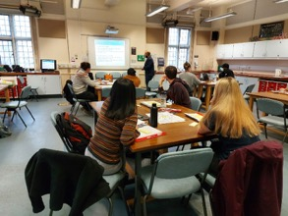
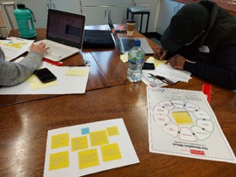
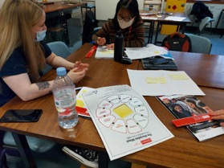
Introducing EI at University of Leicester
PGCE Science and RE students
One day event
Introduction
Workshops
Saviour siblings
Is a robot alive
Video responses
The voice of students as captured on the day

Slide 16
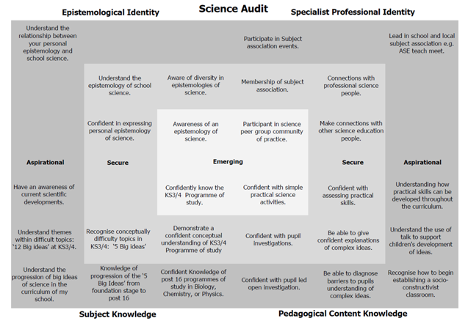
Student Responses
Captured from the videos
Defining Epistemic Insight
Using the tools – the need for expert input
Agency
Looking Ahead
Reimagining the Audit
Epistemic identity
Science Curriculum
Integrating Epistemic Insight
Teacher Agency

Slide 17
Richard III project
10 years since the discovery under a Leicester car park
Multi disciplinary team
Co production with PGCE students (Science, RE, History, Social Science)
Expert input from the discovery team
Using exiting resources
Working with The King Richard III visitor centre
Why using EI is important

Slide 18
Examples from St Mary's
How is your discipline distinctive?
Saviour siblings
What does it mean to be alive?
Why did the titanic sink?
How do you cure the loneliness pandemic?
How do we create a sustainable future?
AI case studies of exams during Covid and driverless cars.

Slide 19
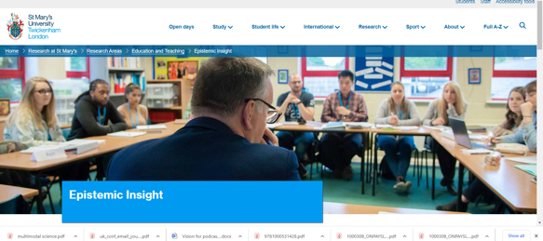
Impact at St Mary's

Slide 20
EI activities: CC
Session at the University of Birmingham
University of Birmingham– co-created and co-delivered a series of workshops with colleagues at UoB to a group of secondary PGCE, specialisms included – history, geography, physics, chemistry, biology and RE
Sessions:
What is Epistemic Insight (EI), tools and strategies
Interactive sessions exploring Big questions – What is a footprint? How is tea made? and Why did Titanic sink?
Sustainability workshop – exploring marine population decline using EI tools

Slide 21
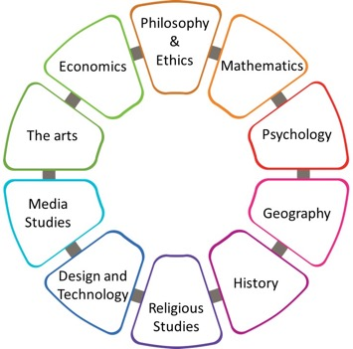
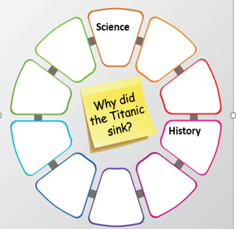
EI activities: CC
Resources and pedagogies used
How does overfishing affect marine population?
Mind-mapping
Group discussions
Expert committee exploration
Knowledge exchange across disciplinary specialisms

Slide 22
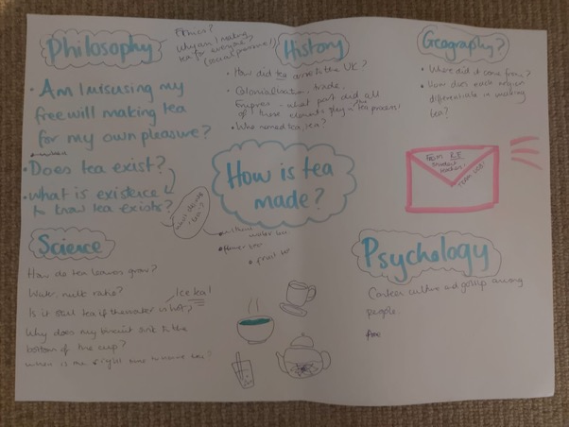
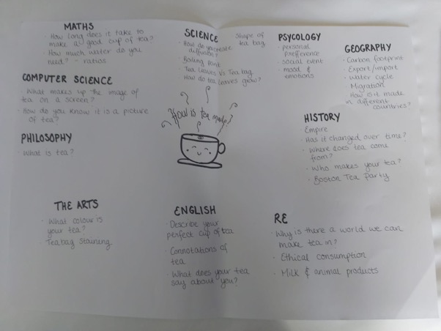
EI activities: CC
Example of students’ work – University of Birmingham

Slide 23
EI activities: CC
Student voice
Has learning about epistemic insight changed your understanding of teaching - if so, how?
It has allowed me to think about practical ways may I can work with other discipline
Developing a broad insight between subjects and helping students to think critically.
interdisciplinary education is important.
yes - I would love to include this in my lessons particularly lower ability closes to get them engaged.
yes it has helped me see how there are cross curricular links we can embed in lessons.
Thinking about Big Questions generating curiosity and talking to departments in school.

Slide 24
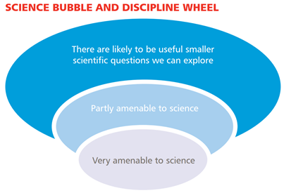
Introducing the Discipline wheel and bubble tools

Slide 25
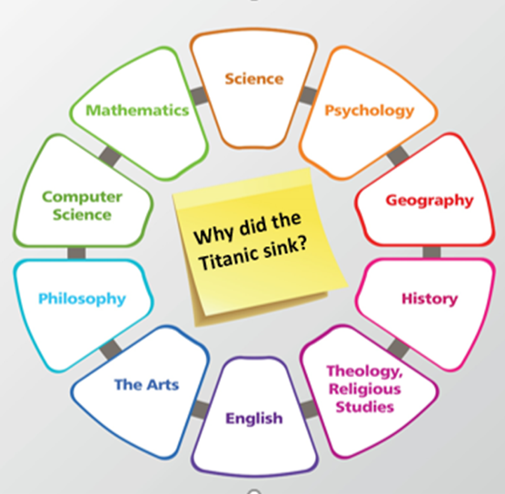
Introducing the Discipline wheel and bubble tools
Big Question

Slide 26
The take home message

Slide 27
Exemplar questions to explore
Can a Robot Dance?
How do I know you have a toothache?​
How do you know that I am in love?​
How do you know the sun will rise tomorrow?​
How is the SARS-CoV-2 virus transmitted?​
Should we ban cattle farming to reduce climate change?​
Should Freedom day have happened on 19th July 2021?​
How do we know global warming is causing climate change?
How can I be confident the sun will rise tomorrow?

