Slide 1
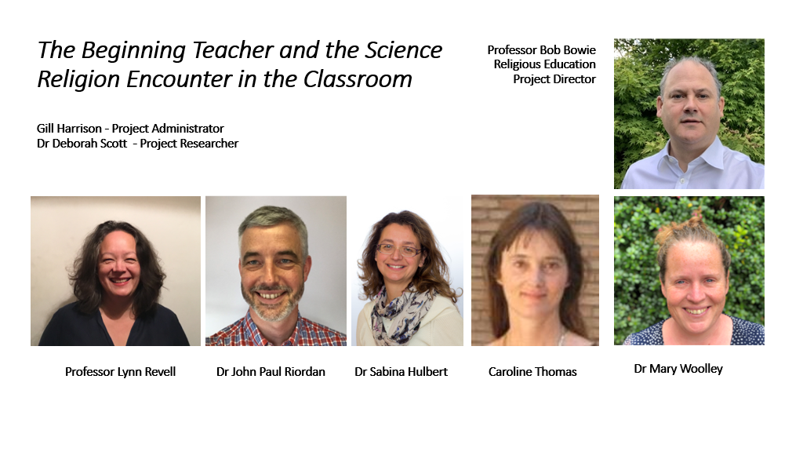
The need to promote dialogue between curriculum subjects and why
that can be meaningful in ITE UCET 2022 Dr Mary Woolley @marywoolley mary.woolley@canterbury.ac.uk Professor Bob Bowie @bobbowie bob.bowie@Canterbury.ac.uk nicer.org.uk/science-religion-encounters

Slide 2
'Mea culpa, mea culpa, mea maxima culpa'
Reframing our work as an evidence led approach to teacher development
Researching the experiences of beginning teachers with some tricky territories
What we found out about, was more than that we set out to find – multi layered, complex
Albeit we profess an ambition to 'impact policy' and influence leaders' is this more about understanding and enabling teacher agency and teacher dialogue?

Slide 4
https://vimeo.com/752016858/b6bba559c5

Slide 5
Research questions
1. How do teachers perceive and engage their students with knowledge about how science and religion can relate to one another, in the context of science lessons and RE lessons? [sub-project 1]​
2. How can we understand the extent and nature of the experience of beginning teachers as to how knowledge works in ‘science/religion encounters’ in the classroom and how this impacts their confidence and competence? [sub-project 2]​
3. How can changes in teacher education programs develop more confident and rich outcomes around how knowledge works in science/religion encounters in the classroom? [sub-project 3]​

Slide 6
The Beginner Teacher in the Science Religion Encounter: Methodology
Scope: 6 Universities
17 Focus groups
75 students
Approximately 1 hour
Strong ethical framework (BERA, 2018; GDPR)
Thematic analysis
(Braun and Clark, 2006)
Findings used to construct an online survey for beginner teachers
Survey accessed by 949 teachers

Slide 7
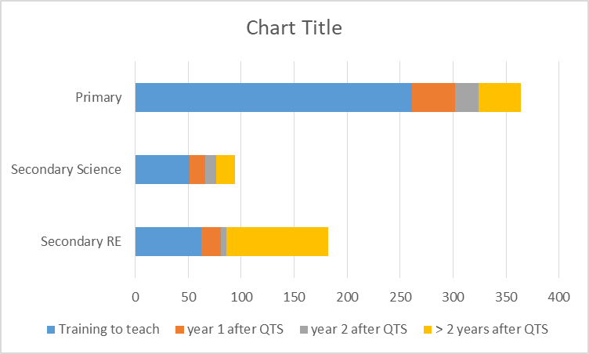
Survey participants
 | Secondary RE | Secondary science | Primary | Total
I am currently training to teach | 62 | 51 | 261 | 374
I am in my first year of teaching after QTS | 19 | 15 | 41 | 75
I am in my second year of teaching after QTS | 5 | 10 | 22 | 37
I have been qualified to teach for more than two years | 96 | 18 | 40 | 154
Total | 182 | 94 | 364 | 640

Slide 8
Purpose of RE on school curriculum
To support the personal development of students
To encourage spiritual development (psychologically, emotionally, aesthetically, culturally)
To provide values education which combats discrimination
To develop skills of questioning, critical education and tools for debate
To educate children in a particular religious/faith life
To acquire knowledge about religions and worldviews
To develop flexibility of mind

Slide 10
What SRE topics are beginning teachers teaching/ wanting to teach?
Planned encounters
Pupils raising topics in a lesson
Would like to teach topic as SRE in the future
Abortion | Philosophy of science
Animal antibodies | Stem cell research
Big Bang | Evolution
Climate Change | Experiences of Covid-19
Creation Stories | Mass vaccination
Death | Gender identity
Design argument for the existence of God | Conception of life, growth, change
Blood transfusions | Natural disasters
Designer Babies | Human impact on the environment
Euthanasia | Nutrition and diet
Care for the environment | Stem cell research

Slide 12
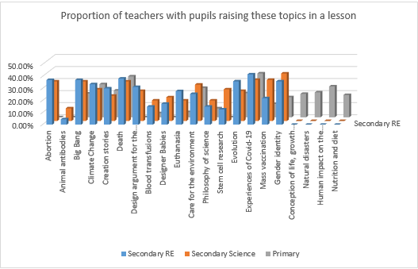

Slide 13
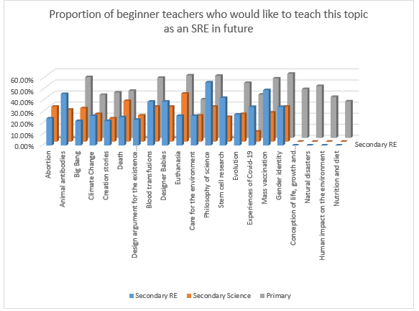

Slide 14
Barriers to teaching of SRE

Slide 15
Facilitators to the teaching of SRE

Slide 16
Confidence and anxiety in teaching SRE

Slide 17
Perceived relationship between science and RE

Slide 18
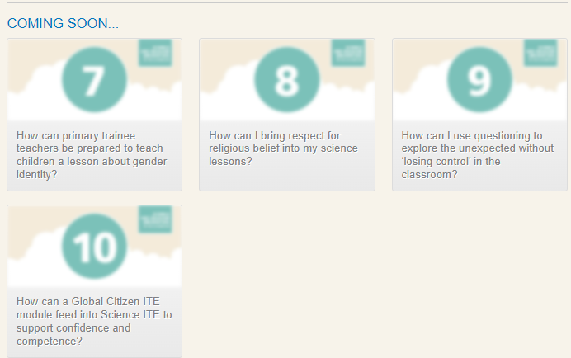
Resources built on research https://nicer.org.uk/science-religion-encounters

Slide 19
Questions for consideration
How might you use these resources on your ITE programme or with partner schools?
What opportunities do you build into your programme for teacher dialogue across subject boundaries?
How can we best prepare student teachers for challenging professional conversations around curriculum?
Where would you advise us to go next in disseminating this research/ these resources?

Slide 20
Purpose of science on school curriculum
To use practical experimentation to understand how scientific knowledge is formed
To understand that the nature of science is concerned with observation and interpretations of the natural world
To teach children the facts and knowledge needed to make sense of the natural world
To stimulate/nurture children's curiosity and capacity to raise questions
To prepare children to think logically and analytically to solve a range of problems
To enable children's understanding of the concepts, principles and laws of science
To raise children's awareness of the moral and ethical implications of the choices humans make
To appreciate the benefits and limitations of science and its application to scientific and technological developments
To equip children with the essential skills they need to succeed in school and beyond
To develop positive scientific attitudes and values, such as cooperation, respect for evidence, concern for life and preservation of the environment

Slide 21
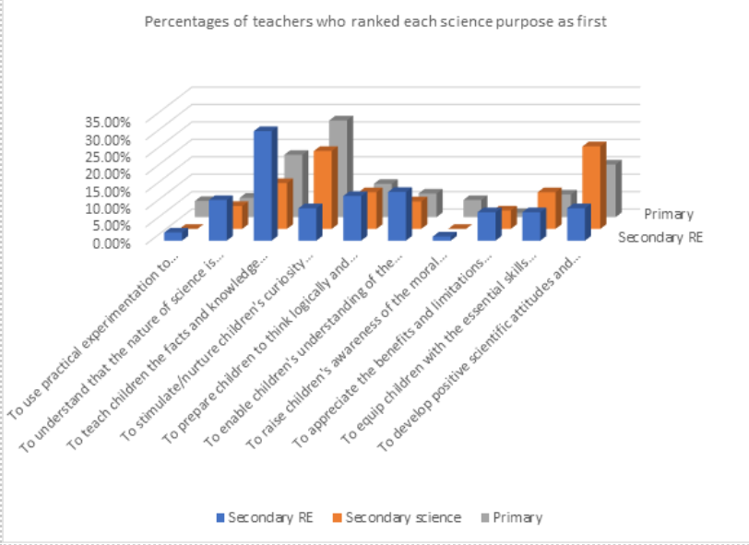

Slide 22
https://nicer.org.uk/science-religion-encounters/development-activities

