Slide 1
ESD at Bradford College
Kirstin Sawyer
Head of School Education and Professional Studies

Slide 2
Strategy
Decide its important
Develop/recruit/find the expertise
Use that expertise across programmes
Decide where/how it can be delivered
Notes:
My history –
Tourism – I used to teach a module about tourism development and so would teach about environmental impact of tourism and social/economic
So have been thinking about and teaching aspects of this for a long time
We have secondary science member of staff with degree in environmental science and 2 primary people (1 humanities and 1 science)

Slide 3
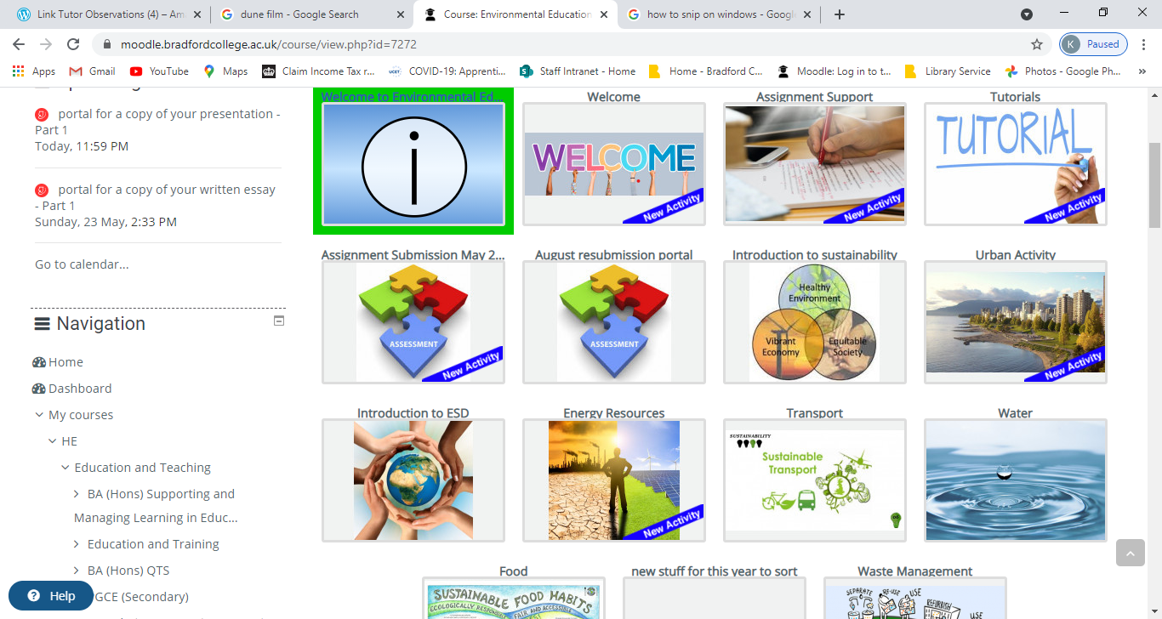
Started with undergraduate degree
Education Studies – Environmental Education module
QAA benchmarks
Module in year 2 alongside Education Outside the Classroom
Notes:
Education Studies – 10 years at least! First periodic review when started managing provision
Who the students are – very urban and widening participation – not environmentally aware – important for cultural capital as the 2 modules together provide trips to enrich student experience

Slide 4
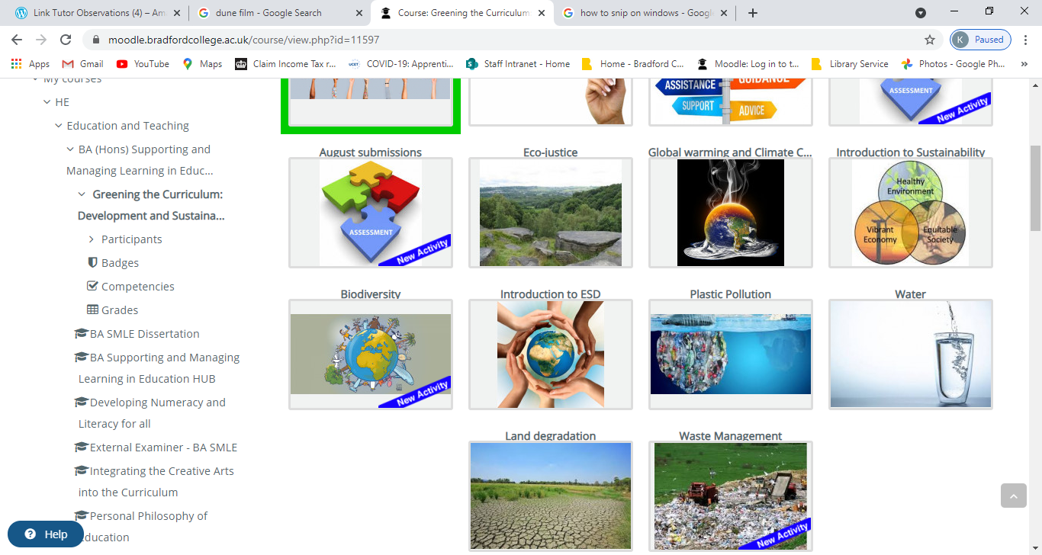
Included during periodic review in a top-up
BA (Hons) top-up Supporting and Managing Learning in Education
Greening the Curriculum: Development and sustainability
Create an education resource and write a rationale
Notes:
BASMLE – who are the students some of these are FE support staff
rearranged and made room for – proved to be inspirational for this student
Since completing her dissertation, (soon to be a graduate as her part-time course ended in Jan 2021), this email demonstrates this practitioner has continued to integrate ESD into her practice and the daily running of the EYFS setting in which she works. It is from the first student who focused their dissertation on ESD.
At work we are still recycling and reusing in nursery as before, we have just got some panels from another setting which is a supermarket at the moment (more chances for reusing) to fit in with this terms story Supertato which is set in a supermarket. However, I will suggest the recycling centre when we change it.

Slide 5
Positive student feedback
The module was really interesting. I thought the module would be about how to teach in an environmentally friendly way, so the module was nothing like I expected, but that isn’t a bad thing!!
Course content exceeded expectations
It’s been my favourite module by a long shot
The Moodle page was good, and so far the only one I’ve actually engaged with, as opposed to just submitting assignments through it.
The teaching methods were good. It allowed me to be able to understand implement research, explain and explore the different impacts not just environmentally, socially and economically but within us as humans and our daily lives.
I do feel that the outcomes allowed me to do a lot of research in terms of the impacts of water sustainability and how important it is and how fast it is changing.

Slide 6
Future Plans: how to include in ITT
Mapping to see how can become a theme across provision (primary, secondary and PSET)
Developing a Moodle site that different ITT programmes can link to.
Will be a ‘hub’ so trainees can find out more
Concern – how to promote engagement so share ideas/resources
Including in schemes of work for next year
PSET – include in Personal and Professional development
Initially a session but considering a placement task
Concern – how to stop it becoming yet another thing to include in lesson planning
Notes:
Example of catering lecturer during SSP talking about a wakelet for his professional cooking site – sustainable fishing, reducing food waste
Tourism – I used to teach a module about tourism development and so would teach about environmental impact of tourism and social/economic
Included in ESOL as a topic to practice language
Beauty – looking at packaging and ingredients in products
Construction – easy
Engineering – easy
Business – easy but some challenging concepts to capitalist orthodoxy!

