Slide 1
ITE in England and the CV-19 Pandemic: challenges and opportunities
UCET R&I Symposium (Virtual) 19th January 2021
Linda la Velle (Bath Spa University)
Stephen Newman (Leeds Beckett University)
with
Catherine Montgomery (University of Durham) and David Hyatt (University of Sheffield)

Slide 2
The CV-19 Snapshot
Part of a global data capture: what was the effect on ITE of the abrupt closure of schools and universities?
ITE programme leaders from four English universities interviewed: 2 post 92 (A, C) and two RG (B, D). All OfSTED ‘outstanding’ ITE providers.
Enquiry focussed on what happened to a model of research-informed professional learning when the opportunity for classroom practice is curtailed

Slide 3
Interviewees were asked:
What was the immediate effect of news of the pandemic? Was there any specific advice to higher education institutions?
How did your institution respond to the threat of the pandemic? Did it ‘virtualise’? If so, how did this take place? What platforms/processes are in place? What pedagogic issues have arisen?
What specific effect has this had on the HEI-based elements of your teacher education programme/s?
Did you have student teachers on practicum? If so, what will be the impact on the potential curtailment of the length of time they should spend in the classroom?
What do think might be the impact upon the practice/theory nexus in teacher education because of changes due to the pandemic?

Slide 4
Emergent themes
The lockdown and ‘virtualisation’
Adaptation of provision
Teaching Practice curtailment

Slide 5
The lockdown and ‘virtualisation’
Immediate ‘panic’ and ‘anxiety’, but leadership in all universities quick to reassure staff and students:
The VC’s advice was very good – caring. We modelled our communication to the trainees on [their] email to staff. (A)
Virtualisation quick to happen. VLEs already in place, but varied experience of using them:
Staff were nervous about online teaching. I had to say to them, ‘you’re not going for an Oscar, and you don’t have to provide everything’. It forced us to reassess what is really important. (A)
Not being able to talk to others face to face is problematic. Some students need to talk with people. It can be difficult for them (C)
Agreement that ITE advice was slow to come:
The DfE did not prioritise teacher training. ITE was left in limbo. (C)
Notes:
Platforms
used across the universities included BlackBoard Collaborate and Microsoft Teams for
teaching where group work was required; Google Hangout Meet for whole class activities;
Panopto as a video platform; OneNote and BlueSky for submission of online portfolios;
telephone, email, WhatsApp and Skype for Business for communicating with trainees.

Slide 6
Adaptation of Provision: ITE online
University-based elements online:
We decided to go for a four-stage approach. We asked ourselves:
What does this trainee need, prior to the session? How can we prepare them for the session?
What is the instructional part of the session? What is the key message you want to get across?
How can you get the trainees working together collaboratively? Trying to mimic what is happening in the classroom via an on-line pedagogic approach.
How do you know that they are learning? We recorded all the sessions so that if they [trainees] were interrupted, e.g. by children around their feet, they could then go back to it. This approach has taken time to develop and was not without initial anxiety from the staff. (A)

Slide 7
Adaptation of Provision: Issues of Equity
Circumstances of digital connectivity varied widely
Each university operated a ‘no detriment’ policy
Innovation in tasks and assessment: e.g. trainees recording their teaching on a specific topic/concept and accepting peer feedback (D); microteaching via BlackBoard Collaborate (C) and writing schemes of work (A).

Slide 8
Theory vs Practice
Additional time for reading and reflection enabled:
More time to think, which enabled a deeper understanding of ideas sooner in the programme. (B)
If I’m really honest, this space has allowed them to really focus on assignments and tasks and their own practice, not being in the classroom, has worked really well for a lot of trainees: they’ve ‘got’ the theory more. (A)
Students are having more time to engage with, and reflect on, the pedagogical literature which has made some comment ‘I’ve done this reading which has helped me to make more sense of what I was doing in the classroom’, which wouldn’t have happened normally as they would still have been on placement. (D)
Evidence of raised quality of written assignments

Slide 9
Teaching Practice Curtailment
Trainees lost 8-9 weeks (up to 45 days of the recommended 120 days – 37.5% of time in schools)
Some students are frustrated and upset as they are missing 9 weeks of getting better at their teaching. (C)
Up to a third of placement schools did not have the capacity to continue to work with the trainees – equity
Some trainees volunteered, e.g. to help with remaining pupils or to teach online – equity
Trajectory to qualification – DfE using providers’ judgements
Universities adopted similar methods of analysis
Additional time for portfolios of evidence – but limited evidence?

Slide 10
Hit the ground running……
Time lost for practice means that:
Students will go into schools next year feeling they have had a lot of opportunities to think about how they teach but will be wishing they had done more actual teaching. (D)
They are supposed to be practising teaching, but they are having to do completely different things. (D)
They may struggle next year as NQTs [Newly Qualified Teachers] with the bridging module and the Teach First dissertation module. This may affect their continuation in the master’s programme. (A)
Consequences for those not hitting Standards at point of lockdown
Consequences for placements for 2020-21 cohort

Slide 11
Emerging Impact
Pre-existing ITE tensions thrown into sharper relief:
Marketisation; recruitment and retention; accountability; placements
Effect of lost TP time, but gained R&R time? Issues of authenticity in TE
Training in online pedagogy – for all. Issues of the ‘digital divide’

Slide 12
Improving online teaching and learning
A model for meaningful online placement experiences
Effective addressing of Teachers’ Standards
Research-based teachers’ knowledge enhanced by digital technology

Slide 13
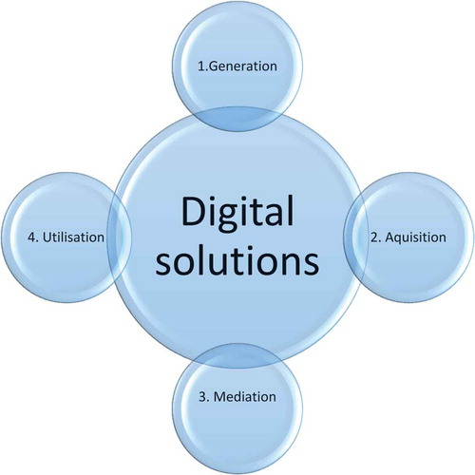
Knowledge Enhancement Framework la Velle and Flores 2018
Generation of new knowledge from research
Acquisition of K by teachers and trainees
Mediation of K into PCK
Utilisation of K within cycle of pedagogic action
Notes:
New knowledge is generated by research
The knowledge is acquired by teachers and trainees
This knowledge is transformed into pedagogic content knowledge (Shulman 1987)
The knowledge is used in the classroom or online within a planned lesson, task or activity or sequence of these, during which the teacher/trainee evaluates its effectiveness, assessing what is being learned and after which s/he reflects, coming to an enhanced level of pedagogical understanding

Slide 14
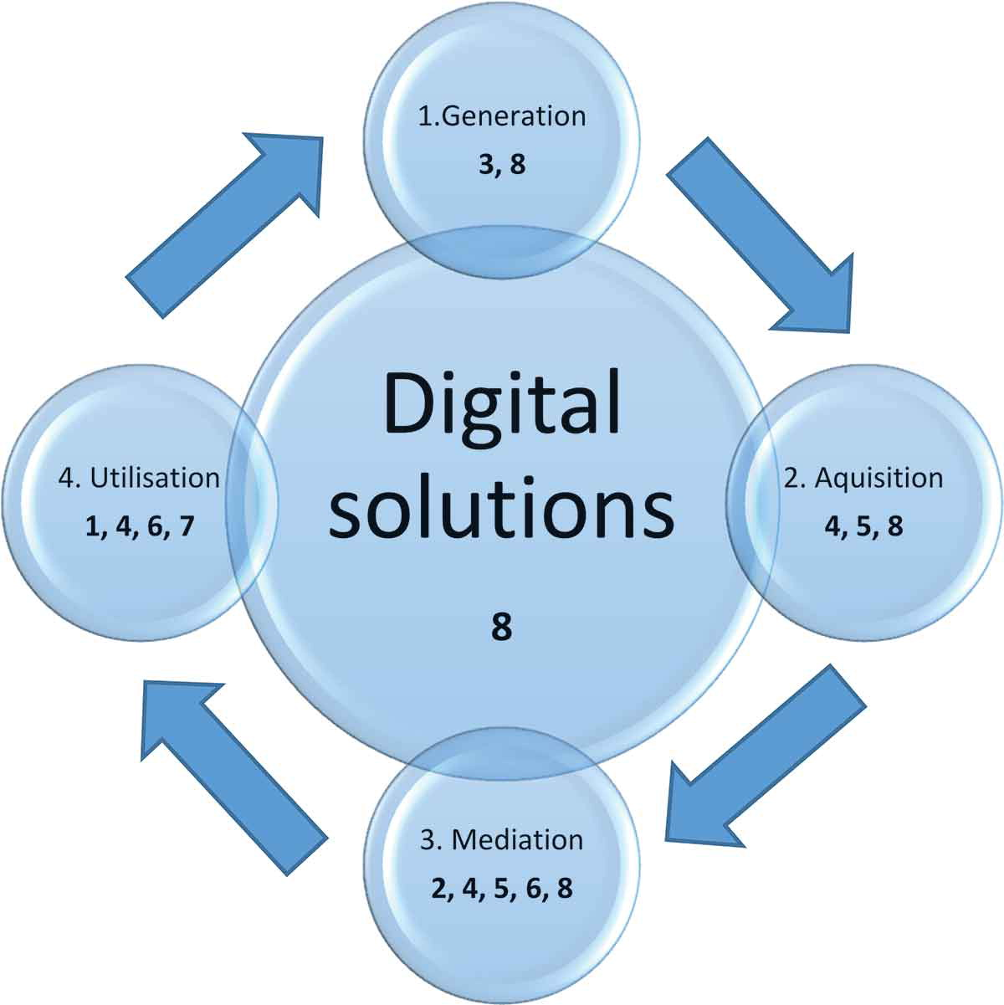
Post-Covid Pedagogy: a knowledge enhancement framework for demonstrating evidence of the Teachers’ Standards
1. Set high expectations which inspire, motivate and challenge pupils;
2. Promote good progress and outcomes;
3. Demonstrate good subject and curriculum knowledge;
4. Plan and teach well-structured lessons;
5. Adapt teaching to respond to the strengths and needs of all pupils;
6. Make accurate and productive use of assessment;
7. Manage behaviour effectively to ensure a good and safe learning environment;
8. Fulfil wider professional responsibilities.
Notes:
Generation (e.g. online publication);
Acquisition (e.g. www, social media, conferencing platforms);
Mediation (transformation) (e.g. simulation software, multimedia; cloud-based collaboration);
Utilisation (e.g. communications media, presentation software, polling/voting software; word processing software, etc.).

Slide 15
Acknowledgements
Our thanks is due to the ITE Programme Leaders and other colleagues at each of our universities for their time and information
We also thank Catherine Montgomery and David Hyatt, for their contribution to this research and who have co-authored the full paper: Initial teacher education in England and the Covid-19 pandemic: challenges and opportunities https://www.tandfonline.com/doi/full/10.1080/02607476.2020.1803051
Linda la Velle l.lavelle@bathspa.ac.uk
Stephen Newman s.n.newman@leedsbeckett.ac.uk

Slide 16
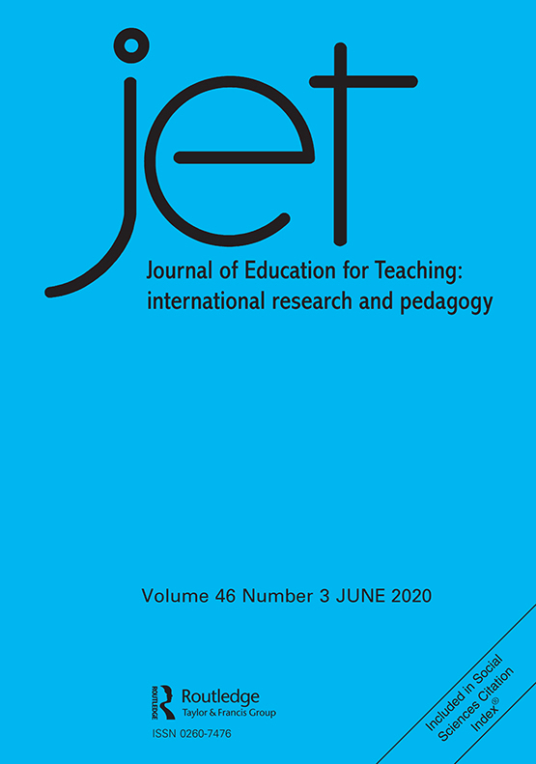
Special Issue of JET: Learning from CV-19: continuity or change in teacher education?
Deputy Editor Rowena Passy and International Board member Honggang Lui
Response of CV-19 challenge
Longer term continuities and/or changes
Adaptation of teacher education to ‘new normal’
300 word abstract by 31st March 2021 to
Rowena.passy@Plymouth.ac.uk
More info: https://www.tandfonline.com/toc/cjet20/current

