Slide 1
UCET CPD Forum
11th June 2021
Mentor Leadership Programme at YSJ
Jenny Carpenter, School Partnerships Lead
j.carpenter@yorksj.ac.uk
WWW.YORKSJ.AC.UK

Slide 2
York St John context
School of Education, Language and Psychology
Education:
Children, Young People & Society, Early Years Education & Care (BA, non-QTS)
Education MA
ITE secondary PGCE, primary UG and PGCE
www.yorksj.ac.uk

Slide 3
Issues we face
Range of effectiveness of mentor training
Workload for mentors
Trainee feedback
Range of partners and locations
ECF and expectations
National Standards for ITT mentors

Slide 4
Re-thinking Mentoring: 2019
Partnership approach: open invitation to be involved
Planning group identified
Head of School, primary head teacher, alliance leads for School Direct, secondary course lead, NQT lead
Initial discussion points
What is mentoring?
What is the purpose of mentoring?
Who is mentoring for?
What's missing from our current programme?
www.yorksj.ac.uk

Slide 5
Three-day programme 2019-2021
For established mentors
Knowing the self as mentor
Mobilising mentor strategies
Practising mentoring
Certification
Possible further programme (to be confirmed)
www.yorksj.ac.uk

Slide 6
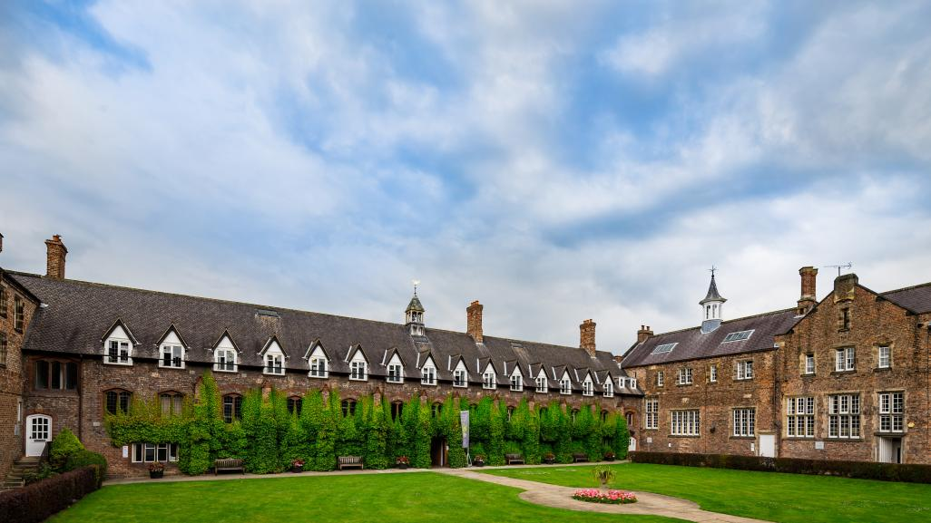
Evaluation and feedback after Days 1 & 2 (on campus)
Quality of speakers and workshops
Networking and community
Access to all sessions
Biscuits!
www.yorksj.ac.uk

Slide 7
Day 3 (online) in January 2021
“I have learnt some very valuable mentoring techniques that I have never heard of before nor would have found on my own. I have become more aware of cues of emotions, learnt to speak less and listen more, and create an environment where this can happen, even if the mentee isn’t very outgoing or forthcoming. I’ve learnt to create an environment where the mentee answers their own questions and finds their own way with my support.”
“I’ve gained more confidence in myself as a mentor following the keynote speakers’ guidance, reflections on myself as a mentor and discussions with fellow mentors regarding their experiences. It was excellent to build relationships over the three days and feel part of a team with other professionals in the same role. I feel motivated to continue to support students but better equipped to do so.”

Slide 8
Aims
To reconceptualise the process of mentoring and acknowledge the complexities arising within the relationship between mentor and mentee
To place the self as mentor in a reflexive capacity so that the mentoring process is both effective and flexible
To create a network of established mentors from a range of schools and settings in order to share and learn from practice
Provide a pathway for mentors towards MA study
Support CPD and professional development for mentors in school
www.yorksj.ac.uk

Slide 9
Completion
93 attendees on Day 1
53 completed all three days
2 headteachers
5 assistant headteachers
Over half were Phase Leaders/Heads of Department
NQT mentors
ITE mentors
A quarter of attendees from secondary schools
www.yorksj.ac.uk

Slide 10
Programme 2: June 2021-February 2022
Limited numbers
Blended: half days online and half days on campus
Same themes and keynote speakers
www.yorksj.ac.uk

Slide 11
Opportunities
Mentors on the programme to be involved in ITE mentor training
Videos of best practice to be shared in CPD twilights with a view to ongoing reflexive practice
Contribution to the teacher education series of seminars
Collaborative research
A support network promoting excellence in mentoring
Your ideas?
www.yorksj.ac.uk

Slide 12
www.yorksj.ac.uk

