Slide 1
Developing a University-Wide Peer Mentoring Framework
Tina Forbes – Chair of Peer Mentoring Framework Task and Finish Group and Peer Mentoring Project Lead, Senior Manager (Student Experience & Nations), Faculty of Arts and Social Sciences
Alison Fox – Student Voice Champion and Postgraduate Peer Coaching Team Lead, Faculty of Wellbeing, Education, Languages and Sport
Lesley Goss – Stakeholder Engagement and Delivery Lead, Pro-Vice Chancellor’s Office for Students
Catherine Comfort – Student Experience Manager and Business Peer Mentoring Scheme Lead, Faculty of Business and Law
With contributions from Sarah Badger – MA alumna and peer personal development planning mentor, Faculty of Wellbeing, Education, Languages and Sport

Slide 2
01
The context for the Task and Finish Group
02
Peer Mentoring at the OU
03
Case Study 1
04
Case Study 2
05
Case Study 3
06
Progress and challenges

Slide 3
Our Context

Slide 4
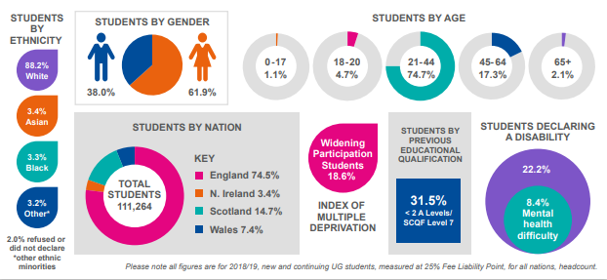
Our students: Studying at the Open University Characteristics and challenges
Notes:
Infographic Lesley
Characteristics
Over 175,000 students in 2019/20
Distance learning, mainly online
Part-time or full-time study (increasingly full time study is popular with our younger students)
Long study journeys – typically 6 years to complete an award
High proportion of students with a declared disability
High proportion of students from the 25% most deprived areas (IMD) in 19/20 this was up to 26%
Flexibility of degrees inc. modular study, offer of open degrees, changing of study intensity
Open entry policy
Challenges
Fitting study around busy personal and professional lives – over 70% of our students are also in work while studying.
Potentially isolating, need to explicitly develop senses of community and belonging
Size and diversity of cohorts – open entry and scale of our institution
Need to frame learning across nations and internationally
Different programme teams support students differently – scale and a standardized approach
Tutor experiences different per module even within a programme again the scale makes standardization a challenge. Almost 4,000 associate lecturers in 2019/20.

Slide 5
The context for the Peer Mentoring Task and Finish Group
Launched in 2019 by an informal group of like-minded people sharing ideas and outputs
Approached by the Open University Access Participation Plan Team to formalise the group as mentoring had become an OU APP priority.
Four main areas of work:
To produce an OU Student Mentoring Framework
Progress: Should be completed for final review end of July 2021
To design and launch a Student Mentoring intranet space/Resource Bank
Internal resource for teams embarking on mentoring/mentoring-type projects
Launch hopefully end 2021
To explore and provide official recognition for mentoring participants, hopefully via a suite of OU digital badges
Safeguarding training for students being developed to contribute to badging
To keep the OU Peer Mentoring Audit document up to date
In order to ensure that all projects are logged, and are aware of the resources above.

Slide 6
Peer Mentoring at the Open University

Slide 7
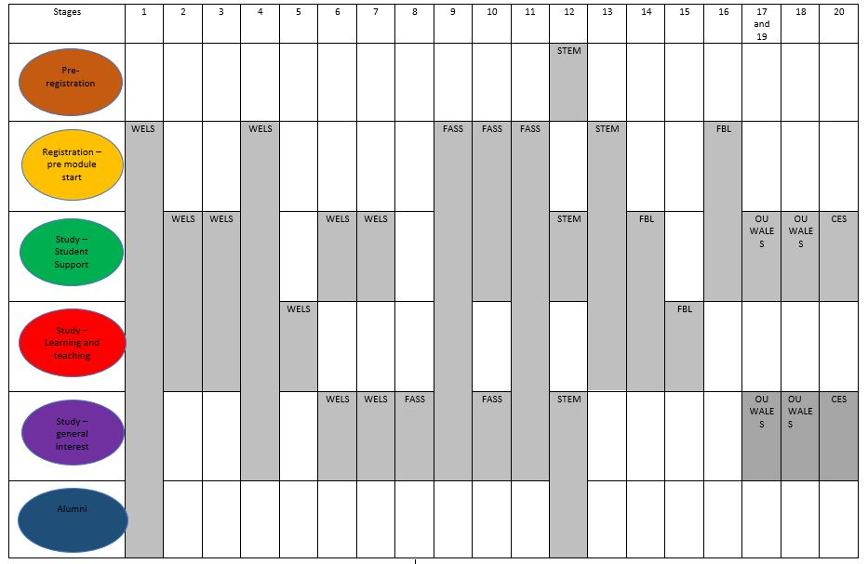
Peer mentoring/coaching/buddying initiatives
Taken from the mapping exercise
20 projects
Notes:
Overview of the projects – Alison

Slide 8
Benefits to peer PDP coaches/mentors
Certificates of participation/vouchers/digital badges Greater understanding of distance learning model in HE
Opportunities for leadership and gaining new skills e.g. digital skills, communication skills
Gain support from working with other students
Opportunity to
give something back
to feed something forward
Notes:
Tina - Developed from slide with peer mentors (would be nice to credit them)

Slide 9
Benefits to students on coached/mentored modules
Being encouraged to engage with studies and gain in confidence
Being inspired by peers modelling online participation and collaboration
Feeling more of a sense of belonging and student community by expanding the topics for online communication with one another
(For PDP coaching, support to engage with something which might otherwise seem an ‘add-on’, ‘unnecessary’, ‘a hurdle to jump through’)
Notes:
Lesley - Developed from slide with peer mentors
This is what our Peer Mentors have said about the benefits they have identified for themselves.
This slide has been taken from a presentation that they themselves have constructed.

Slide 10
Case Study 1
Student Mentoring in the Faculty of Arts & Social Sciences (FASS) – Tina Forbes

Slide 11
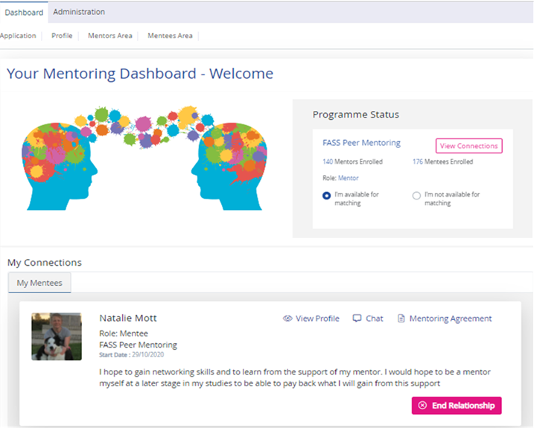
The OU working in partnership with
Tabs for guidance and support
Opens up the ‘chat box’
Notes:
Just a little bit of background…
Awareness 1:1 vertical mentoring happens in face to face HEIs on a regular basis e.g.:
A more experienced student inducts a new student to the HEI
Gives the new student a friendly ‘contact’
And this contributes to a ‘sense of belonging’
We wanted to emulate this ‘one-to-one-ness’ in a distance context
DD102/DD103 Pilots in 2015 and 2017 showed encouraging results in:
Retention on module
VLE engagement
TMA/EMA Submissions
Pass rate
The Key point here is - Mentors/Mentees were manually matched for the pilots
No system internally for matching at scale so had to outsource.
Successfully bid for APP funding
Procurement during a pandemic for a SaaS provider
Built to our requirements
Single sign-on
‘Opt-in’
Training for Mentors
Mentor/mentee agreement
Guidance docs
Mentor ‘group chat’
[Quickly go through dashboard]
2020 Evaluation now taking place
Tracking Mentors as well as Mentees to see the benefits of mentoring on the Mentor side
Expanding in 21J (Phase 2) including enhancements to portal, guidance, number of modules and a Theory of change approach

Slide 12
Case Study 2
Peer mentoring in the Faculty of Business and Law (FBL) – Catherine Comfort

Slide 13
Developing a pilot Business peer mentoring project
Learning from the experience of others
Peer mentoring Pilot for October 2021
For students beginning OU UG journey, paired with those at the end
Coming back to education + online learning + potential isolation
To offer mutual support and help them achieve study goals.
Mentees
from those who have been in their place, feel they fit in belong in academic environment and can achieve their goals
Mentors
The Open University
what students worry about
from the experiences of other OU schemes, from mentors and mentees plus experience of team setting it up
Project team
to value their knowledge, coaching and mentoring skills; satisfaction can give back
What difficulties there are on modules
What helps students learn
Learning
Notes:
Tutors very concerned about safeguarding complex to fit within current teaching systems e.g. when students can be allocated to mentoring forums

Slide 14
Developing a pilot Business peer mentoring project
Learning from our own experience
Value of a small scale pilot
Working with stakeholders who are impacted e.g. tutors, student reps
Online makes it more accessible – wherever students are and whenever it suits them to communicate
…but creates its own issues – technology may drive what you can do
Benefit of team working and different perspectives
Think about how to evaluate from the start
Notes:
Tutors very concerned about safeguarding complex to fit within current teaching systems e.g. when students can be allocated to mentoring forums

Slide 15
Case Study 3
Peer PDP coaching and mentoring in the Faculty of Wellbeing, Education, Languages and Sport (WELS) – Alison Fox

Slide 16
Staff-student collaboration towards supporting PDP
Deepen and increase engagement with module study (recognising the added value of study)
Module engagement
Develop support for PDP by through student-staff coaching team & links beyond
Increase student engagement with PDP
To better understand how to support students’ meta-cognitive skill of self-regulation of learning (Zimmerman, 1989)
PDP engagement
Self-regulation of learning
PDP support
Develop support for PDP by learning from
student engagement with PDP
To give higher status to PDP
PDP status
ePortfolio tool
Trial the use of a template and Microsoft OneNote as an ePortfolio tool

Slide 17
Recognising peer PDP coaching and mentoring
Model use of PDP in action
Facilitate discussions about PDP between students
Forum discussions
Webinars
Report back to staff PDP team
Contribute to future developments of PDP coaching
Contribute to training of coaches
Leadership role
Plan coaching programme
Offer online support for coaches
Collaborate with OU staff as co-researchers and co-learning designers
Notes:
Alison – talk about how there were no ways to recognise this at the early stages of the project. Whilst gave vouchers for engagement in the original activities (when funded by scholarship project funding) this wasn’t sustainable or gave anything of legacy for the work they had been involved in. Originally emailed them badges. Now offering through Open Badge Factory. Will be evaluating as part of wider project whether employers, students and module teams prefer through OBF or inhouse through OpenLearn.

Slide 18
Student engagement
 | Unique student readers/viewers
Coach activity | 2018/19 (Feb – May) | 2019/20
MA Stage 1 Leadership and Management module forum | 61 % | 48 %
MA Stage 1 Learning and Teaching module forum | n/a - module launched in 2019 | 65 %
MA Stage 2 Leadership and Management module forum | 58 % | 64 %
MA Stage 2 Learning and Teaching module forum | n/a – module launched in 2019 | 72 %
Live and recorded webinars on MA website | 39 students | 35 + 15 students
Masters (MA) website forum | 17 | n/a – all forum activity on the Masters modules
Live and recorded induction webinar on BA Hons Ed Studies website | n/a | 47 % of those attending induction
BA Hons Ed Studies E209 module forum | 41 % | 37 %

Slide 19
Progress and challenges

Slide 20
Development of initiatives: multi-year developments
Gaining funding for pilot projects
Piloting (possibly with partners)
Evaluation and next steps planning
Scaling up
Embedding and sustaining
Notes:
Alison
Refer back to mapping document to say how projects at different stages and scales
Different funding sources determine scale of projects and how many/which staff can become involved – from small-scale/no budget WELS to large-scale with external provider support FASS
How to scale up and sustain needed a coming together and the coordination of the PMF group
Sharing of ideas/experiences/resources/additional considerations
Bringing in wider support from Safeguarding team and for OpenLearn for example

Slide 21
Key learning points
Realising appetite for students to help one another
Student reflection is enhanced when supported by other students to maximise the value of their HEI study
Important to develop student-staff collaborations as part of community building in a (distance learning) University
Evaluation is important - Learning from student engagement can drive the development, evolution and sustainability of projects
An evaluation strategy could include metrics of student performance and retention to identify increases in academic engagement
Exciting opportunities for co-creation can be enabled (seeing students as partners)
In order to successfully target student groups, it may not be enough to offer the scheme merely open to all
Different projects could come and go, but networked knowledge-building can sustain and maximise the benefits of these initiatives
Notes:
Alison - Developed from slide with peer mentors (would be nice to credit them) – anyone feel free to amend

Slide 22
Challenges/Conundrums
The OU Peer Mentoring Framework:
‘One size fits all’ not sufficient
Different projects have different objectives/predicted outcomes and purpose so an ‘OU model’ was not considered viable
Framework covering every eventuality and drawing on all project experiences
It’s a long document, written by committee
Needs to be ‘live’ and reviewed (which takes ongoing resource)
Advice for project teams:
Targeting
How to identify and successfully/fairly target particular groups of students
Intersectionality/EDI priorities
Control groups
How do you find/use a ‘control’ whilst being inclusive?
Time to embed
For any project, evaluation may take several years to ‘prove’ it has benefit
Other
How to develop meaningful badging without it being related to ‘study’
Sustaining coordination of initiatives beyond task and finish group
Maintenance of the intranet space
How to evaluate impact amongst many interventions
Notes:
Tina
These are things we are currently working through/grappling with.

Slide 23
Practical next steps: The Framework, website, badges and community
Framework
Dissemination
This Photo by Unknown Author is licensed under CC BY-SA
Intranet & Website
Badges
This Photo by Unknown Author is licensed under CC BY-SA-NC
Notes:
Lesley
Framework – development and maintenance of a University wide framework.
Intranet and website – where will the framework and resources be hosted? Are there things that could be appropriate for an external audience.
Dissemination – comms plan how will we will raise awareness across the university of its existence and to ensure it is widely used.
Badges – rewarding mentors and the development of digital badges that could be used on students CVs and or records of study.

Slide 24
Cited work, project inputs and outputs
Andreanoff, J. (2016a) The impact of a peer coaching programme on the academic performance of undergraduate students: a mixed methods study. Journal of Learning Development in Higher Education Special Edition: Academic Peer Learning, ISSN 1759-667X, pp.1-27.
Andreanoff, J. (2016b) Issues in conducting quantitative studies on the impact of coaching and mentoring in Higher Education. International Journal of Evidence Based Coaching & Mentoring, Special Issue 10, pp.202-216. Available at: http://ijebcm.brookes.ac.uk
Andrews, J & Clark, R (2011) Peer Mentoring Works! How Peer Mentoring Enhances Student Success in Higher Education, Aston University, published online: https://www.heacademy.ac.uk/system/files/aston_what_works_final_report_1.pdf
Fayram, J., Boswood, N., Kan, Q., Motzo, A. and Proudfoot, A. (2018) Investigating the benefits of online peer mentoring for student confidence and motivation. International Journal of mentoring and Coaching in Education. 7(23) DOI:10.1108/IJMCE-10-2017-0065
Taylor, L; Edwards, C; Hardie, L; & Gregory, L (2020) ‘How peer mentoring can support students during the pandemic’, The Open University, online blog available: http://law-school.open.ac.uk/news/how-peer-mentoring-can-support-students-during-pandemic
Zimmerman, B.J. (1989) A social cognitive view of self-regulated academic learning. Journal of educational psychology, 81(3), p.329.

Slide 25
THANK YOU FOR JOINING US We would love to hear about others’ experiences and activity in this area Tina Forbes email: tina.forbes@open.ac.uk Alison Fox email: alison.fox@open.ac.uk Lesley Goss email: lesley.goss@open.ac.uk Catherine Comfort email: catherine.comfort@open.ac.uk

