Slide 1
BAME Developing Coaching and Mentoring Support
Lizana Oberholzer
June 2021

Slide 2
Context:
85% of UEL students are from BAME backgrounds
PG – 90% are from BAME backgrounds
Leadership Capacity
3.1% of heads in schools are from BME backgrounds compared to the pupil population of 31.4% in primary and 27.9% of secondary (DfE, 2016)
Important to develop leadership teams that mirror the communities they serve.

Slide 3
Approach:
Develop mentors and coaches on a Stage 1, 2 and 3 coaching and mentoring course
A scaffolded approach to mentoring and coaching
Outlining how relationships evolve and how the relationship and support needs to develop
How mentors and coaches need to progress with mentees based on their needs on the continuum of coaching and mentoring.

Slide 4
The importance of Background and Context:
Mentees and coachees often experience challenges on their leadership journeys for example:
Lack of self-efficacy
Racism
Limited opportunities
Lack of role models
Important in the mentoring and coaching to acknowledge that before we can move forward with in the coaching and mentoring conversation.
If not coaching and mentoring conversations tend to revert back to the trauma and experiences.
It needs to be fully acknowledged.

Slide 5
Due to the varying experiences of mentees/ coachees…
Mentors/ coaches need support too, as they often need to reflect on what took place in the mentoring and coaching sessions
Supervision was put in place one a month

Slide 6
Supervision:
We drew on supervision practices used by the Association of Coaching
It was also felt by coaches and mentors that they want a learning element in the session, where they were keen to continue to develop their coaching skills in a safe space.
Networking opportunities to share practice – 47 trained coaches
Co-constructive learning experiences

Slide 7
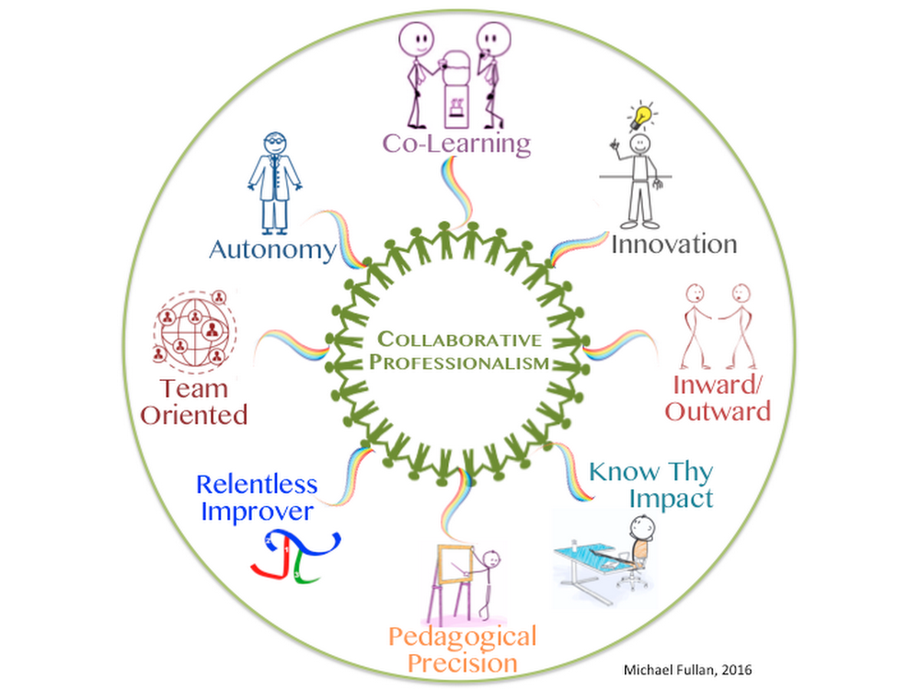
Collaborative Professionalism (Fullan, 2016 and Hargreaves and O’Connor, 2018)

Slide 8
Impact:
Peer to Peer Coaching/ mentoring
Leadership progression
Career Events
Greater Confidence
Safe learning spaces
Better conversations
Collaborative professionalism

Slide 9
Mentee perspectives:
‘Coaching has been a great way to explore my emotions, and give me time and room to explore my leadership role…. my sessions gave me the freedom to speak freely and honestly.’
‘Coaching provided me with some form of escapism where I could realign with my moral purpose and my coach led me to me to acknowledge that leading with compassion in this difficult time was the right thing to do.’
‘My sessions reminded me that in order to be able to continue to lead people through these times, I had to ensure that I also looked after myself. Regular coaching sessions was one way that I could ensure that I was doing just that.’

Slide 10
Next Steps:
Continue
Continue to build on capacity
Continue
Continue to refine the supervision practices
Empower
Empower coaches and mentors to lead as part of the network leadership model

Slide 11
References:
Buck, A. (2020) The BASIC Coaching Method, UK: Cadogan Press
Blanchard, K and Diaz-Ortiz, C. (2017) One Minute Mentoring: How to find and work with a mentor – and why you’ll benefit from being one, UK: Thorsons
Campbell, J. and van Nieuwerburgh, C. (2018), The Leader’s Guide to Coaching in Schools: Creating Conditions for Effective Learning, UK: Corwin
Hargreaves, A. and O’Connor, M.T (2018) Collaborative Professionalism: When Teaching Together means Learning for All, UK: Corwin
Van Nieuwerburgh, C. (2017) An Introduction to Coaching Skills: A Practical Guide, UK: Sage Publications Ltd

