Slide 1
Quality Assurance, Enhancement and Risk Management
Prof Des Hewitt, Centre for Teacher Education, Warwick
d.m.Hewitt@warwick.ac.uk
UCET November 2020
Notes:
Slides 1-5 10.50-11.15

Slide 2
Principles of QA/ E and Risk Management
Despite the context, mode of delivery and local conditions, the key questions are:
Is the quality of the academic and professional outcomes (and provision) at least as good as other providers?
Are we delivering our programmes (LOs with assessment opportunities)?
Are we meeting statutory requirements (H&S, Equality, ITT Criteria, OFSTED [CCF] etc)
How do we know that?
Evaluation of student and school data/ information
Evaluations by students, schools, tutors (all online);
Internal moderation by mentors (face to face)
External moderation by Examiners (online)

Slide 3
Promoting quality, addressing risk
A ‘Quality First’ approach to teacher education;
Building capacity: in SLT, oversight (committees), partnership; for instance, through training;
360 degree (regular) communication strategy (students, staff, partners, University);
A measured but decisive response to national and local Covid-19 circumstances;
Balancing risks: understanding the cost/ benefits of activities/ actions
So how has QA changes as a result of Covid-19?
Don’t over complicate

Slide 4
Online School-based Moderation in Autumn term
Up to 4 hours per student
All online communication up to Xmas (by University Link tutors)
We’ll make a decision in November about a return to face to face/ school visits
Personal tutor/ Moderating Link Tutor
Some ideas for using this time:
Online meeting with student
Student to explain/ discuss:
the context (physical environment, range of needs, the broad and balanced curriculum);
A lesson they have taught which has been observed and evaluated by the mentor;
Share copies of mentor evaluations.
Online meeting with mentor and/ or class teacher
General progress
School-based training (Observation by trainee, any CPD in school etc)
Workload and trainee’s response (is it manageable and in line with expectation);
Discuss the above lesson the student has taught and the mentor’s evaluation/ observation;
Targets/ actions: identified in above to be discussed with mentor and trainee, preferably together, but that may depend on availability
Purpose
Moderation of quality of training and impact on trainee
Formative: Refocus on training and away from outcomes
Summative: Refocus on outcomes and the quality of the training/ curriculum experience

Slide 5
Focus for OFSTED ITE Inspection
Are trainees receiving their minimum entitlement to the Core Content Framework?
COVID-19 (coronavirus) As schools and educational settings return to a new form of reality, those in ITE will be looking to provide an ambitious curriculum that can be flexibly adapted to meet the ever-changing landscape. We introduced a transition statement in the good criteria of our handbook, for the education and training judgement, so that partnerships who can demonstrate that they have an ambitious and compliant curriculum, will not be unfairly penalised if they are not able to deliver it in its entirety.

Slide 6
Centre, Alliance and School-based provision/ ITT Core Content
Do we provide our students/ trainees with the knowledge they need?
Procedural Knowledge: ITT Core Content
Knowing how…. to plan, teach and assess
Declarative knowledge: ITT Core Content
Knowing that… (content / knowledge per se)
Critical knowledge: HE Level 4-7 assessment criteria
Knowing why… (principles and theory underpinning professional approaches)
Knowing why… (ethical stance of teacher)

Slide 7
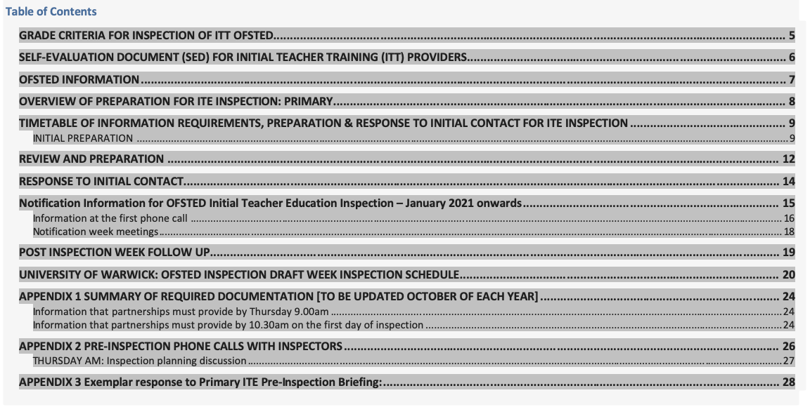

Slide 8
OFSTED ITT Inspection Grade 2 criteria (extracts) Intent: principles informing the ITE curriculum
Ambitious
In primary and secondary programmes, the ITT core content framework defines in detail the minimum entitlement of all trainee teachers, which all ITT partnerships must incorporate – in full – within their curriculums. The ITE curriculum covers the full entitlement described in the ITT core content framework, including all ‘learn that’ and ‘learn how to’ statements.
Designed around subject and phase
The course structure is designed around subject- and/or phase-specific dimensions. The application of any generic principles is taught and practised as and when appropriate.
Purposefully integrated
The ITE curriculum is purposefully integrated across its different partnership settings.
Inclusion and teaching pupils with SEND are meaningfully integrated into all aspects of the training programme.
Informed by up-to-date or pertinent research
The ITE curriculum is designed to ensure that trainees engage with up-to- date or pertinent research findings, for example the research informing the ITT core content framework (for primary and secondary phase trainees).
Trainees know about up-to-date research for promoting inclusion and teaching pupils with SEND, and those who speak EAL. They are able to apply this knowledge in their subject and phase.

Slide 9
Self evaluation / Pre-inspection phone calls with inspectors
the partnership’s context, and the progress it has made since the previous inspection, including assessment of the partnership’s current strengths and weaknesses, and any specific progress made on areas for improvement identified at previous inspections that remain relevant under the current inspection framework
how leaders ensure, and assure themselves of, the ambition of the ITE curriculum, that it is designed around subject and phase dimensions, and that it is coherently planned and sequenced towards cumulatively sufficient knowledge and skills for future learning and employment
for partnerships that include primary and secondary trainees, the way in which leaders have translated the ITT core content framework into a carefully sequenced curriculum for trainees and how they have ensured that all aspects of that framework are covered. Inspectors will also discuss aspects of the programme that go beyond that framework. The discussion will explore how and why leaders have prioritised particular aspects of the programme
how the partnership assesses trainees formatively throughout the course (and summatively against the teachers’ standards for primary and secondary trainees, including those on the assessment only route and the early years teachers’ standards for early years trainees)
how trainees are taught to promote pupils’ positive behaviour and attitudes, and how their practice in meeting the needs of pupils who speak English as an additional language (EAL) and pupils with special educational needs and/or disabilities (SEND) is developed throughout the ITE curriculums offered
how leaders have ensured that the partnership is contributing to and meeting the local demand for teachers
any enhancements and adaptations to the programme to meet the needs of current trainees and local/national priorities
how leaders ensure (where applicable) that the centre-based and placement-based ITE curriculums are integrated to ensure that trainees make the best possible progress in their teaching
how leaders ensure, and assure themselves, that trainees receive clear, consistent and effective training and mentoring
how leaders ensure formative and summative assessment of trainees’ progress in mastering the components of the ITE curriculum, without creating an unnecessary burden.

Slide 10
Additional Questions
11. How does the university ensure the quality of ITE provision across the partnership with schools?
Impact of COVID
Evaluation of the ITT changes to any of the above and their impact arising linked to Covid-19
Evaluation of additional measures to ensure quality, consistency and parity of training during COVID-19

Slide 11
Next steps
Update on OFSTED/ Core Content Framework
Priorities
What can we achieve in the time we have?
What do we have to do between now and January?
How can we use existing structures (meetings etc)?
How can we effectively communicate details with staff, students and schools given the current situation?
What is the impact of continuing issues with Covid-19 into Spring?

